Slide 1
WINCHESTER CATHEDRAL – BLENHEIM PALACE
These slides are from the estate of Paul Berthelot who found the English culture and architecture intriguing. He acquired these images while stationed in England serving in the US Air Force.

Slide 2
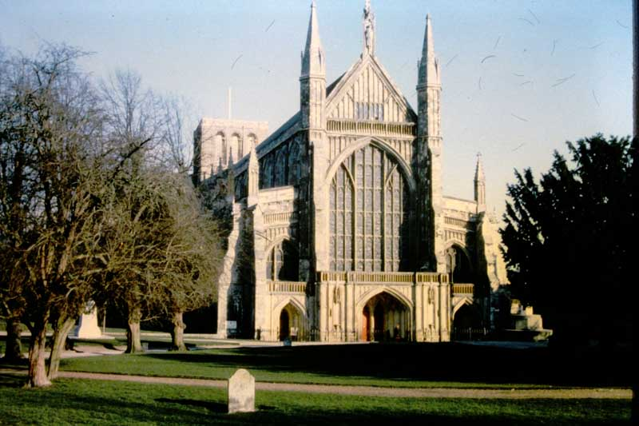
WINCHESTER CATHEDRAL – The West Front- perpendicular Gothic XIVth century (Bp Edington)

Slide 3
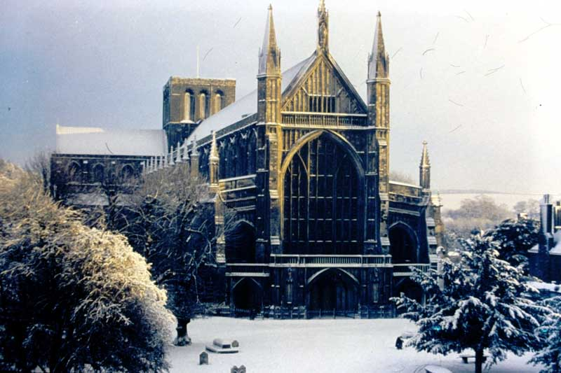
WINCHESTER CATHEDRAL – The West Front, A Christmas setting.

Slide 4
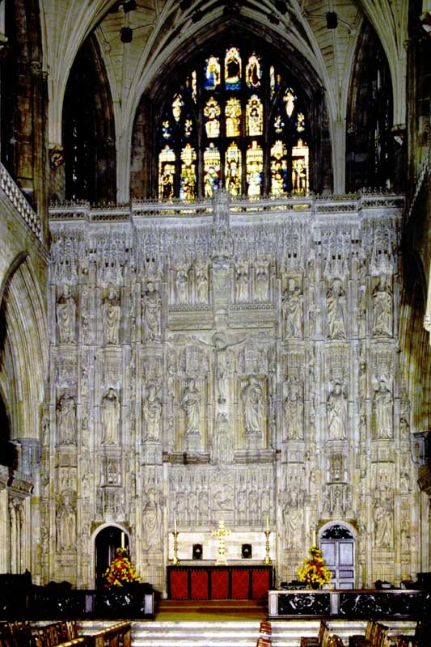
WINCHESTER CATHEDRAL – High Alter & Great Screen – XVth century (Cardinal Beaufort). Statues designed or restored XIXth century.

Slide 5
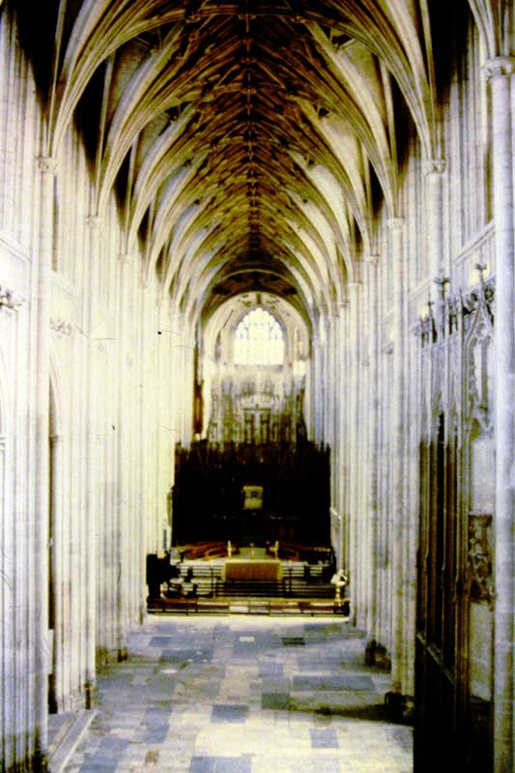
WINCHESTER CATHEDRAL – Nave – Perpendicular Gothic XIVth century (Bps Edington & Wm of Wykeham). Wooden Choir Screen designed by Gilbert Scott 1873.

Slide 6
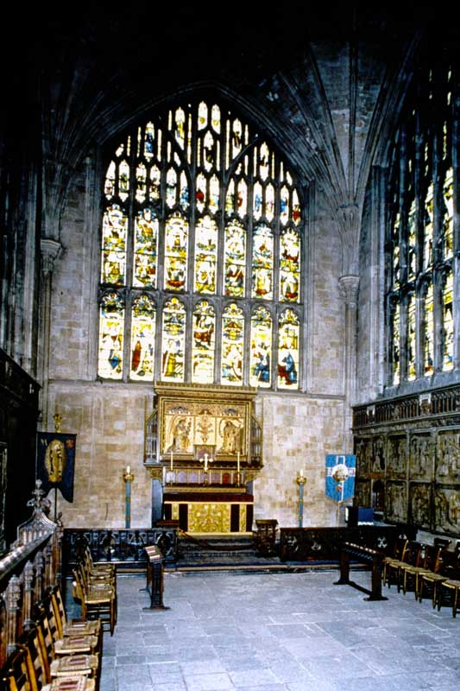
WINCHESTER CATHEDRAL – Lady Chapel c.1200 (Bp de Lucy). Windows late XVth century; glass by C. E. Kempe 1900.

Slide 7
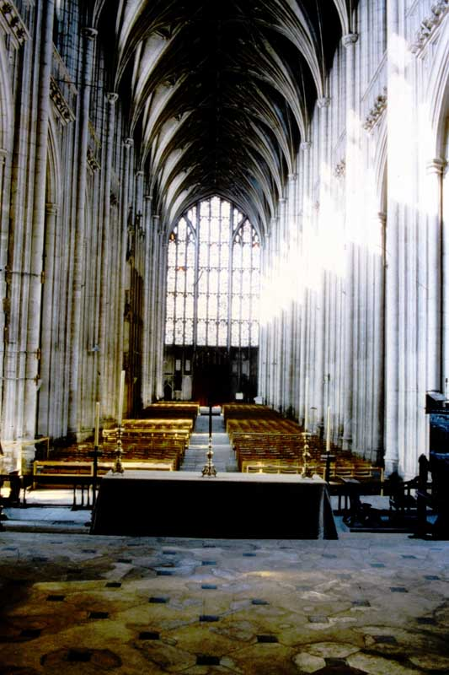
WINCHESTER CATHEDRAL –The Nave (XIVth Century) and lierne vaulted roof, looking westward.

Slide 8
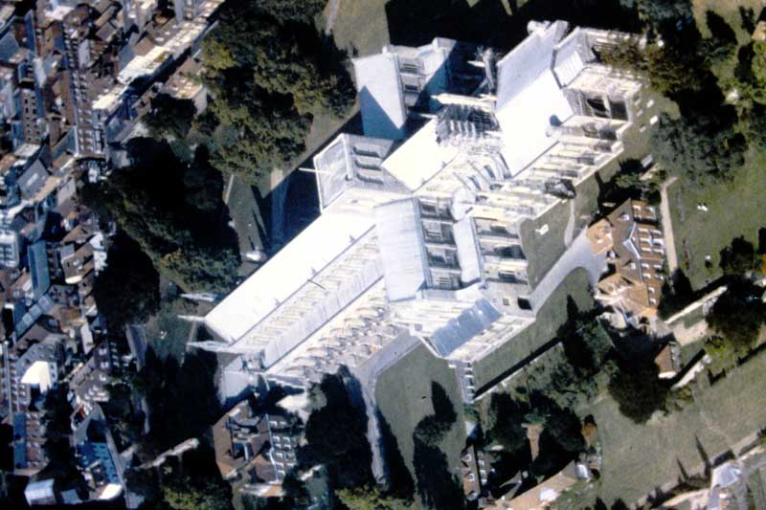
WINCHESTER CATHEDRAL – Cathedral from the air. At 556ft. It is the longest in England.

Slide 9
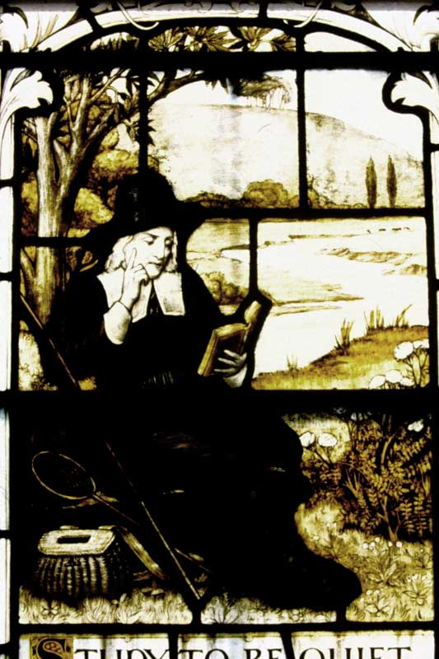
WINCHESTER CATHEDRAL – Sir Isaac Walton – window in Silkstede Chapel, In which Walton is buried. Background: River Itchen with St. Catherine’s Hill.

Slide 10
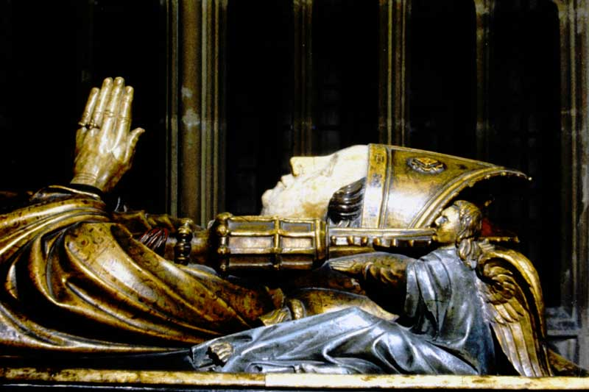
WINCHESTER CATHEDRAL – Bishop William of Wykeham, builder of the Gothic Nave and founder of the Winchester College, 1382.

Slide 11
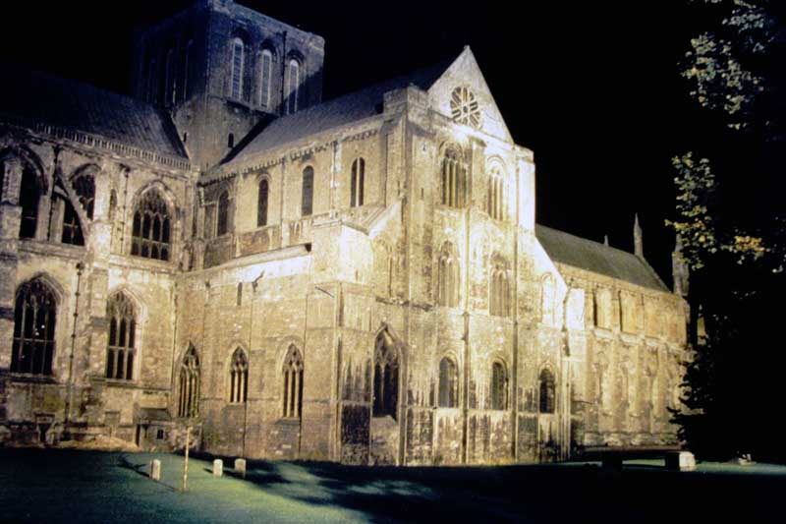
WINCHESTER CATHEDRAL – The floodlit Cathedral, showing the XIth century North transept and the tower (1120).

Slide 12
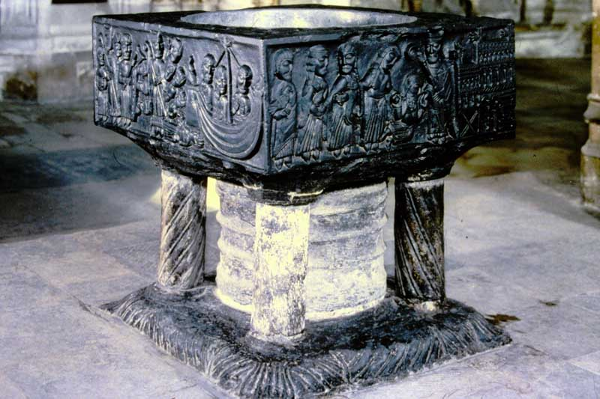
WINCHESTER CATHEDRAL – The XIIth century carved Tournal marble font, where Henry III was baptized.

Slide 13
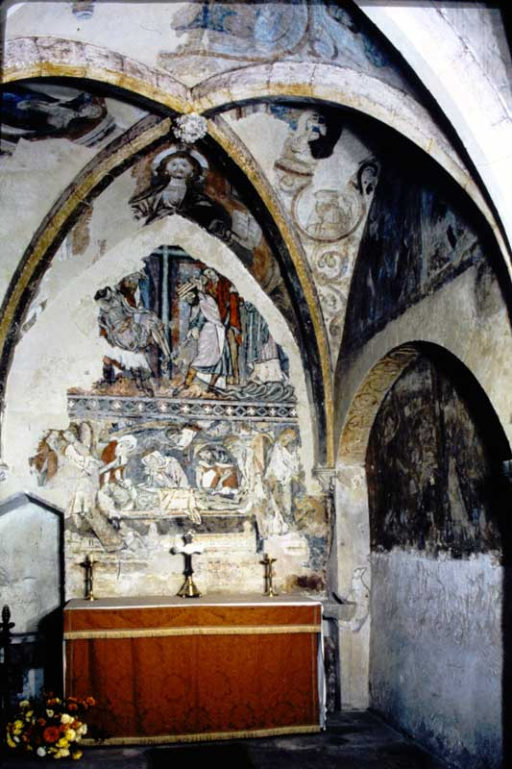
WINCHESTER CATHEDRAL - Holy Sepulcher Chapel (XIIth century) with contemporary wall painting of the Deposition of Christ.

Slide 14
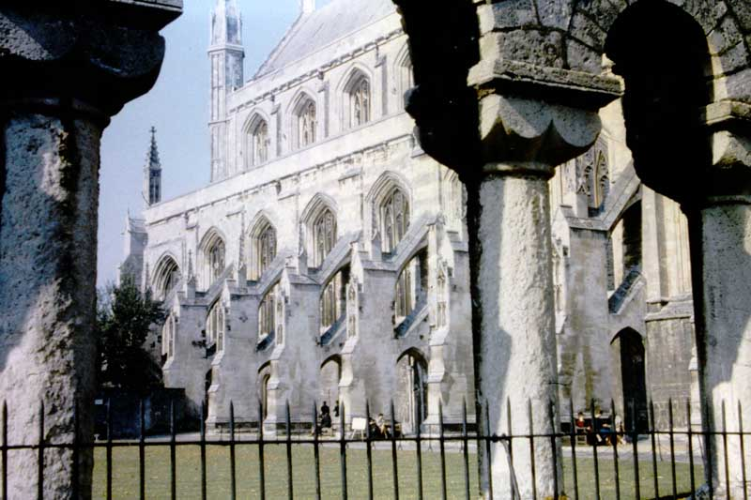
WINCHESTER CATHEDRAL – Site of Cloisters, and buttresses built to preserve the Cathedral 1906-12.

Slide 15
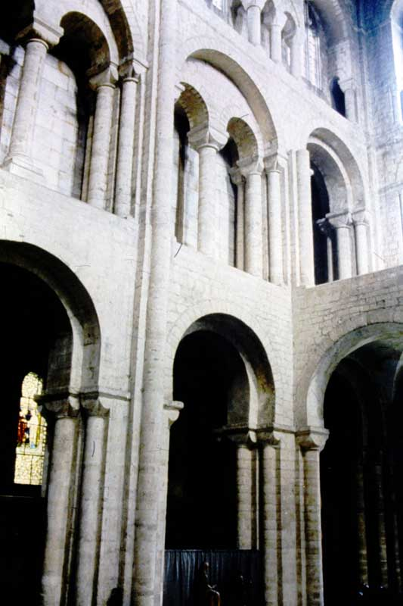
WINCHESTER CATHEDRAL – Norman North transept, through which pilgrims passed to the shrine of St. Swithun.

Slide 16
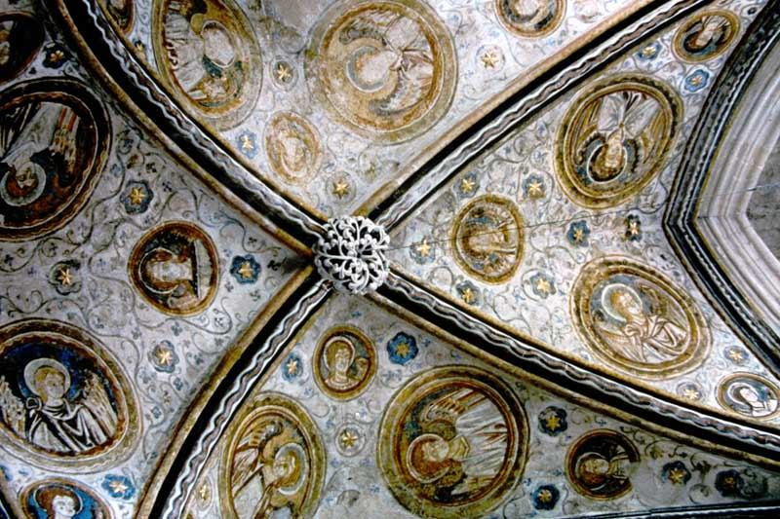
WINCHESTER CATHEDRAL – Guardian Angels chapel (XIII c.) Early ribbed vaulting, with angels looking down from starry ceiling.

Slide 17
The next 12 slides are duplicates from other slide boxes and they are shown here as they were found in the box. I suspect they were special event slides duplicated for some unknown purpose

Slide 18
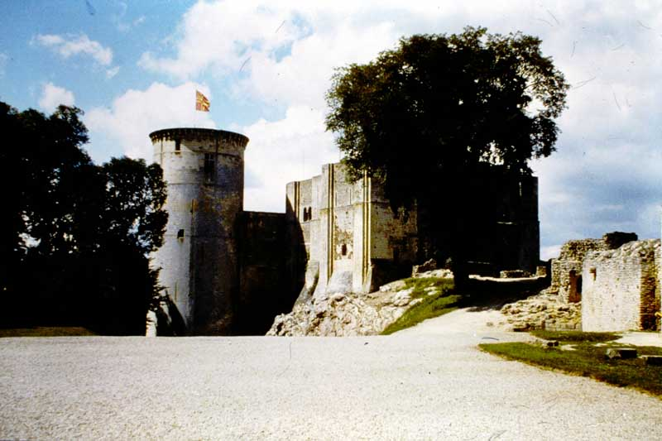
1. Doomsday Exhibit

Slide 19
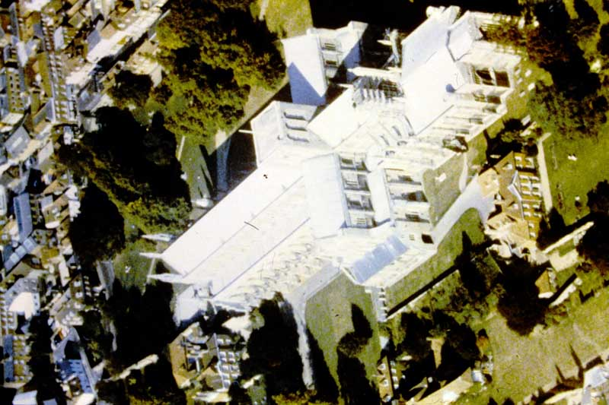
2. Doomsday Exhibit

Slide 20
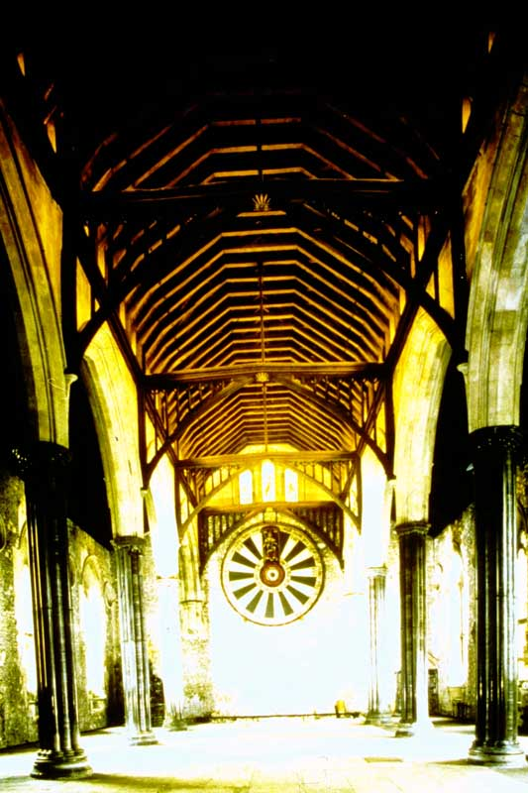
3. Doomsday Exhibit

Slide 21
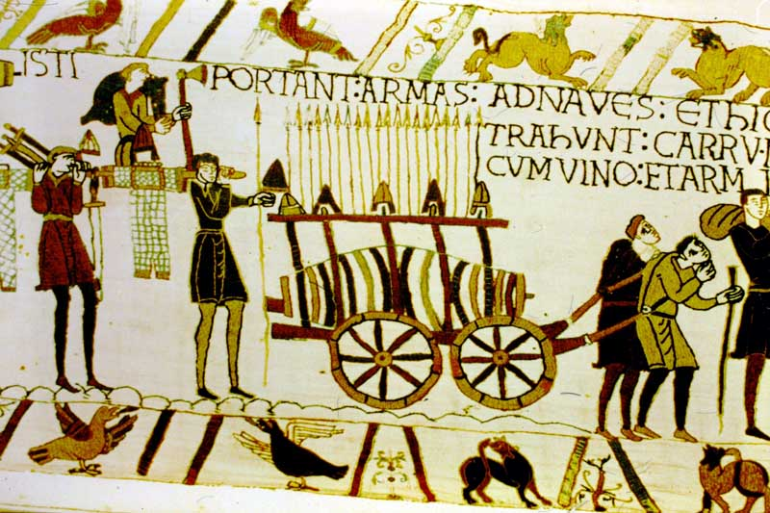
4. Doomsday Exhibit

Slide 22
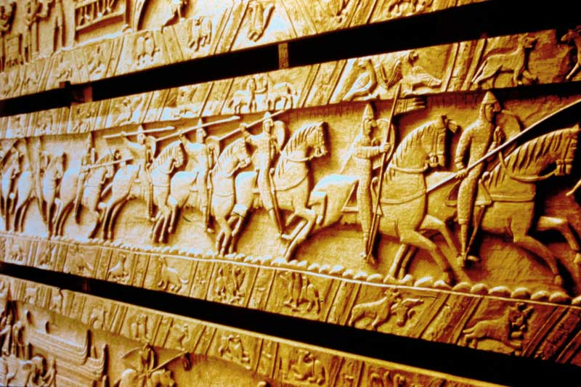
5. Doomsday Exhibit

Slide 23
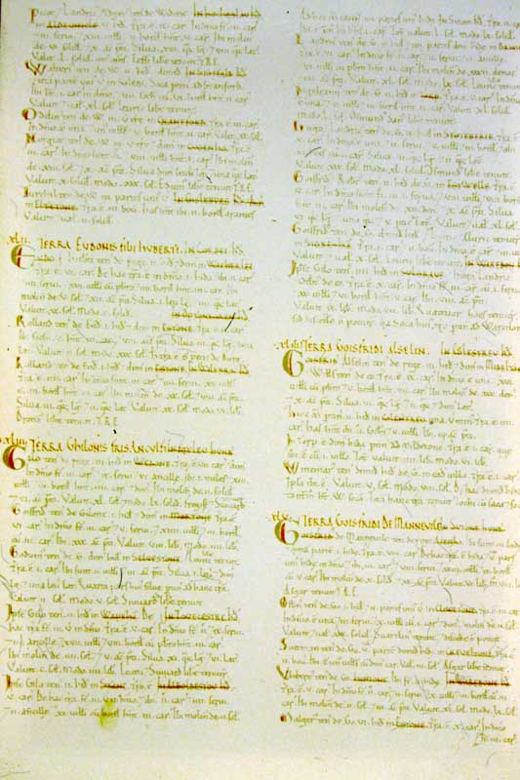
6. Doomsday Exhibit

Slide 24
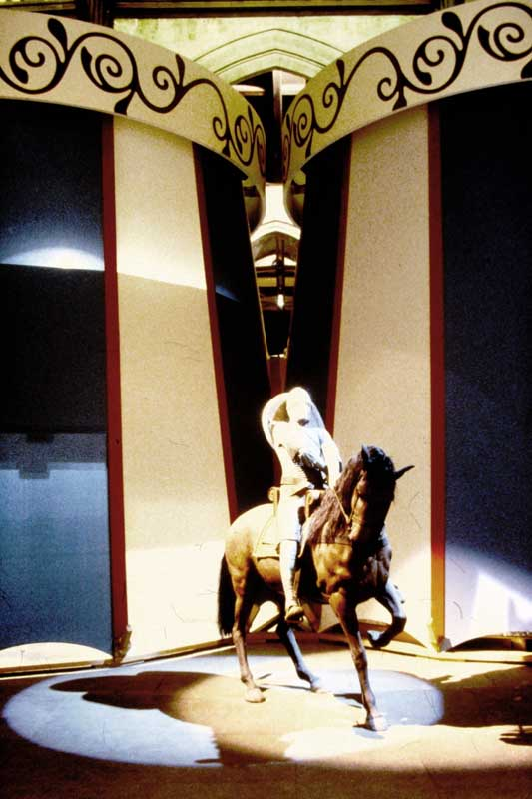
7. Doomsday Exhibit

Slide 25
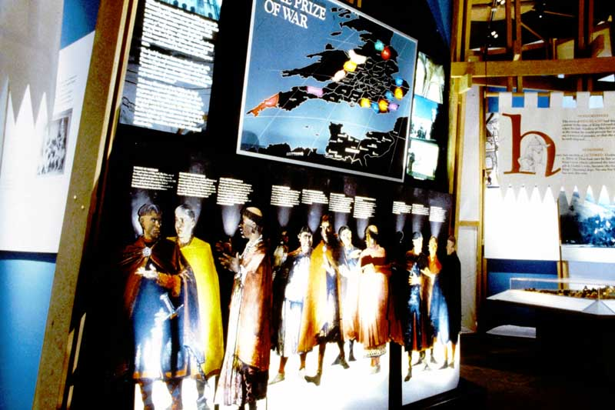
8. Doomsday Exhibit

Slide 26
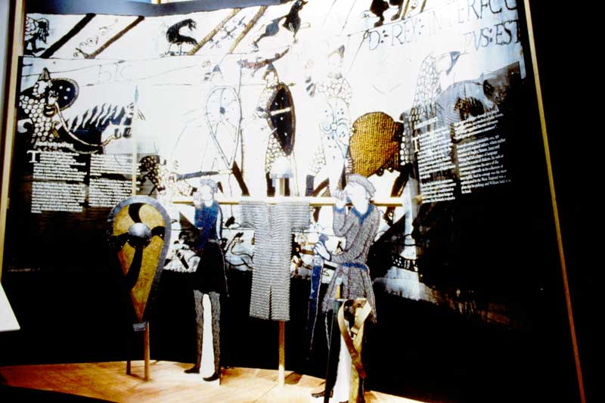
9. Doomsday Exhibit

Slide 27
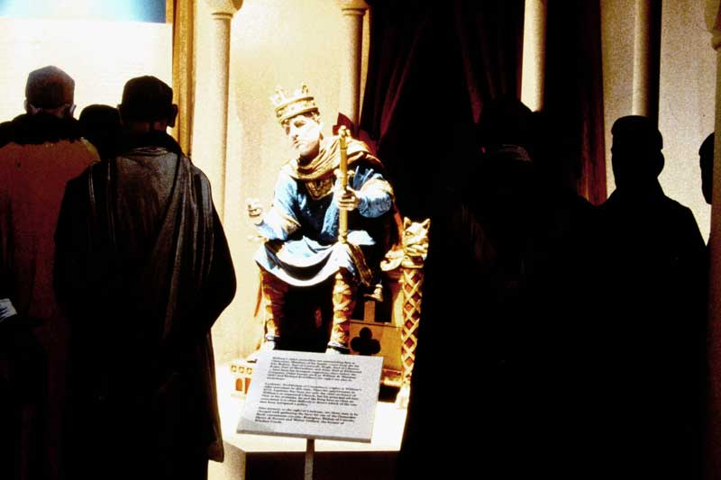
10. Doomsday Exhibit

Slide 28
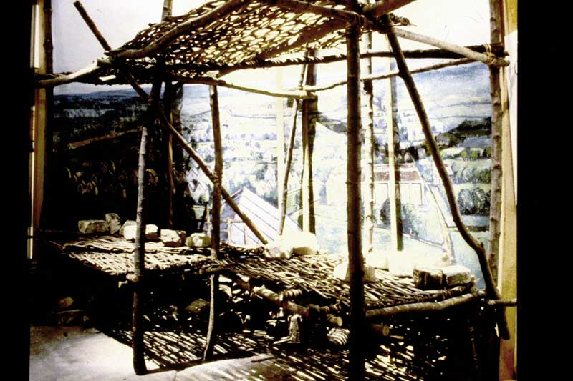
11. Doomsday Exhibit

Slide 29
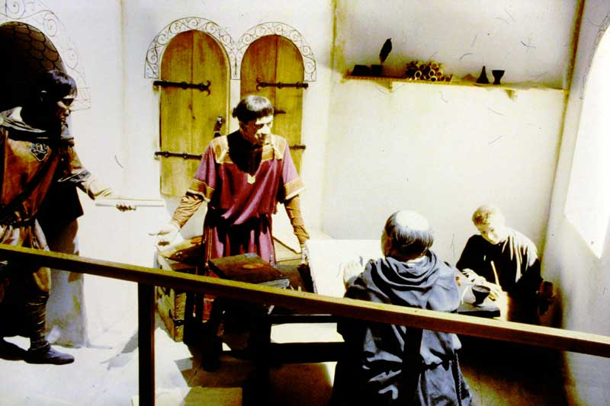
12. Doomsday Exhibit

Slide 30
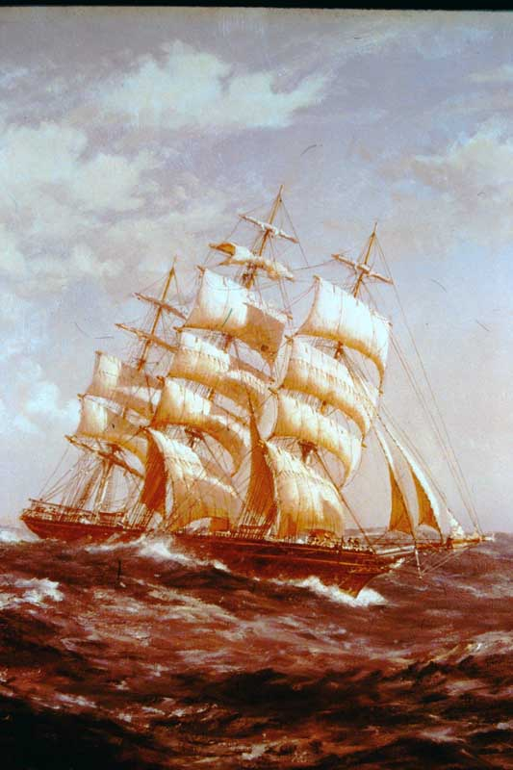
1. The CUTTY SARK – Running her easting down by John Alicot

Slide 31
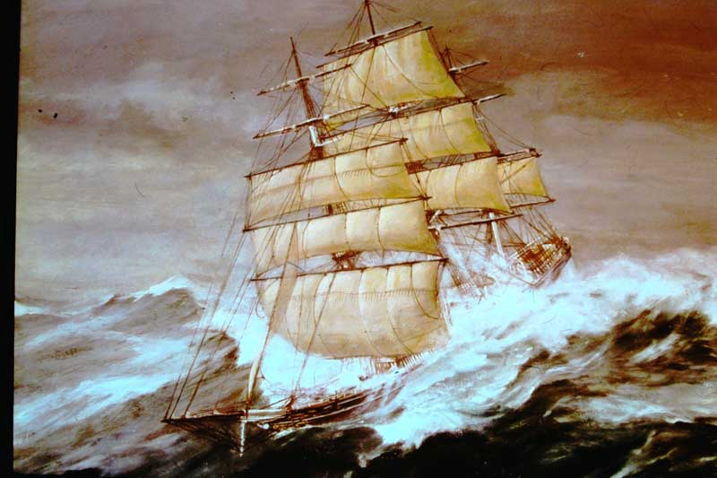
2. The CUTTY SARK – The Great Wave of 28 June 1891 by Donald Swan.

Slide 32
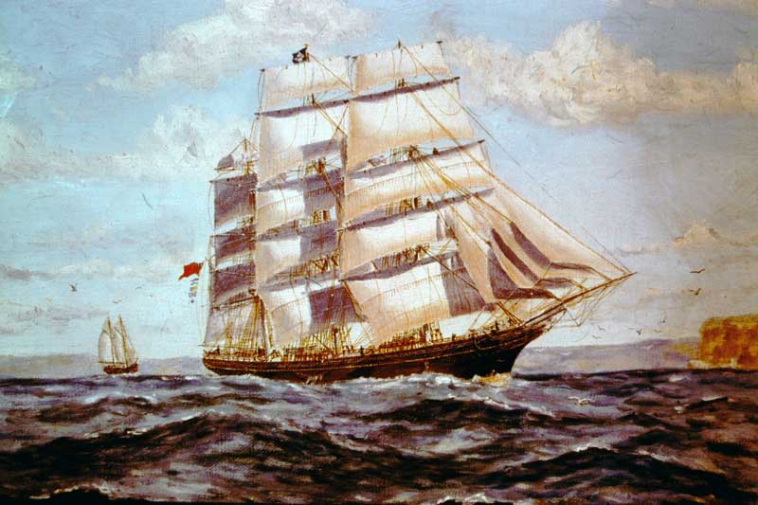
The CUTTY SARK - As a Wool Clipper off Sidney Heads by J G McCredie

Slide 33
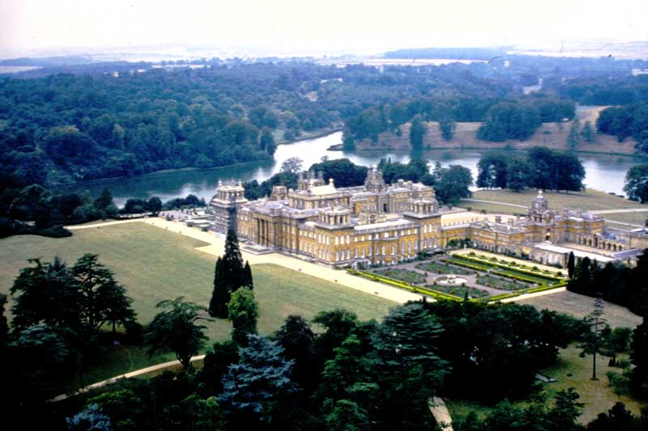
Blenheim Palace from the East

Slide 34
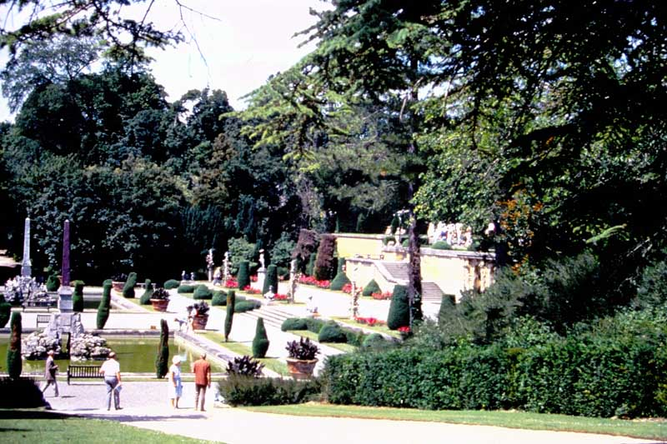
Blenheim Palace Lower Water Terrace

Slide 35
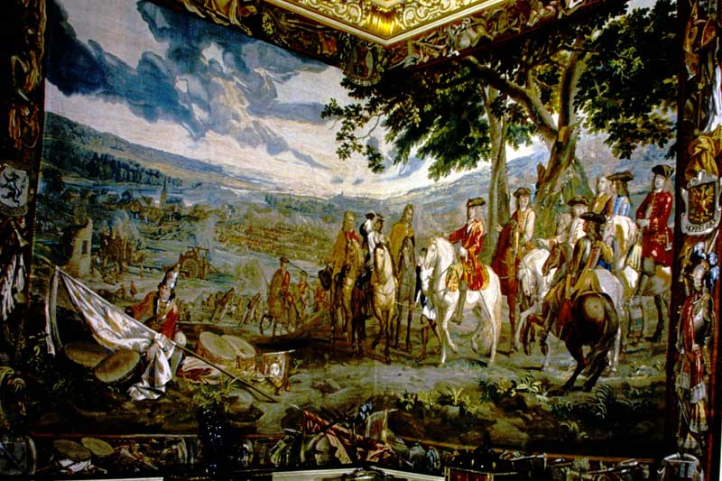
The Blenheim Tapestry

Slide 36
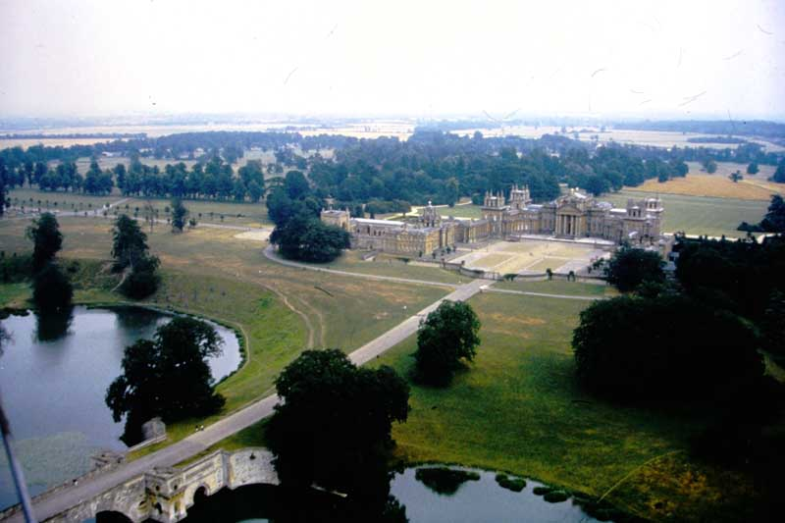
Blenheim Palace – North Front

Slide 37
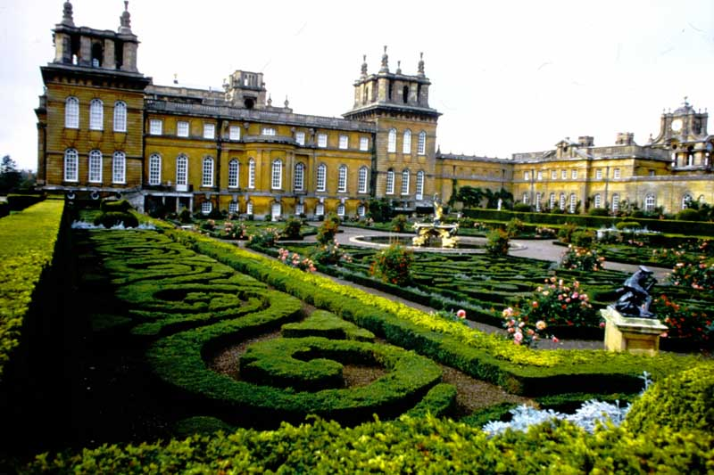
Blenheim Palace – Italian Gardens

Slide 38
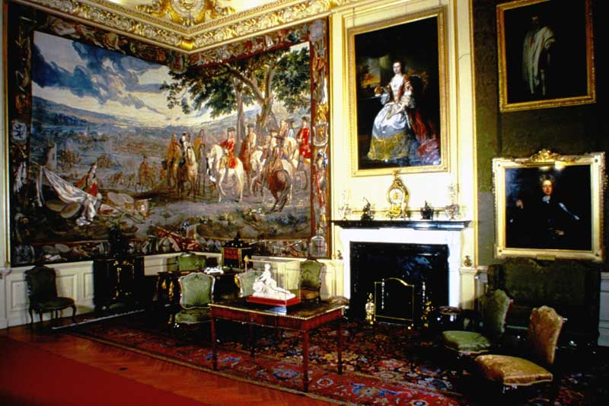
Blenheim Palace – Green Writing Room

Slide 39
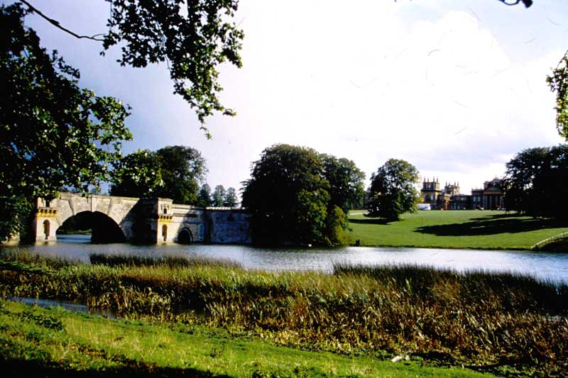
Blenheim Palace – Grand Bridge and Lake

Slide 40
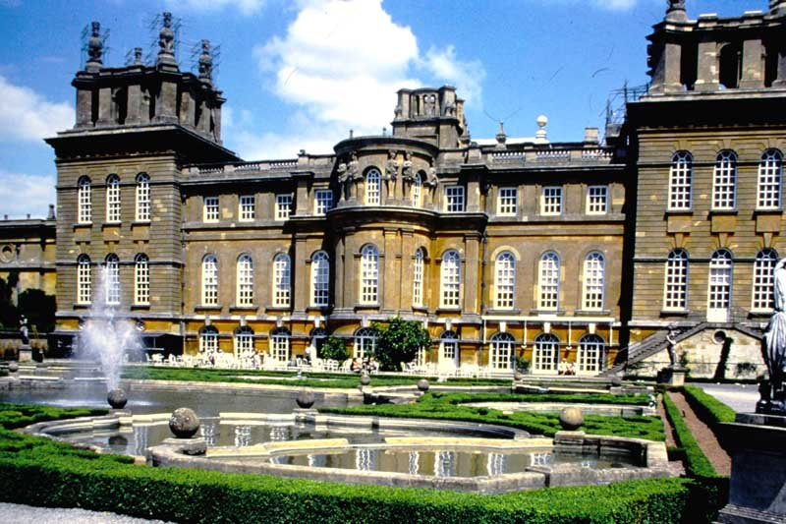
Blenheim Palace – French Water Gardens

Slide 41
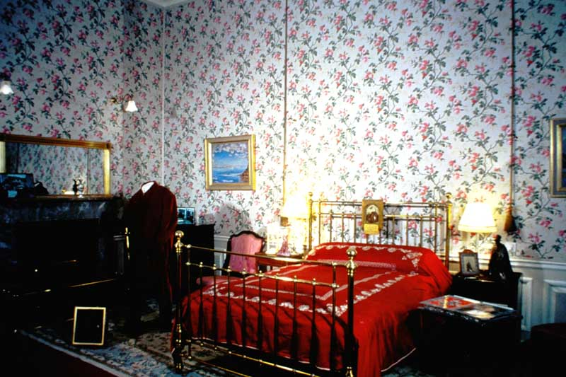
Blenheim Palace – Sir Winston Churchill's Birth Room.

Slide 42
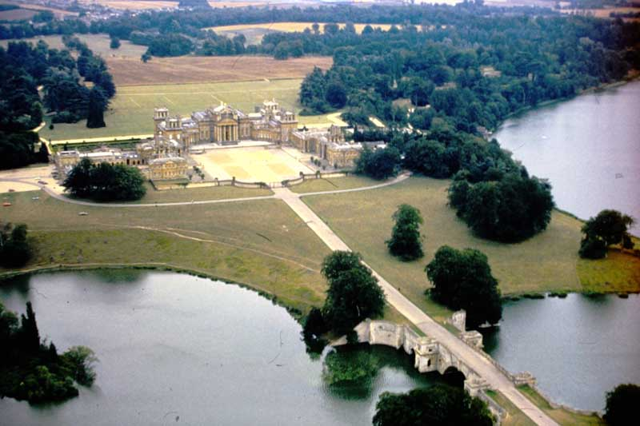
Blenheim Palace – North Front

Slide 43
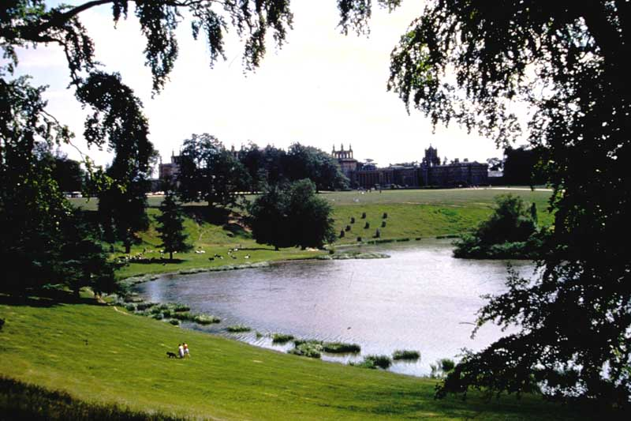
Blenheim Palace – Lake and Palace

Slide 44
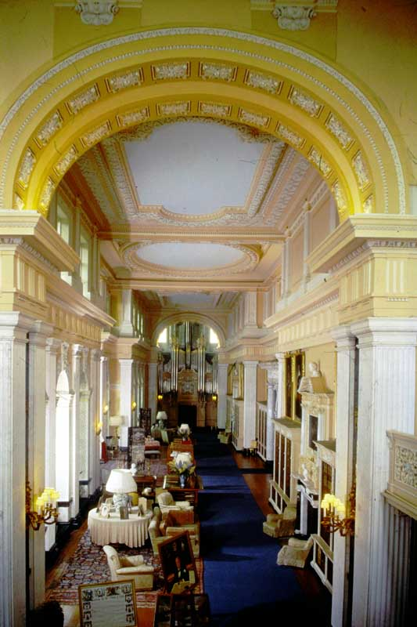
Blenheim Palace – The Long Library

Slide 45
End of Box 6

