Slide 1
WARWICK CASTLE
These slides are from the estate of Paul Berthelot who found the English culture and architecture intriguing. He acquired these images while stationed in England serving in the US Air Force.

Slide 2
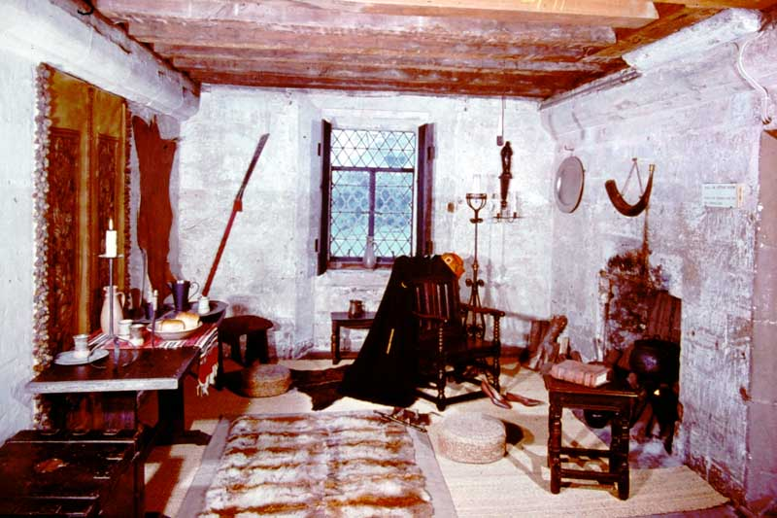
Photo # 159 A Hall in the Clock Tower

Slide 3
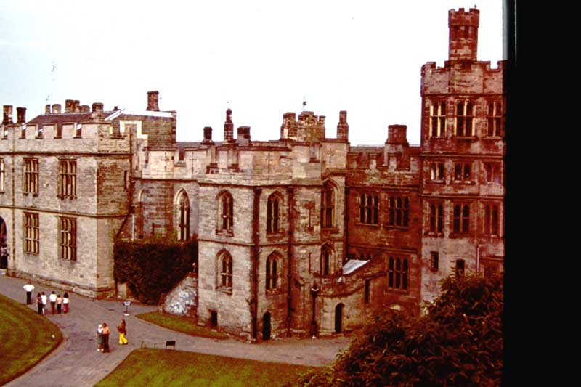
Photo # 160 Visitors Entrance and Spy Tower

Slide 4
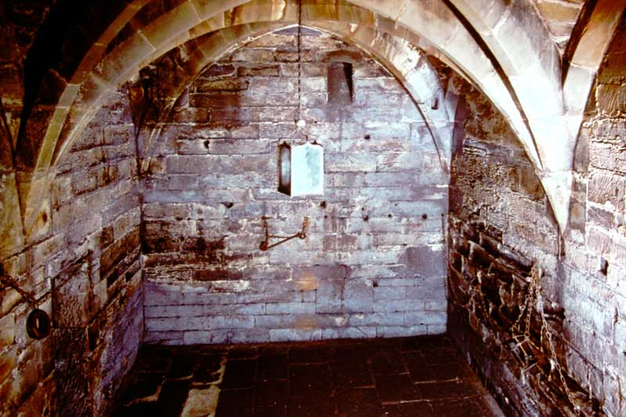
Photo # 166 Dungeon

Slide 5
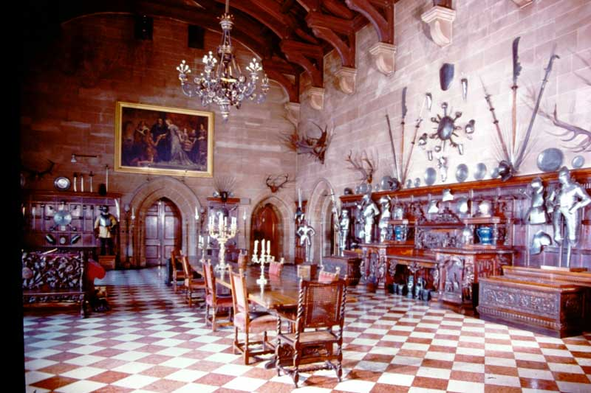
Photo # 168 The Great Hall

Slide 6
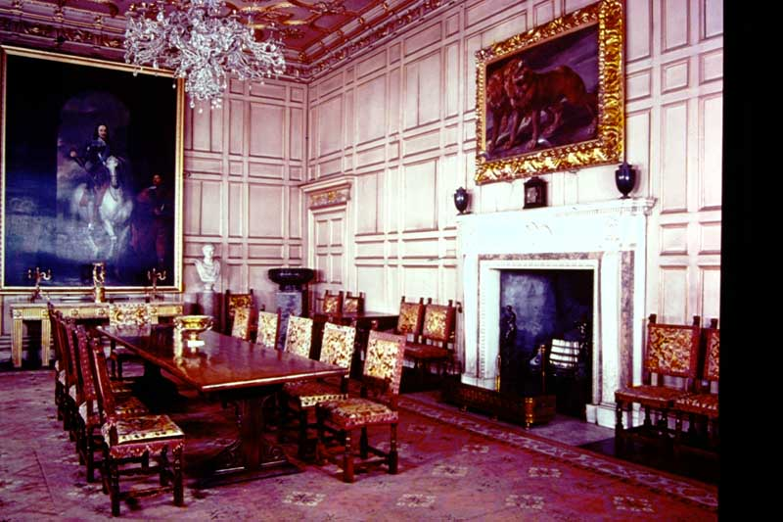
Photo # 169 The State Dining Room

Slide 7
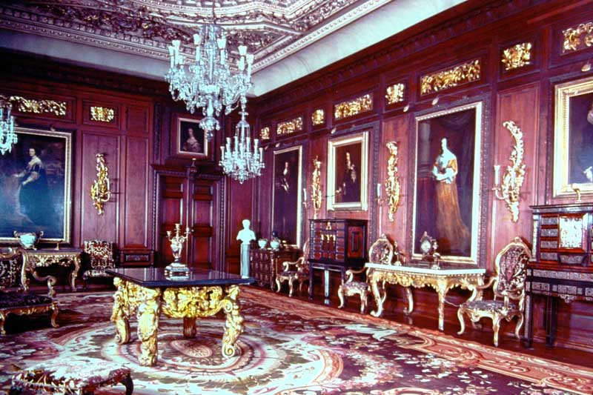
Photo # 170 Cedar Drawing Room

Slide 8
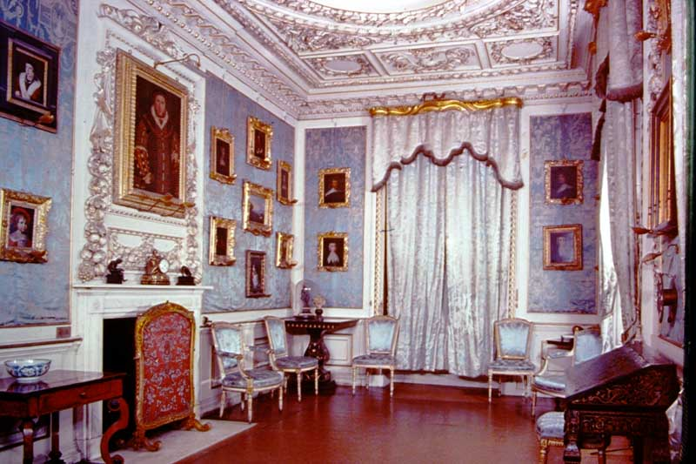
Photo # 171 The Blue Boudoir

Slide 9
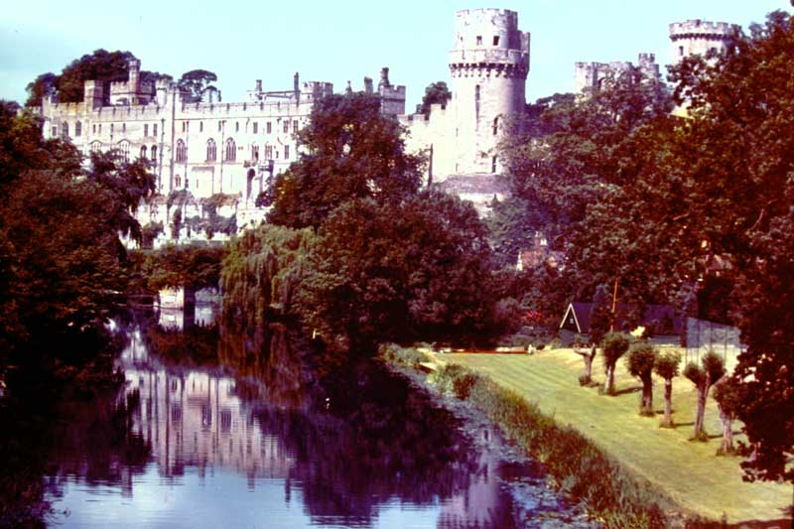
Photo # 177 Castle from River Avon

Slide 10
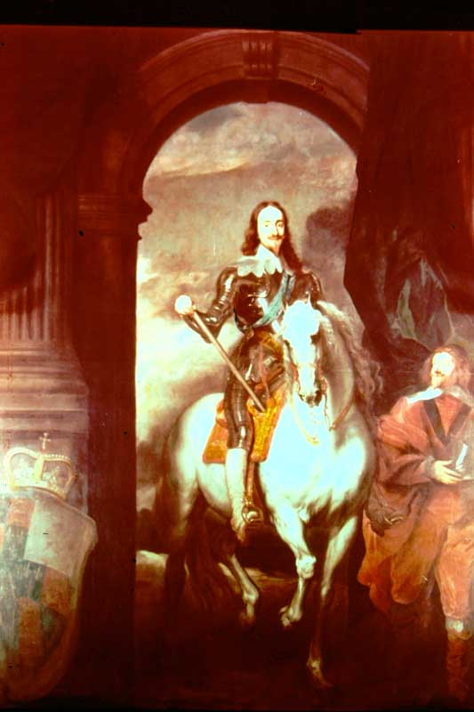
Photo # 176 Charles 1

Slide 11
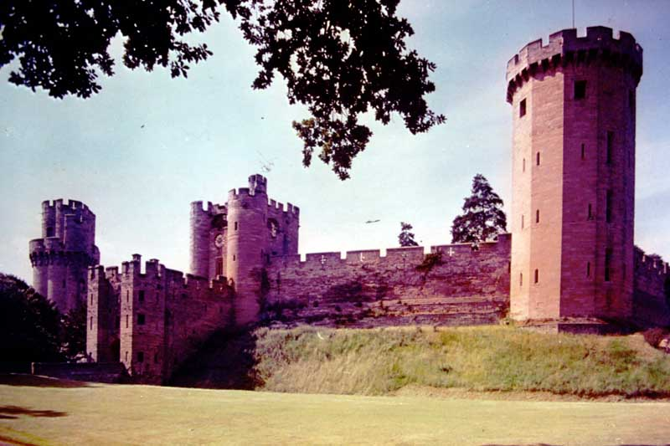
Photo # 180 East Front Caesar’s Tower, Clock Tower & Guy’s Tower

Slide 12
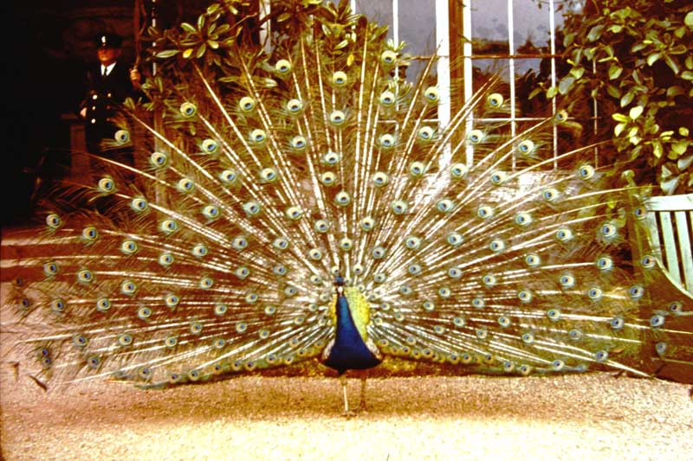
Photo # 181 A Resident Peacock

Slide 13
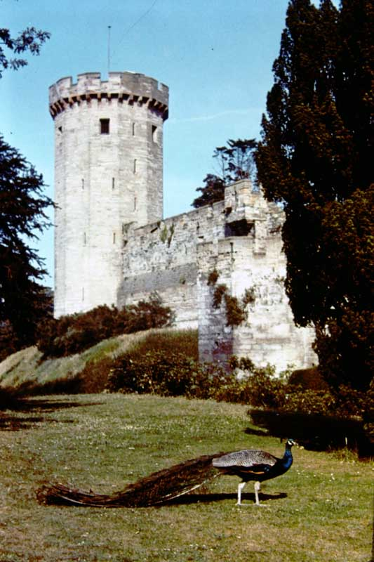
Photo # 188 Guy’s Tower and the Ramparts

Slide 14
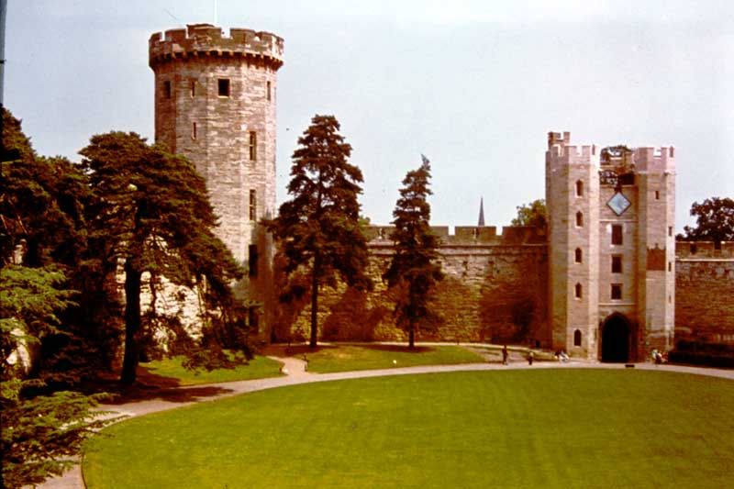
Photo # 199 Clock Tower and Guy’s Tower

Slide 15
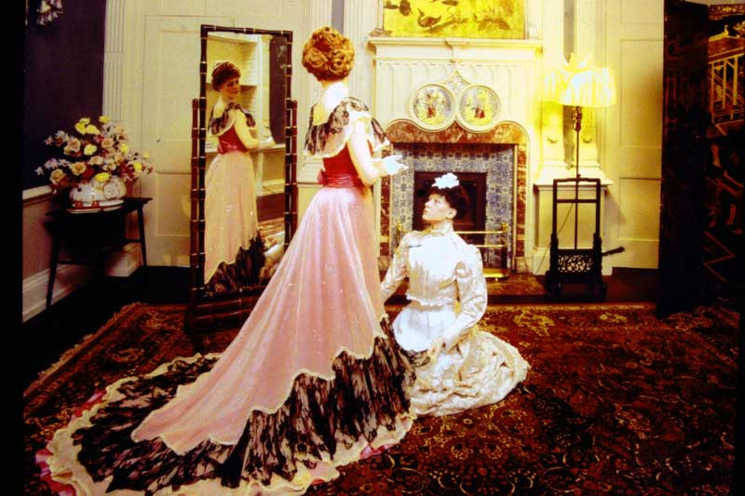
Photo # 700 The Chinese Bedroom – The Private Apartments “A Royal Weekend Party – 1898” by Madame Tussaud’s

Slide 16
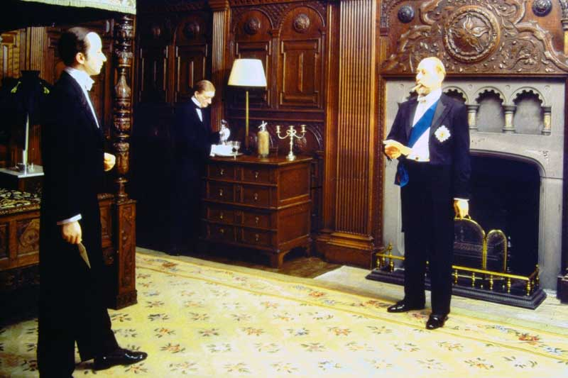
Photo # 701 The Kenilworth Bedroom– The Private Apartments “A Royal Weekend Party – 1898” by Madame Tussaud’s

Slide 17
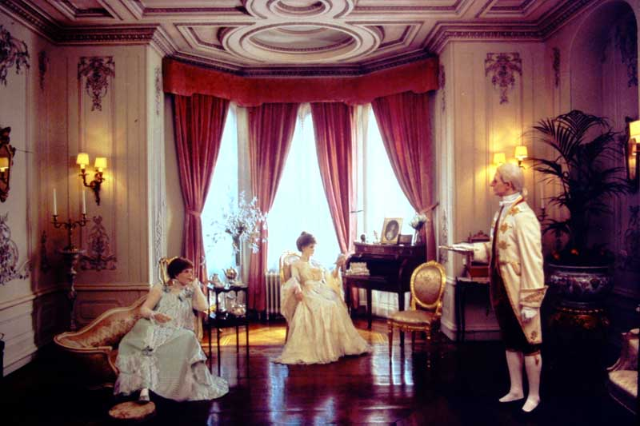
Photo # 702 The Boudoir– The Private Apartments “A Royal Weekend Party – 1898” by Madame Tussaud’s

Slide 18
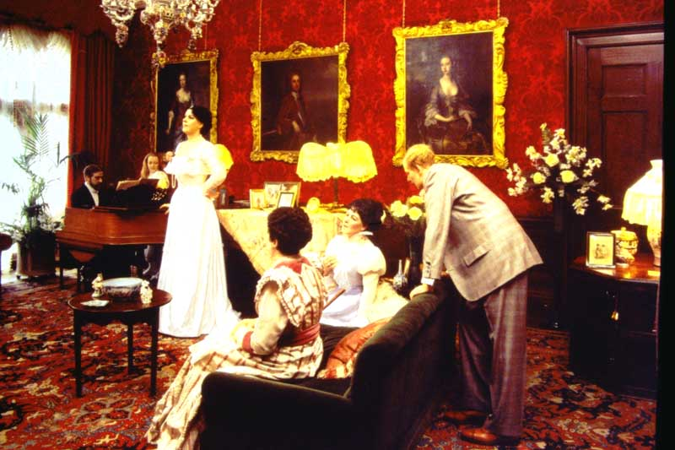
Photo # 703 The Music Room – The Private Apartments “A Royal Weekend Party – 1898” by Madame Tussaud’s

Slide 19
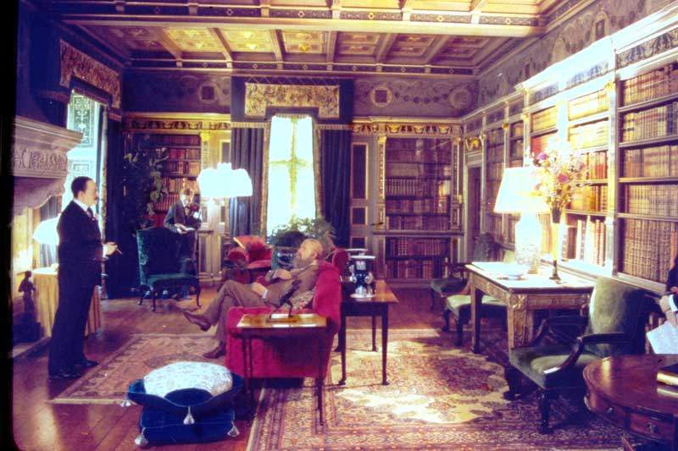
Photo # 704 The Library – The Private Apartments “A Royal Weekend Party – 1898” by Madame Tussaud’s

Slide 20
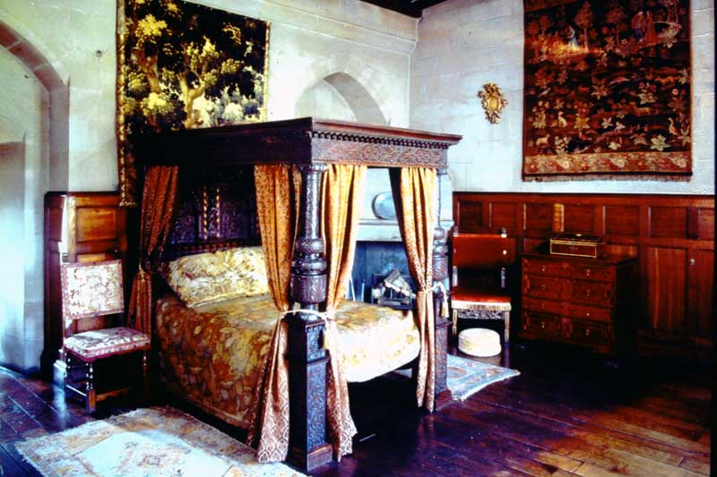
Photo # 705 Bedroom, Ghost Tower

Slide 21
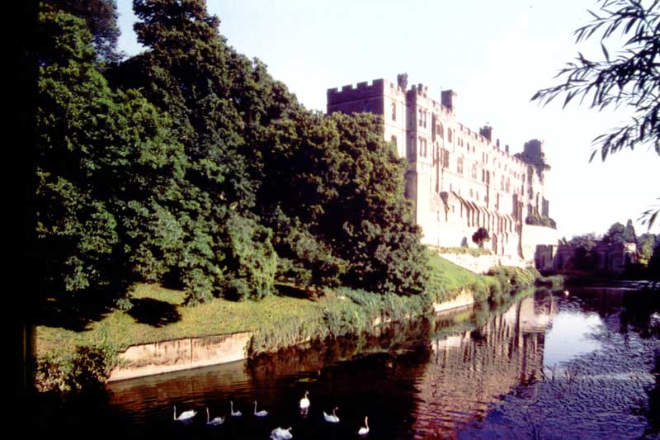
Photo # 706 The River Front

Slide 22
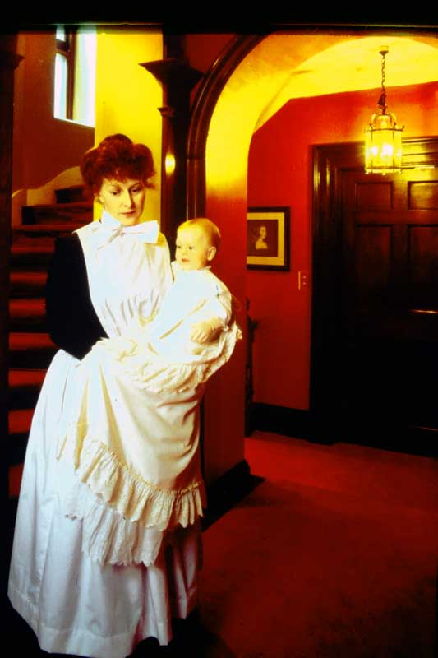
Photo # 707 The Marquees of Blanford and his Nurse

Slide 23
Bjorn Borg and John McEnroe by Madame Tussaud’s

Slide 24
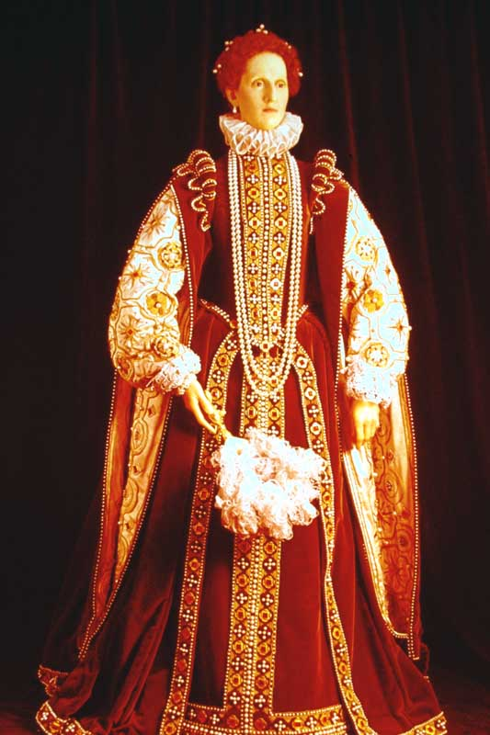
Elizabeth 1 by Madame Tussaud’s

Slide 25
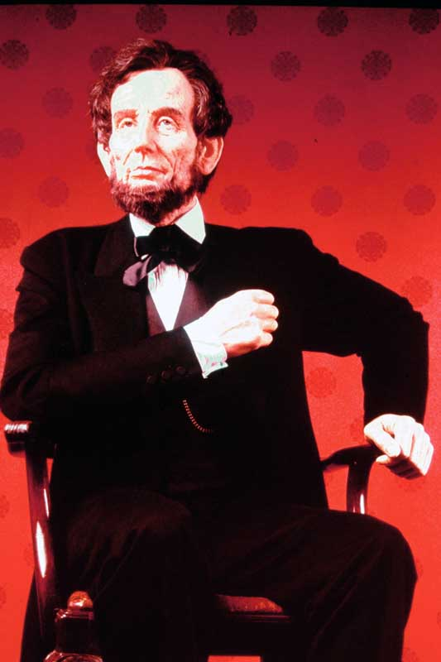
Abraham Lincoln by Madame Tussaud’s

Slide 26
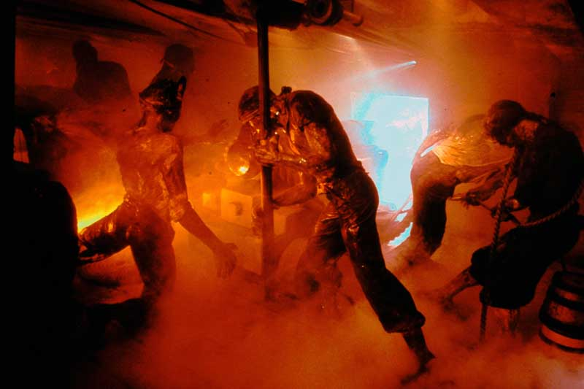
The Battle of Trafalgar 1805 by Madame Tussaud’s

Slide 27
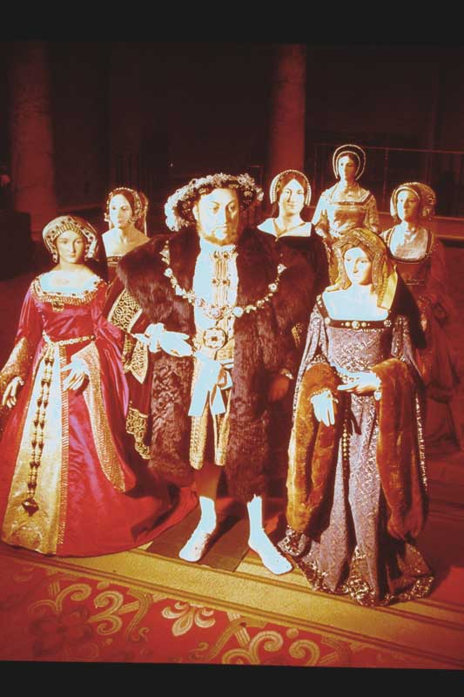
Henry VIII by Madame Tussaud’s

Slide 28
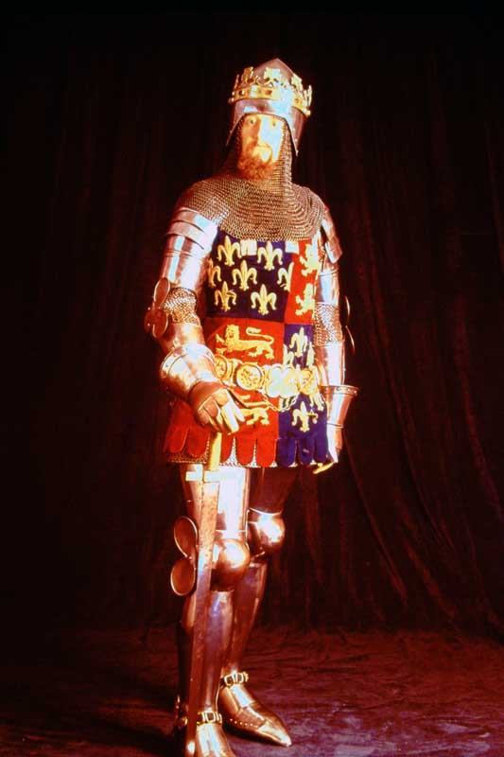
The Black Prince by Madame Tussaud’s

Slide 29
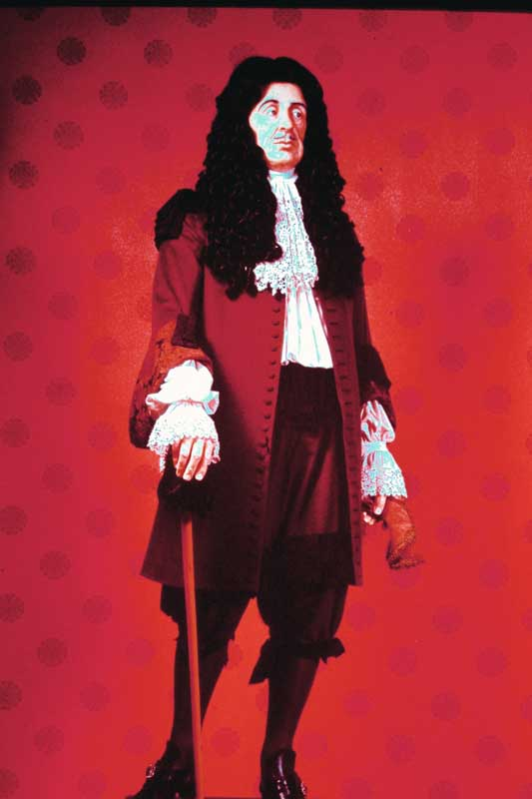
Charles II by Madame Tussaud’s

Slide 30
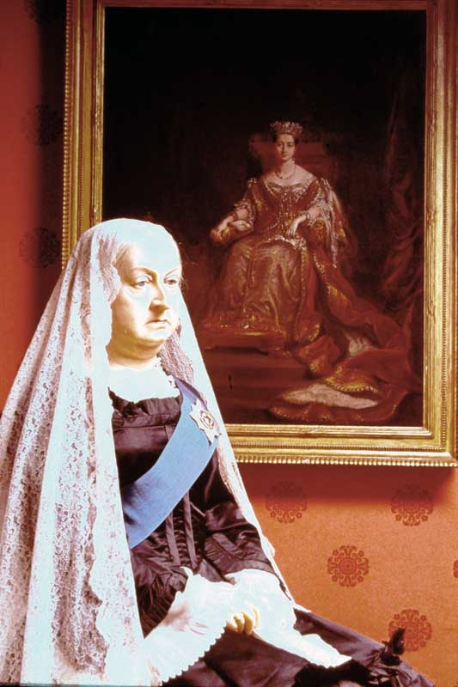
Queen Victoria by Madame Tussaud’s

Slide 31
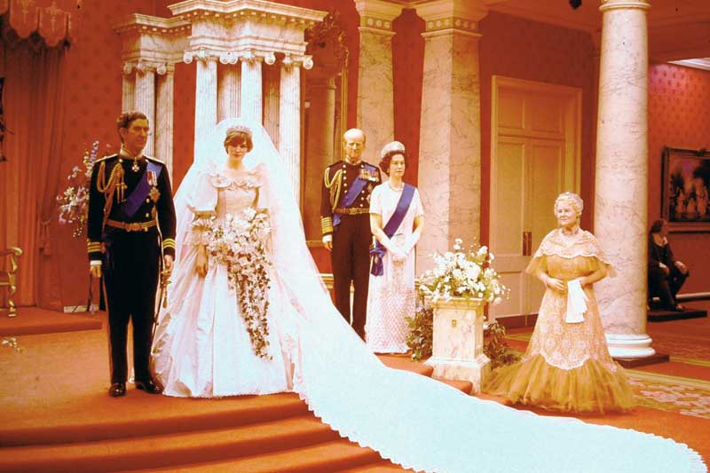
The Royal Family by Madame Tussaud’s

Slide 32
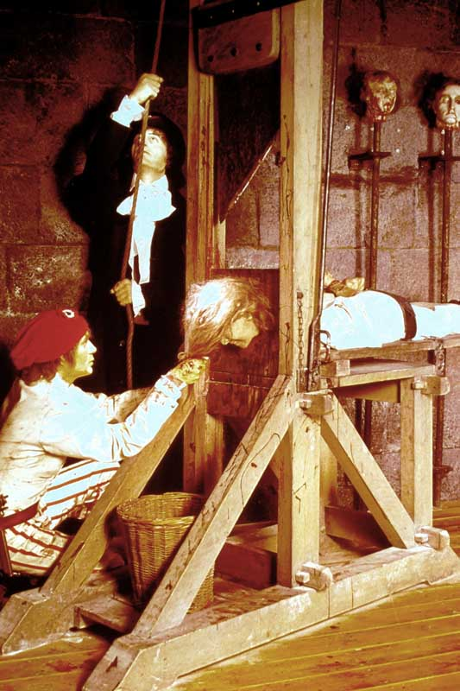
The Guillotine – France by Madame Tussaud’s

Slide 33
The Gallows – United Kingdom by Madame Tussaud’s

Slide 34
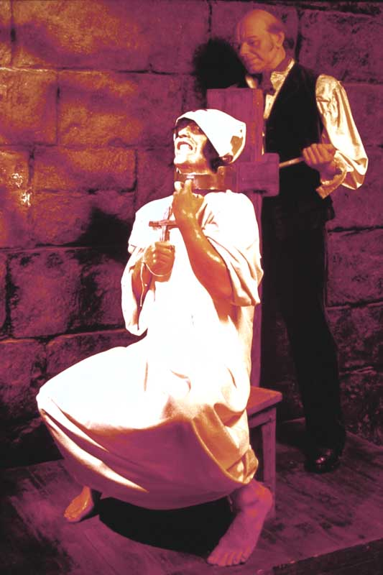
The Garrote – Spain by Madame Tussaud’s

Slide 35
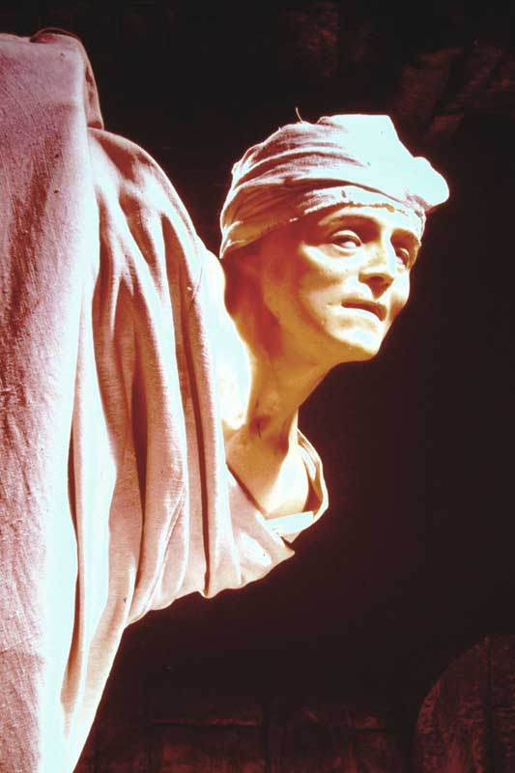
Marat by Madame Tussaud’s

Slide 36
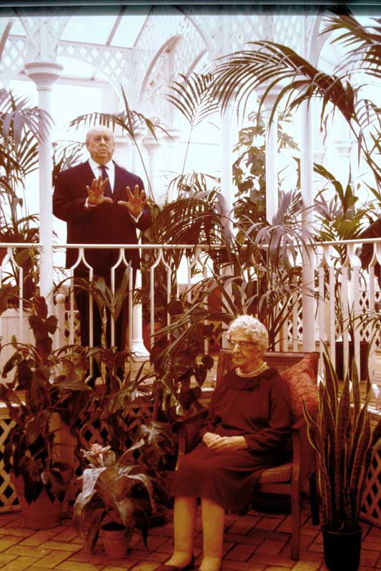
Alfred Hitchcock and Agatha Christie by Madame Tussaud’s

Slide 37
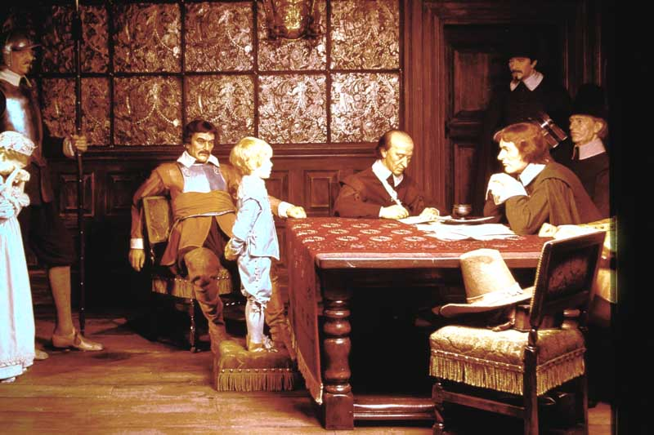
And when did you last see your father? By Madame Tussaud’s

Slide 38
The End of Slide Box 1

