Slide 1
WINDSOR CASTLE AND THE ROYAL MEWS
Buckingham Palace
These slides are from the estate of Paul Berthelot who found the English culture and architecture intriguing. He acquired these images while stationed in England serving in the US Air Force.

Slide 2
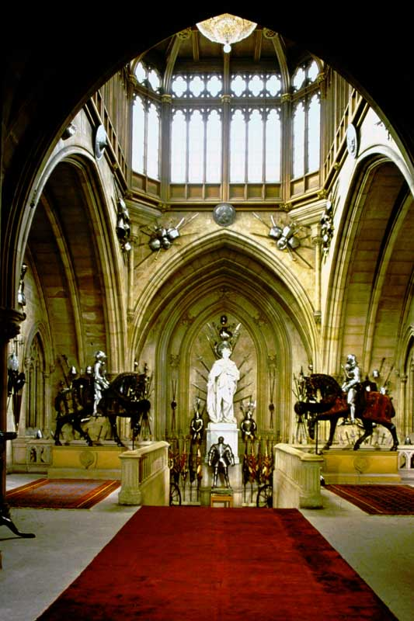
1. WINDSOR CASTLE – The Grand Staircase

Slide 3
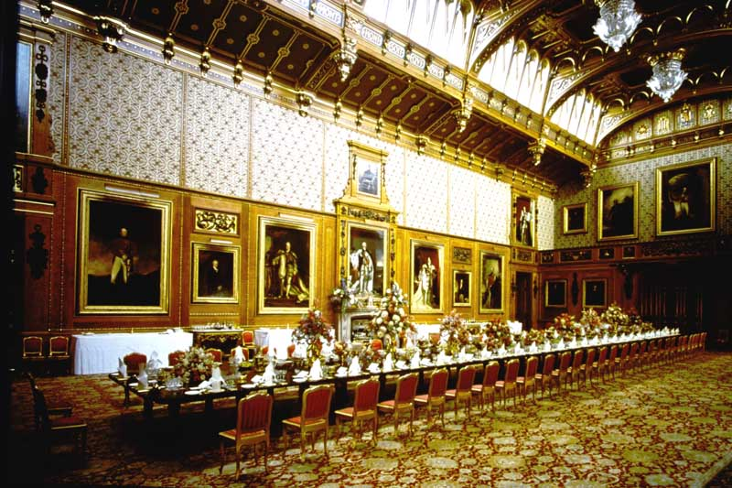
2. WINDSOR CASTLE – The Waterloo Chamber

Slide 4
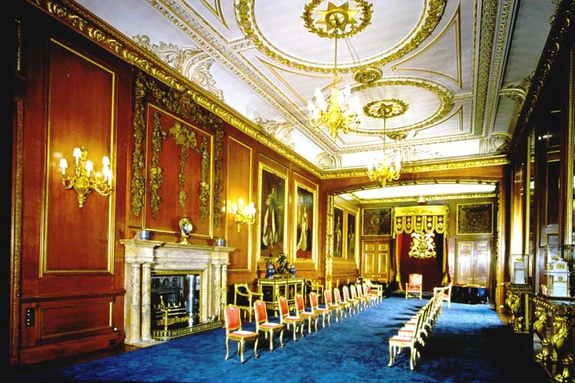
3. WINDSOR CASTLE - The Garter Throne Room

Slide 5
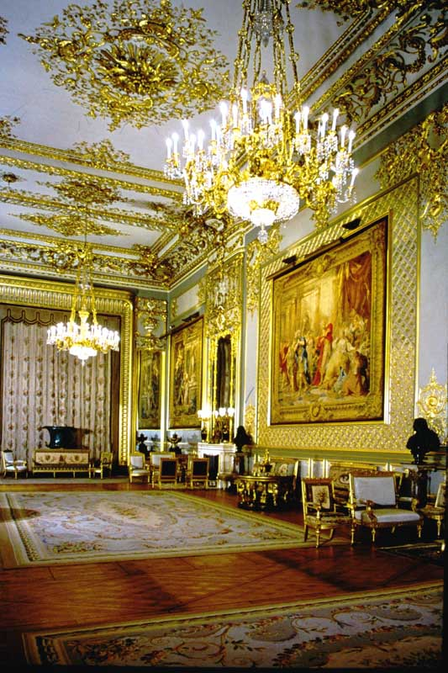
4. WINDSOR CASTLE – The Grand Reception Room

Slide 6
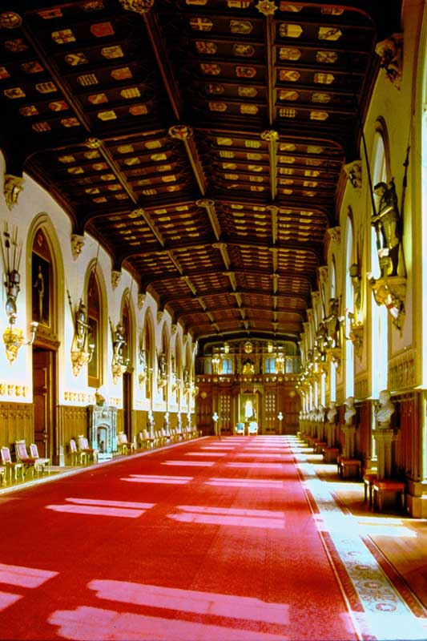
5. WINDSOR CASTLE – St. George’s Hall

Slide 7
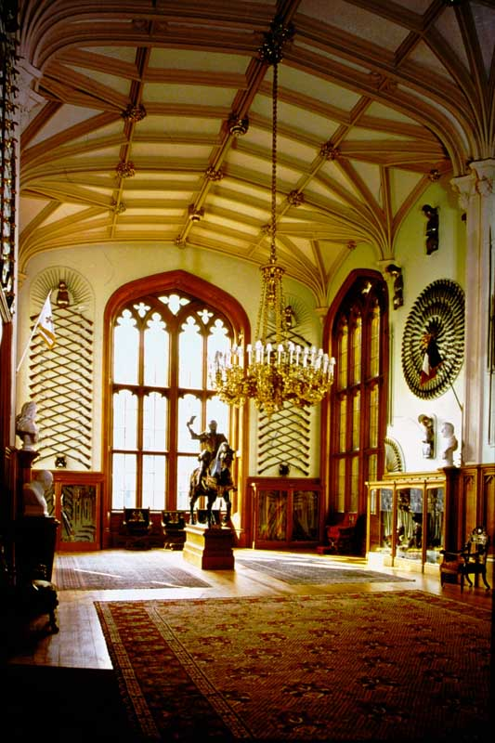
6. WINDSOR CASTLE – The Queen’s Guard Chamber

Slide 8
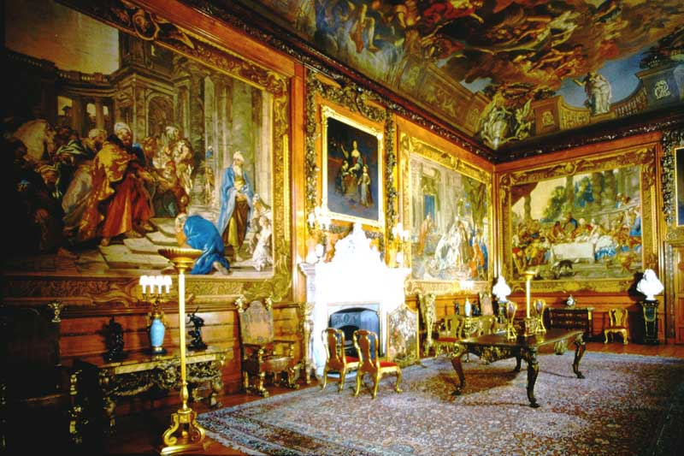
7. WINDSOR CASTLE – The Queen’s Presence Chamber

Slide 9
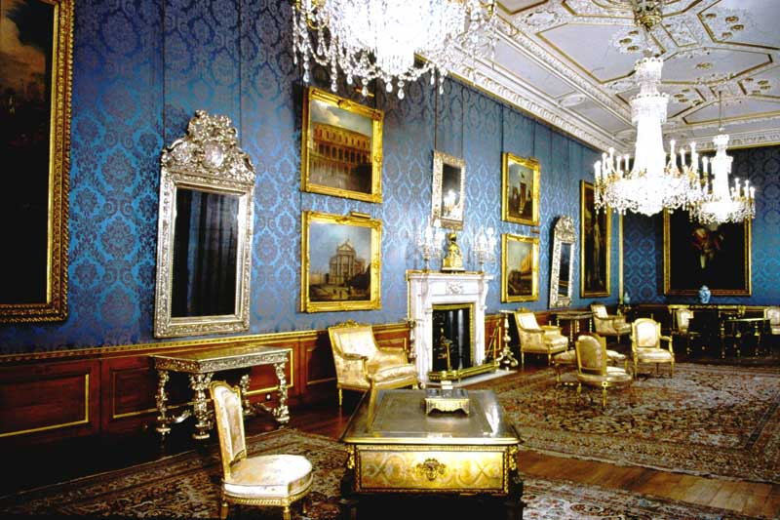
8. WINDSOR CASTLE – The Queen’s Ballroom

Slide 10
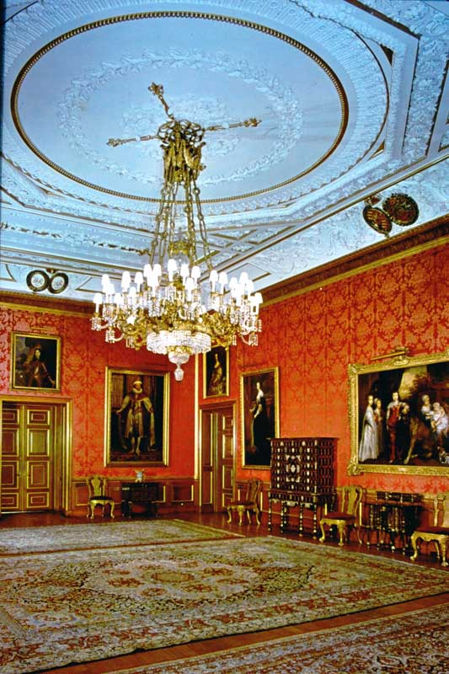
9. WINDSOR CASTLE – The Queen’s Drawing Room

Slide 11
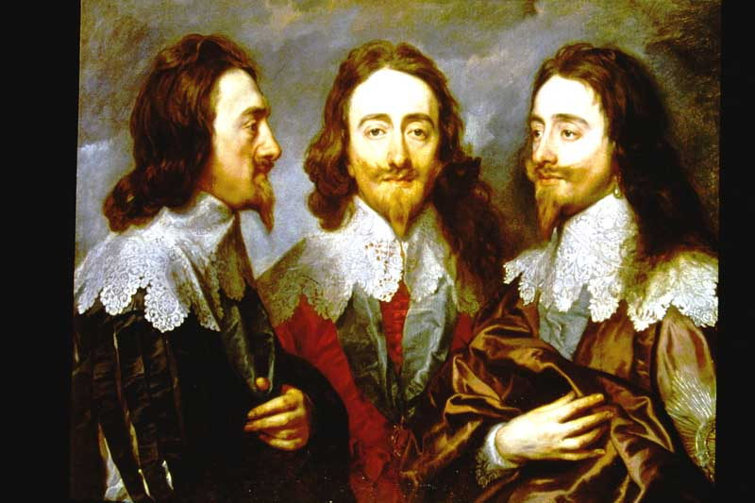
10. WINDSOR CASTLE – Triple Portrait of King Charles I

Slide 12
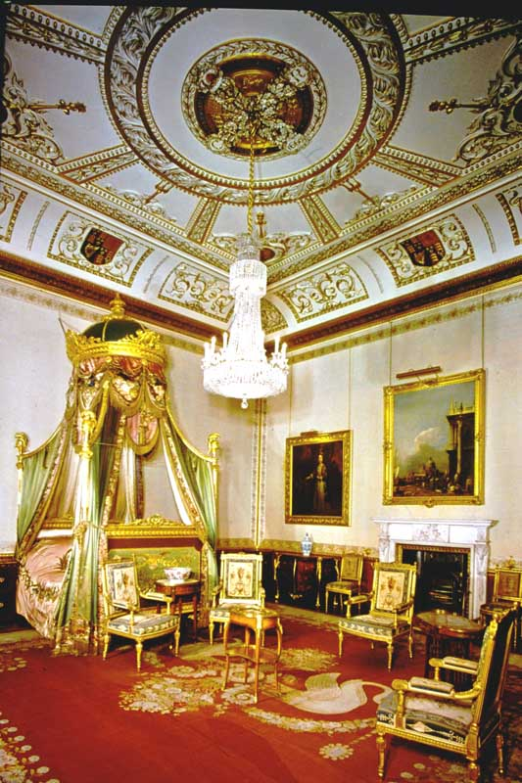
11. WINDSOR CASTLE – The king’s State Bed Chamber

Slide 13
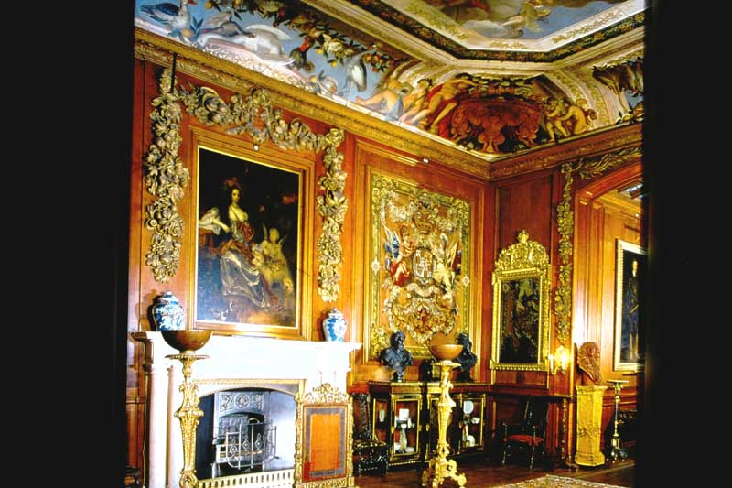
12. WINDSOR CASTLE – The King’s Dining Room

Slide 14
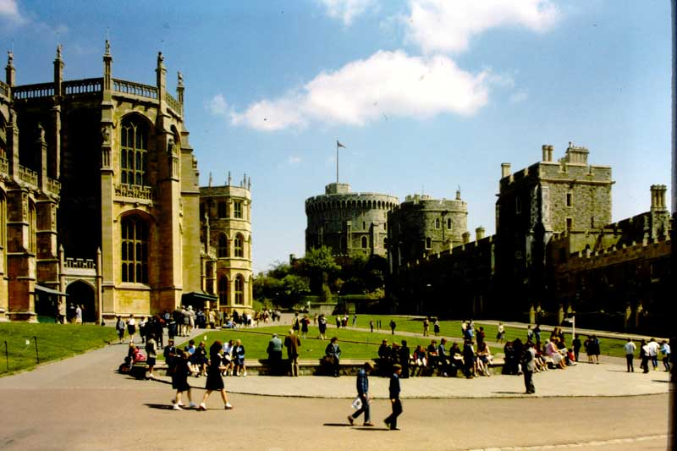
Photo # 965 WINDSOR CASTLE – Lower Ward

Slide 15
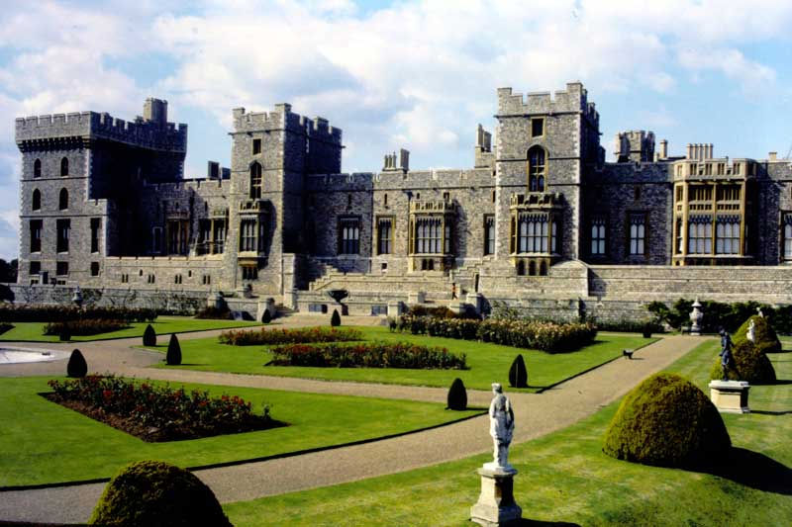
Photo # 966 WINDSOR CASTLE – East Terrace

Slide 16
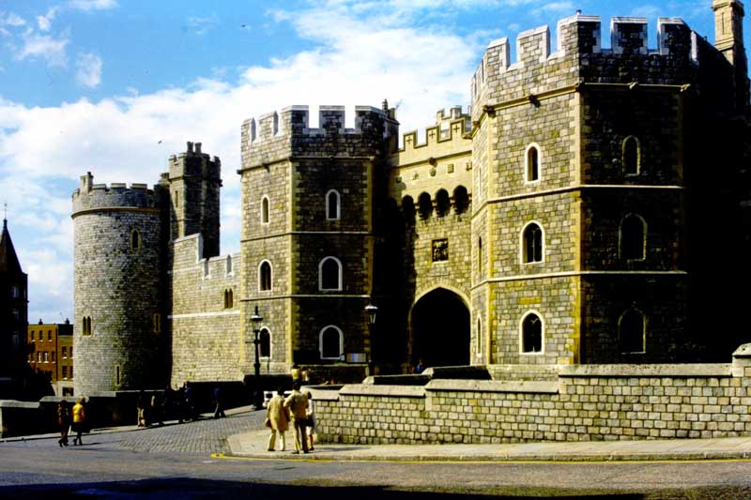
Photo # 967 WINDSOR CASTLE – Henry VIII’s Gateway

Slide 17
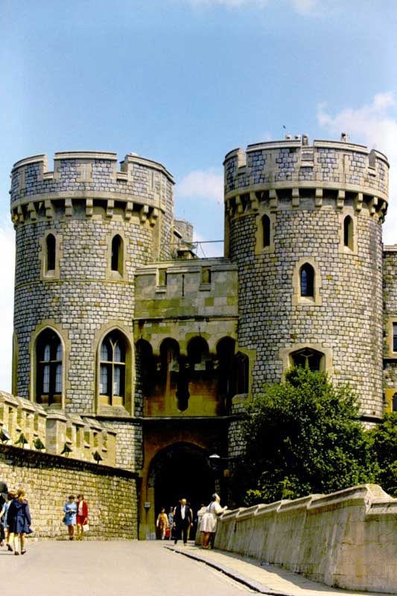
Photo # 968 WINDSOR CASTLE – Norman Gate

Slide 18
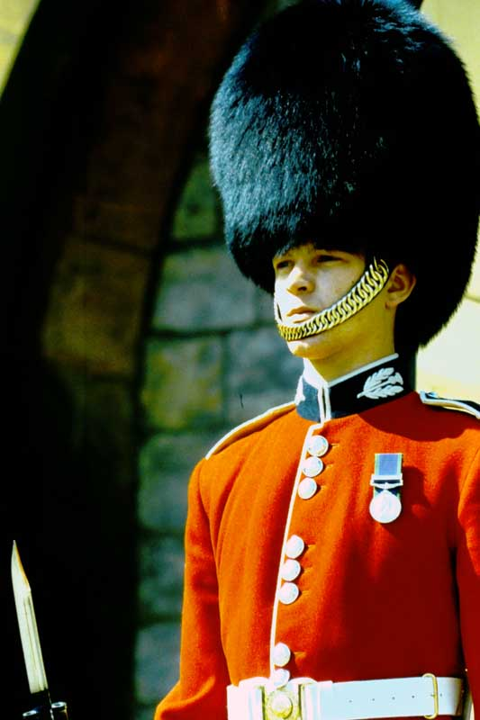
Photo # 969 WINDSOR CASTLE - Sentry

Slide 19
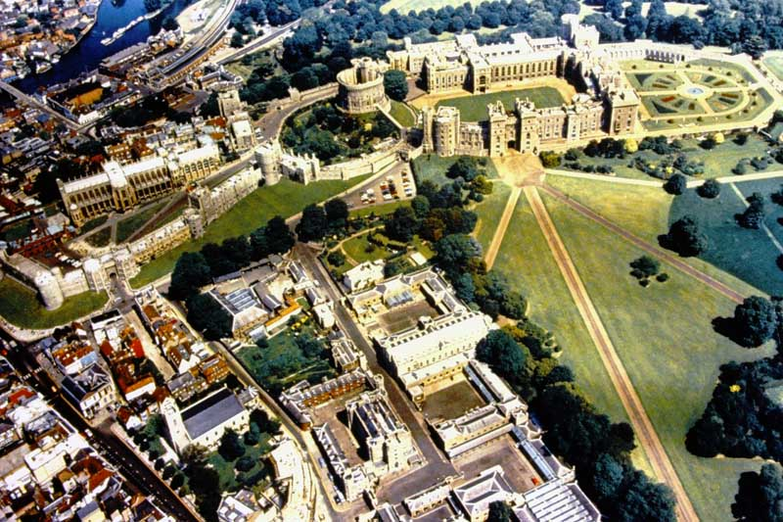
WINDSOR CASTLE – Aerial View

Slide 20
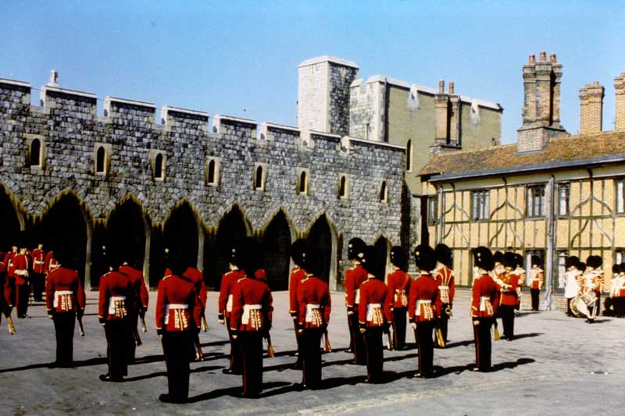
WINDSOR CASTLE - Guards

Slide 21
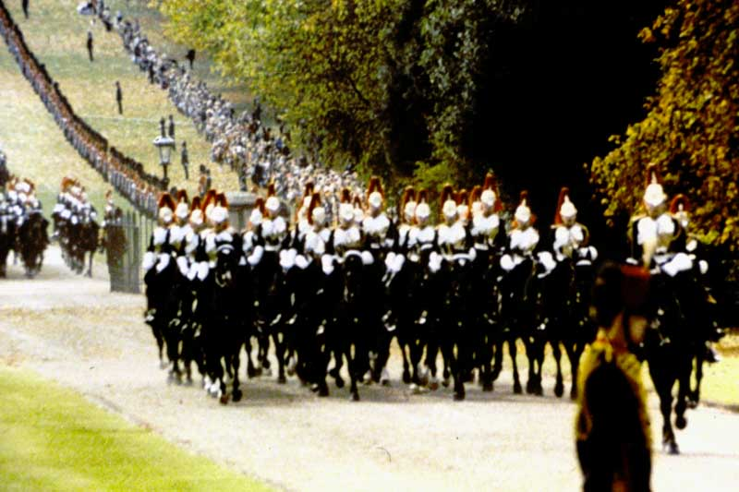
WINDSOR CASTLE - Guards

Slide 22
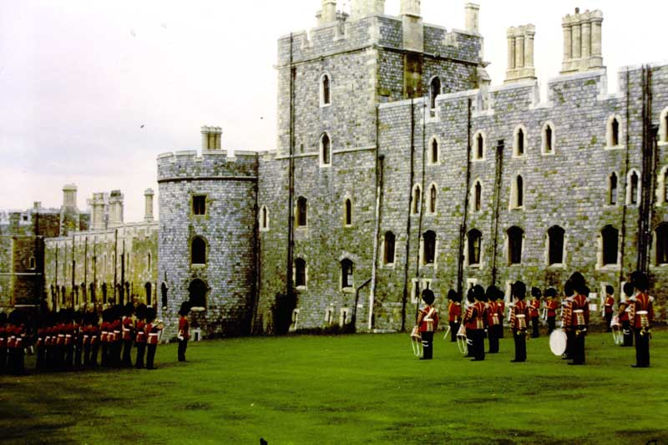
WINDSOR CASTLE - Guards

Slide 23
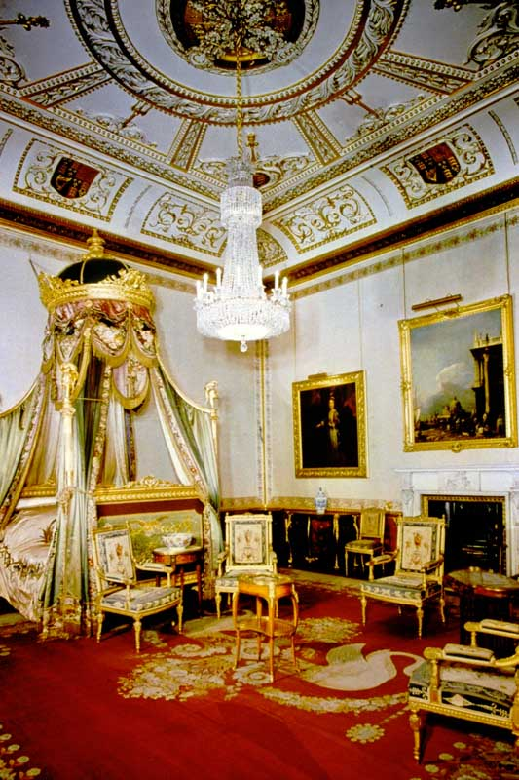
The Kings Bedroom – State Apartments, WINDSOR CASTLE

Slide 24
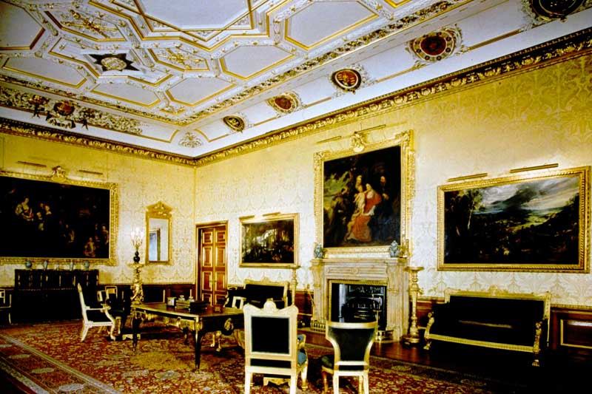
King’s Drawing Room - State Apartments, WINDSOR CASTLE

Slide 25
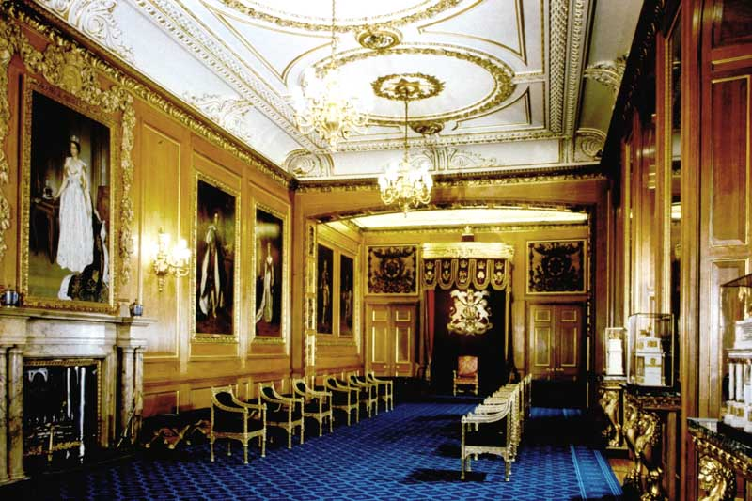
Garter Throne Room - State Apartments, WINDSOR CASTLE

Slide 26
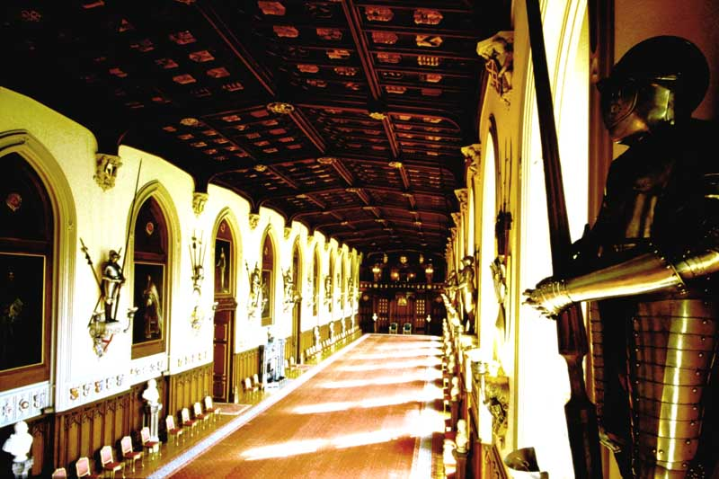
St. George’s Hall - State Apartments, WINDSOR CASTLE

Slide 27
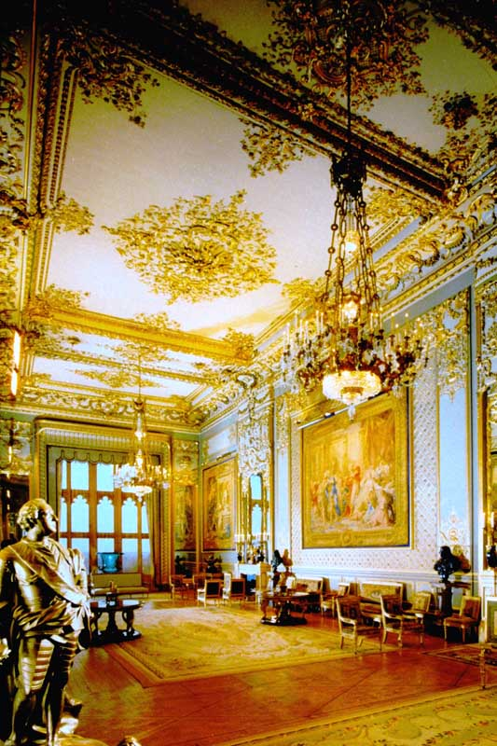
Grand Reception Room - State Apartments, WINDSOR CASTLE

Slide 28
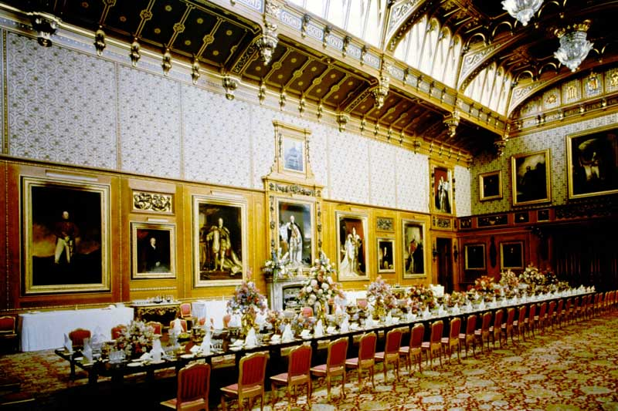
The Waterloo Chamber - State Apartments, WINDSOR CASTLE

Slide 29
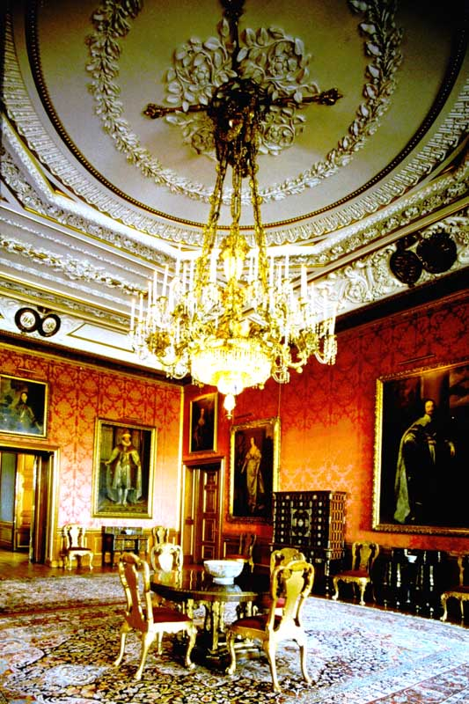
Queen’s Drawing Room - State Apartments, WINDSOR CASTLE

Slide 30
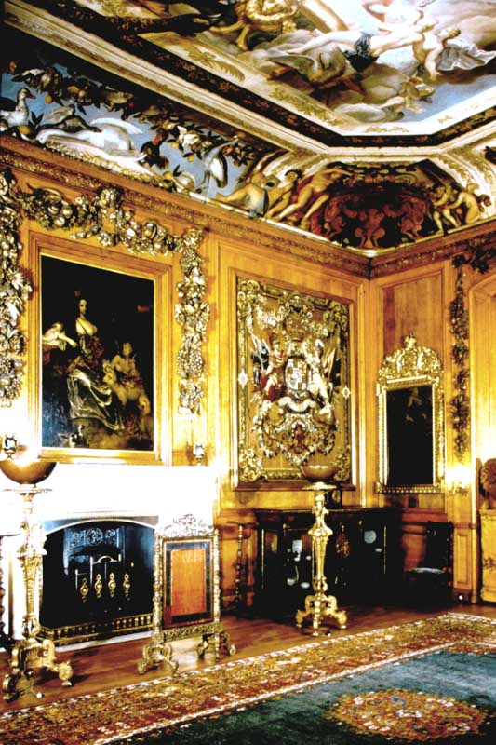
King’s Dining Room - State Apartments, WINDSOR CASTLE

Slide 31
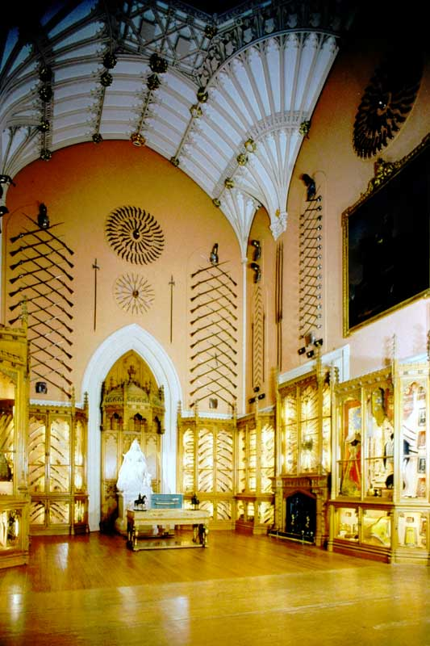
Grand Vestibule - State Apartments, WINDSOR CASTLE

Slide 32
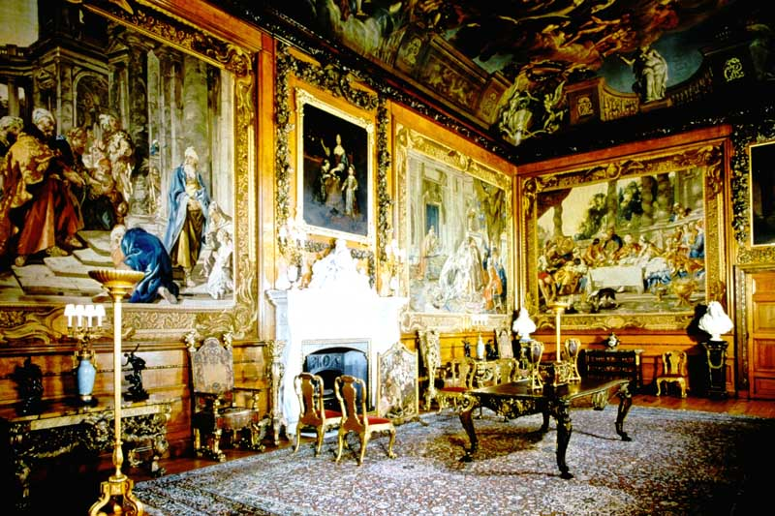
Queen’s Presence Chamber - State Apartments, WINDSOR CASTLE

Slide 33
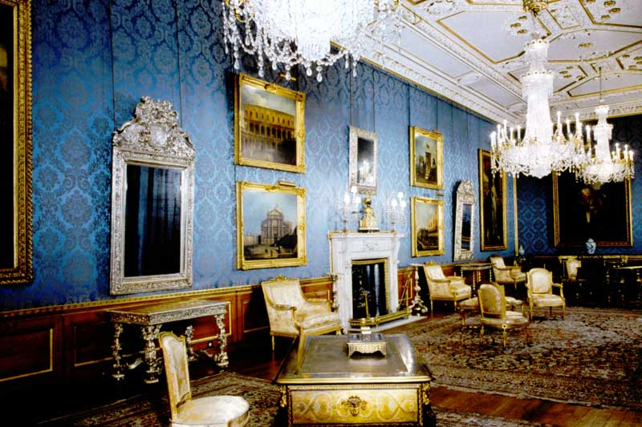
Queen’s Ballroom - State Apartments, WINDSOR CASTLE

Slide 34
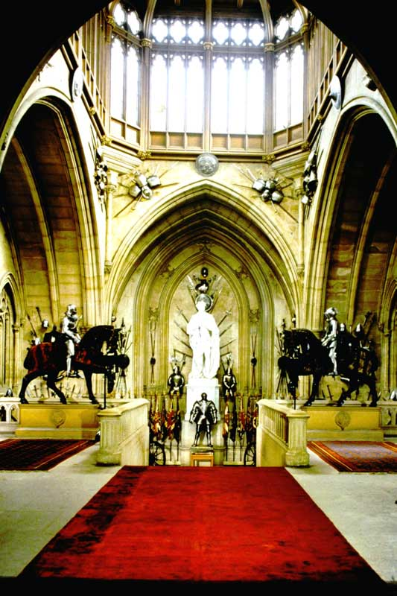
Grand Staircase - State Apartments, WINDSOR CASTLE

Slide 35
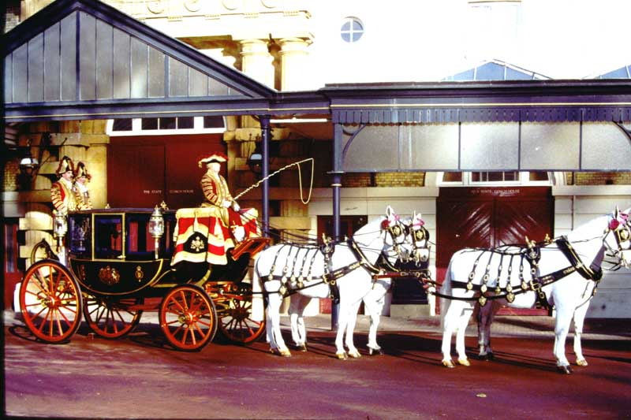
1. The Glass Coach – THE ROYAL MEWS, Buckingham Palace

Slide 36
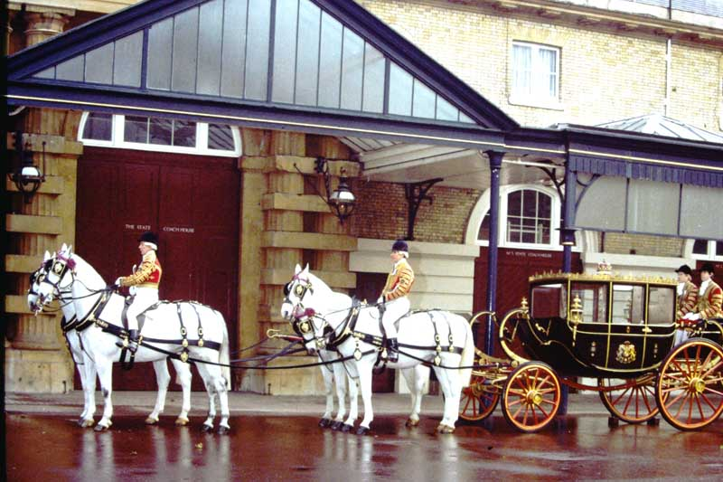
2. Sottish State Coach - THE ROYAL MEWS, Buckingham Palace

Slide 37
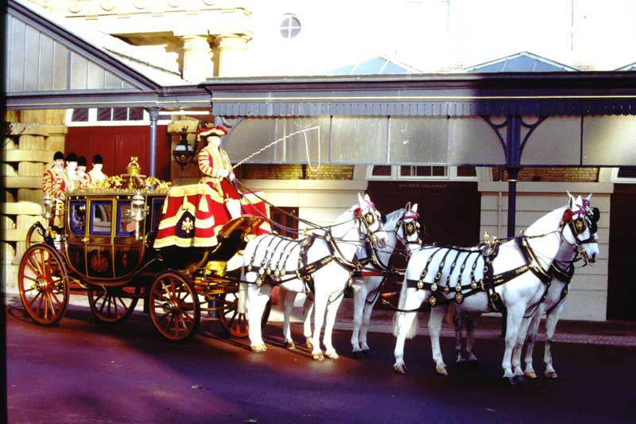
3. Irish State Coach - THE ROYAL MEWS, Buckingham Palace

Slide 38
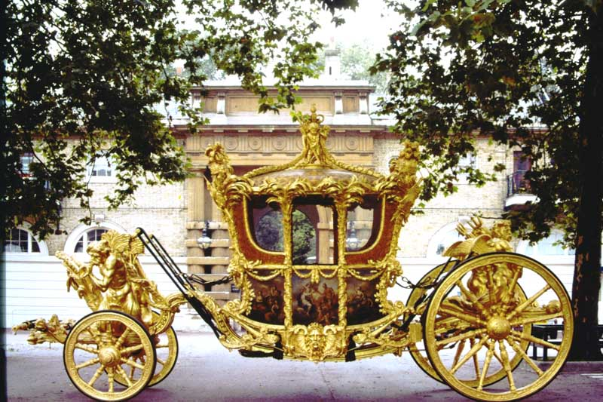
4. The Gold Coach - THE ROYAL MEWS, Buckingham Palace

Slide 39
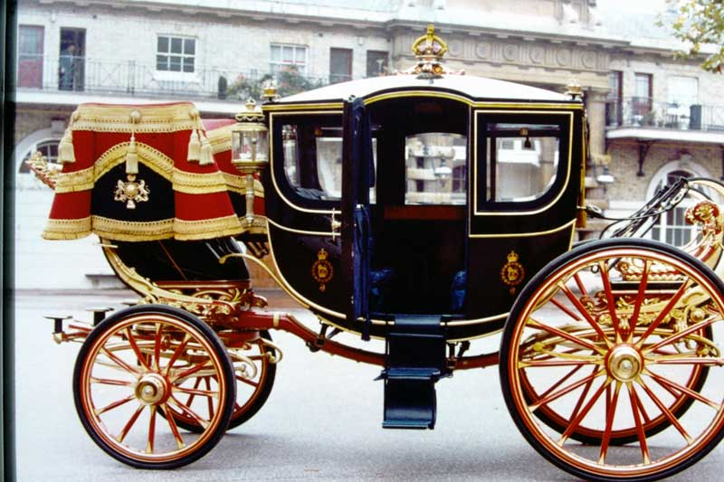
5. Queen Alexandra’s State Coach - THE ROYAL MEWS, Buckingham Palace

Slide 40
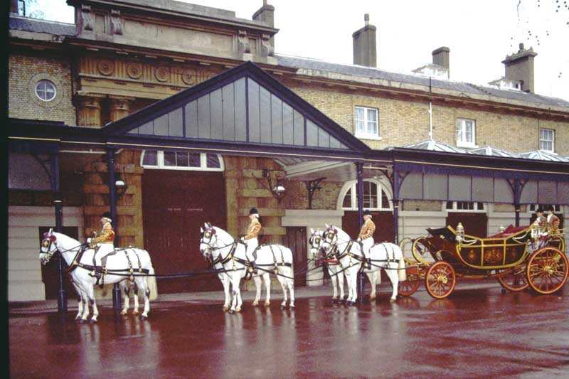
6. 1902 State Landau - THE ROYAL MEWS, Buckingham Palace

Slide 41
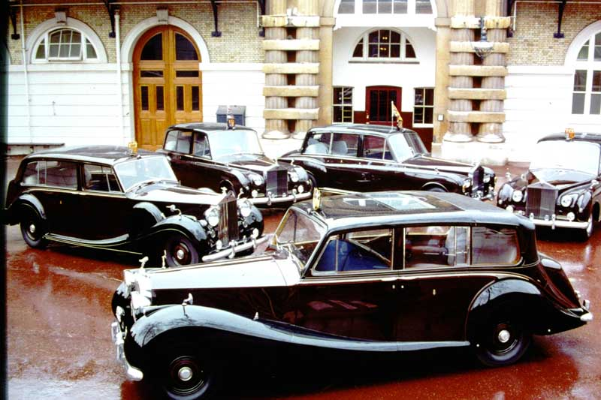
1. The 5 State Rolls Royces - THE ROYAL MEWS, Buckingham Palace

Slide 42
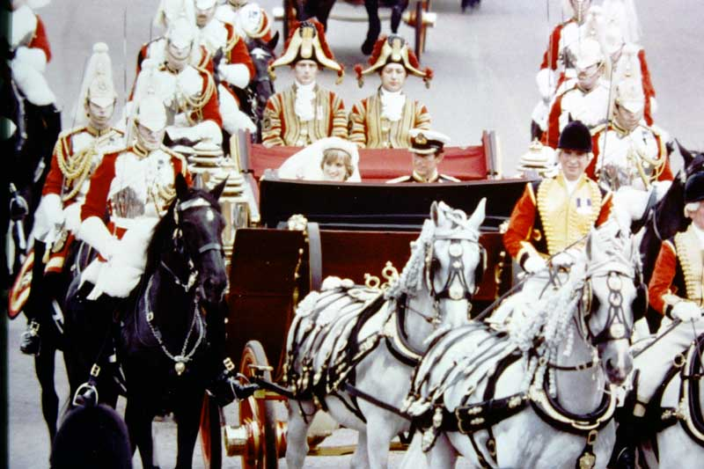
2. 1902 State Landau – Prince of Wales’s Wedding, 1981 - THE ROYAL MEWS, Buckingham Palace

Slide 43
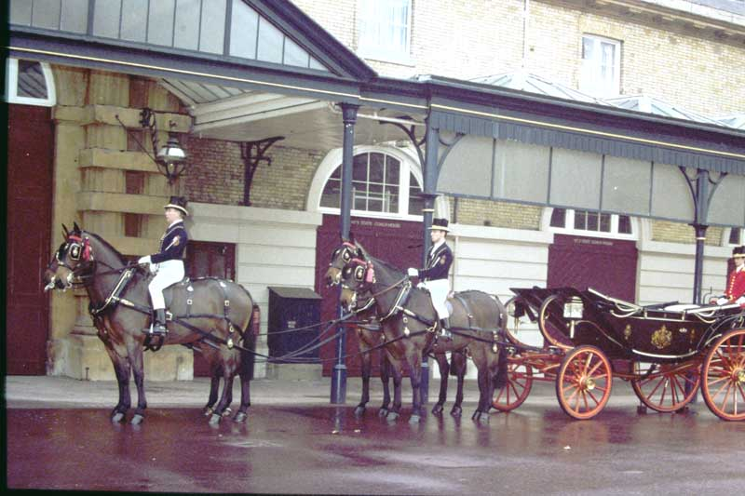
3. Semi-State Landau - THE ROYAL MEWS, Buckingham Palace

Slide 44
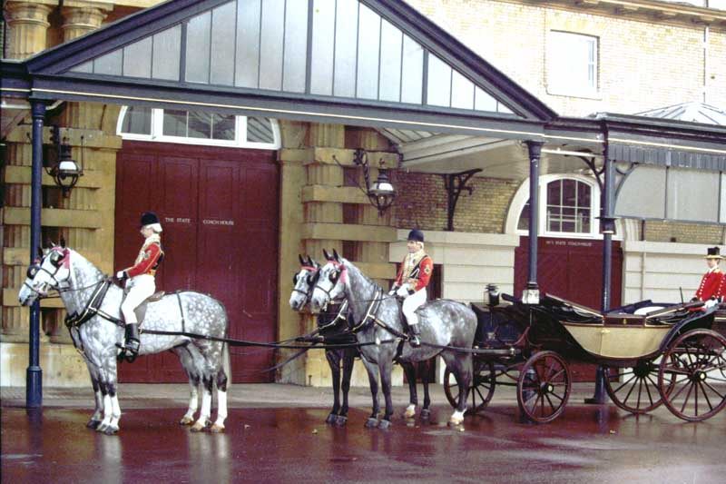
4. Ascot Landau with Horses - THE ROYAL MEWS, Buckingham Palace

Slide 45
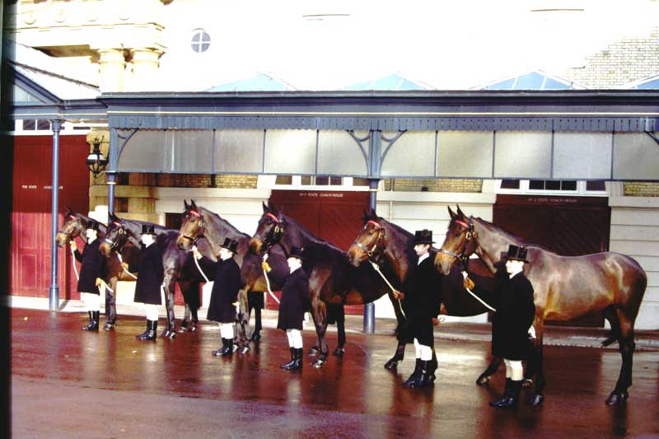
5. Home Bred Bay Carriage Horses - THE ROYAL MEWS, Buckingham Palace

Slide 46
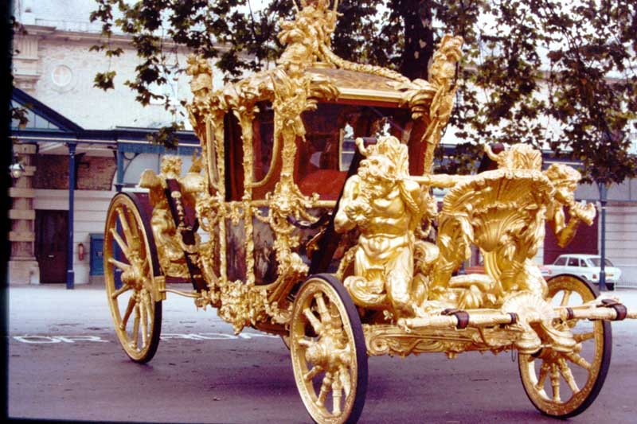
6. Gold State Coach Front View - THE ROYAL MEWS, Buckingham Palace

Slide 47
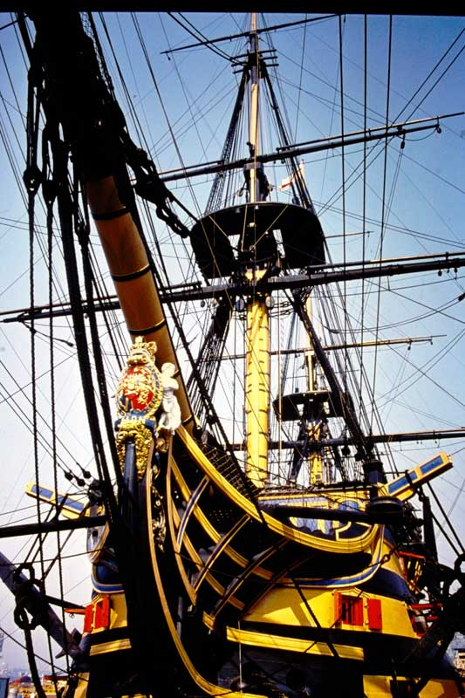
13. H.M.S. VICTORY, Close up Bow View

Slide 48
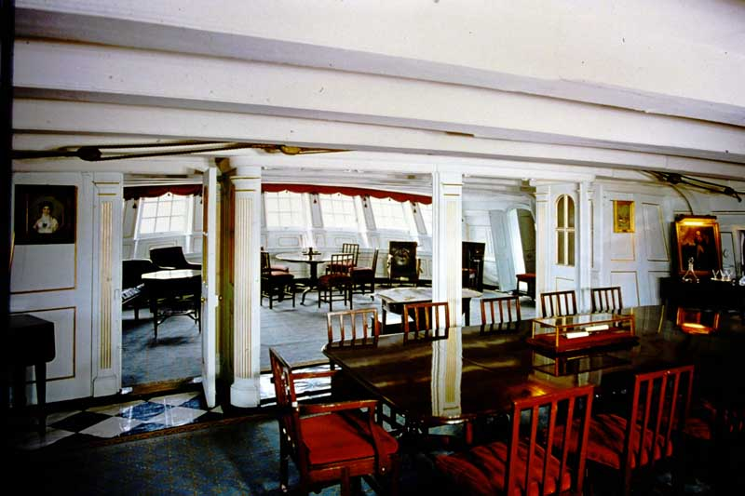
18. H.M.S. VICTORY Great Cabin

Slide 49
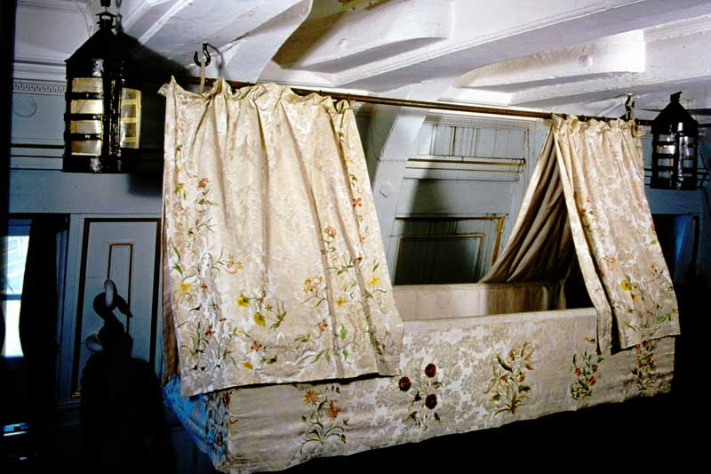
21. H.M.S. VICTORY Nelson’s Cot

Slide 50
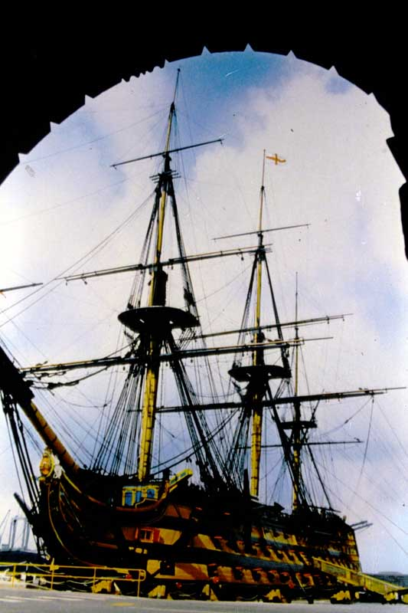
H.M.S. VICTORY View from forward

Slide 51
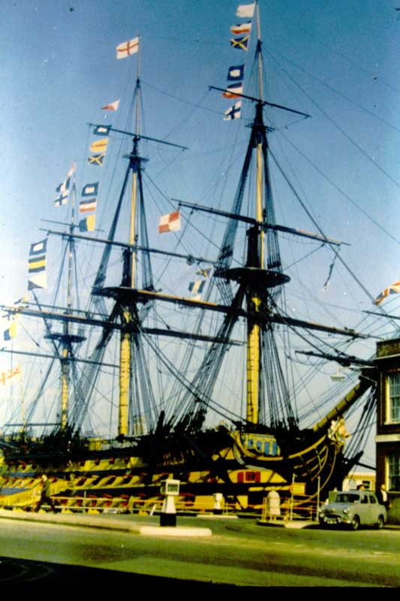
H.M.S.VICTORY Lord Nelson’s Famous Signal (England Expects….)

Slide 52
H.M.S. VICTORY Dressed Overall

Slide 53
END OF SLIDE BOX 4

