Slide 1
The Royal Pavilion Brighton, Dover Castle, Leeds Castle, & Coppergate Excavation.
These slides are from the estate of Paul Berthelot who found the English culture and architecture intriguing. He acquired these images while stationed in England serving in the US Air Force.

Slide 2
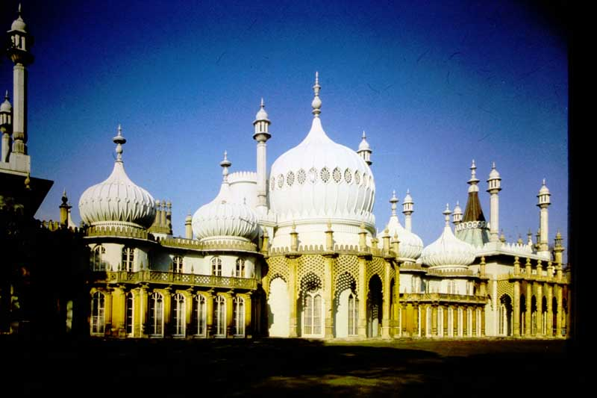
1. The Royal Pavilion Brighton – The East Front.

Slide 3
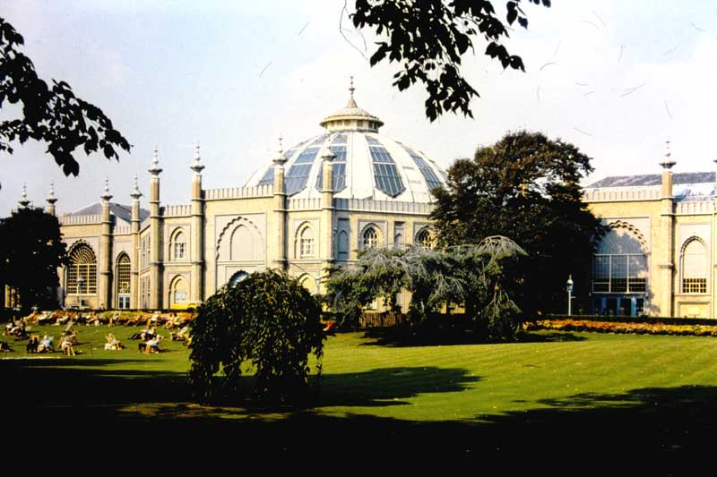
2. The Royal Pavilion Brighton – The Dome.

Slide 4
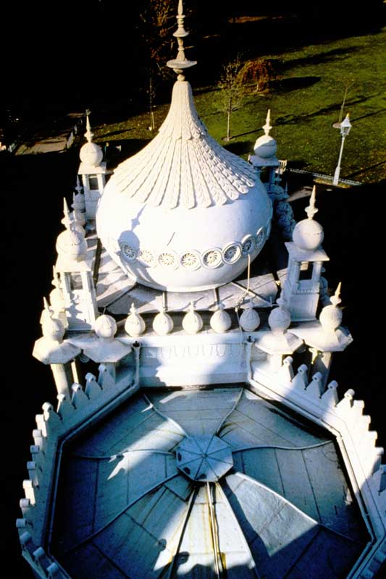
3. The Royal Pavilion Brighton –Roof of West Porch.

Slide 5
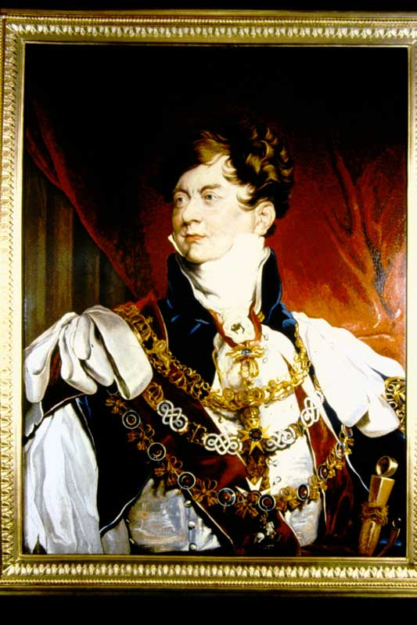
4. The Royal Pavilion Brighton – George IV in Coronation Robes.

Slide 6
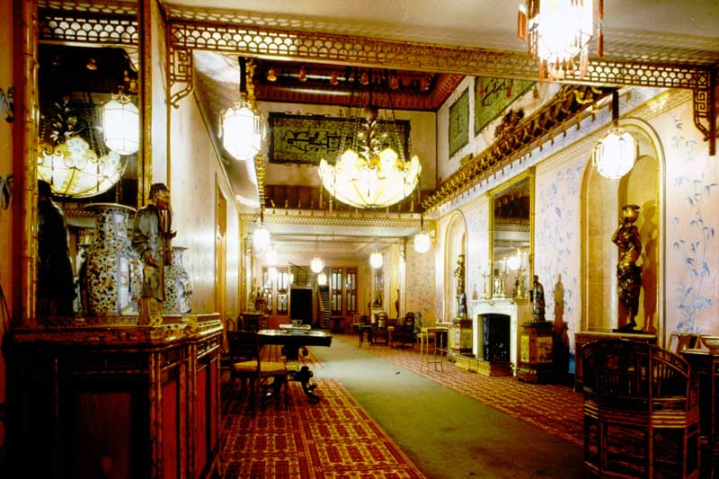
5. The Royal Pavilion Brighton – Corridor.

Slide 7
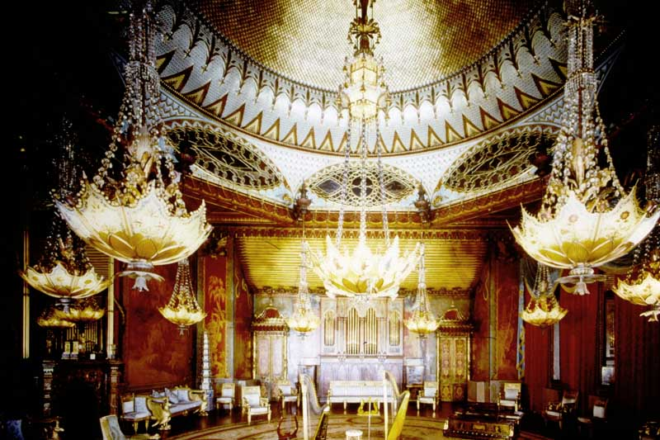
6. The Royal Pavilion Brighton – Music Room

Slide 8
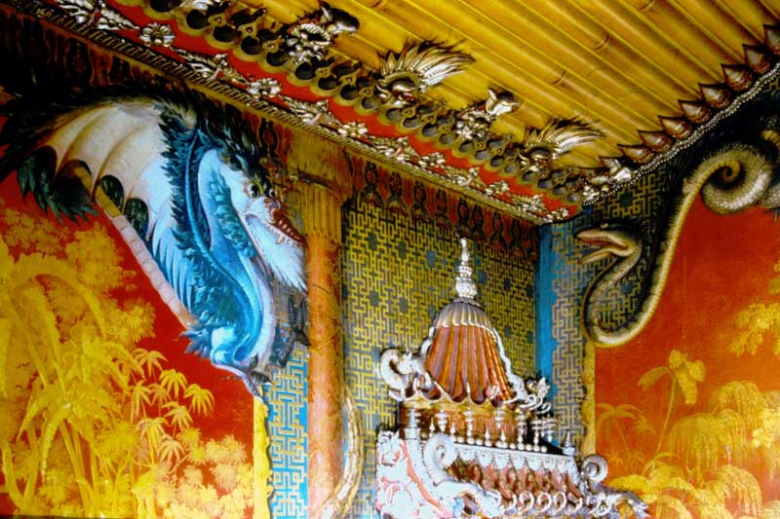
7. The Royal Pavilion Brighton – Music Room Panel

Slide 9
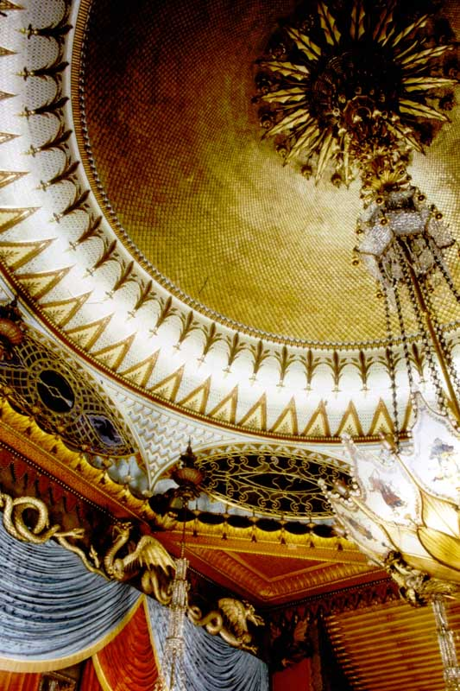
8. The Royal Pavilion Brighton – Music Room Ceiling.

Slide 10
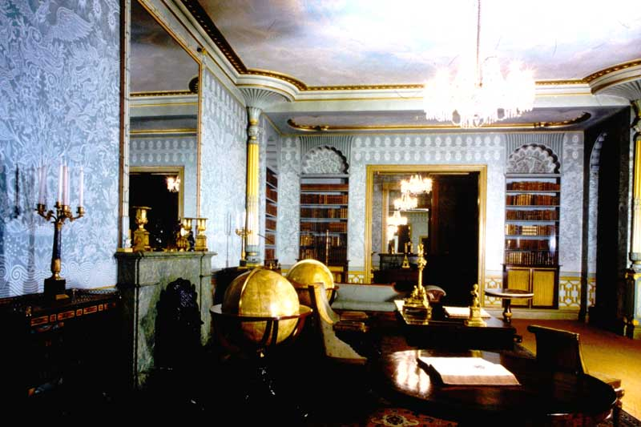
9. The Royal Pavilion Brighton – King’s Library.

Slide 11
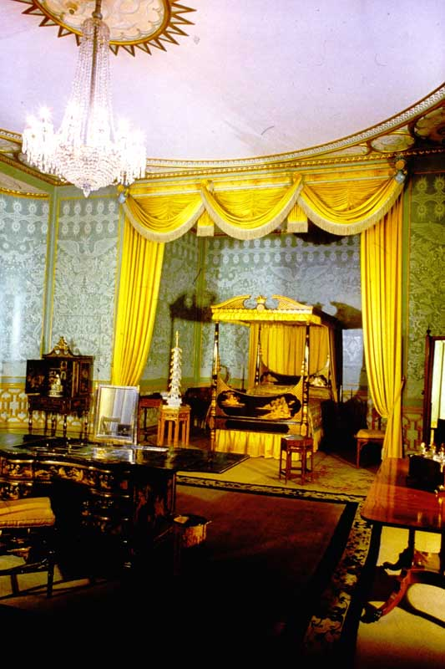
10. The Royal Pavilion Brighton – King’s Bedroom.

Slide 12
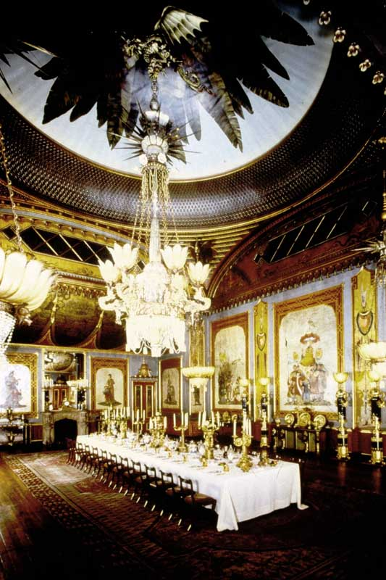
11. The Royal Pavilion Brighton – Banqueting Room.

Slide 13
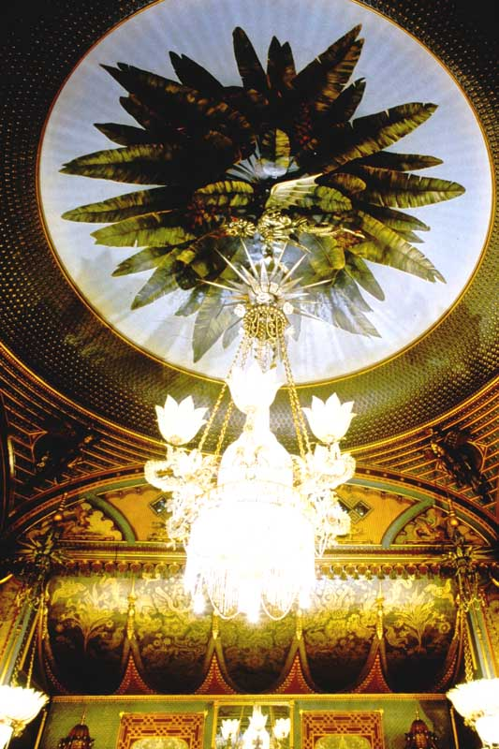
12. The Royal Pavilion Brighton - Banqueting Room Ceiling.

Slide 14
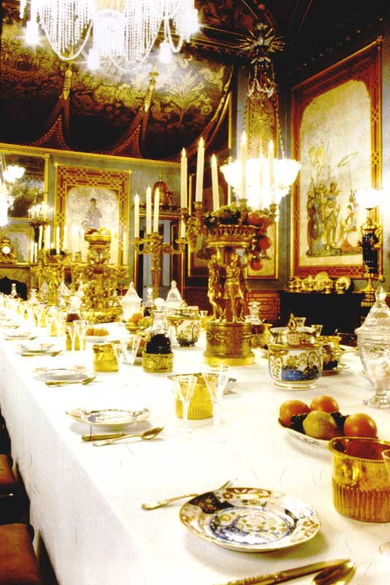
13. The Royal Pavilion Brighton – Banqueting Room Table.

Slide 15
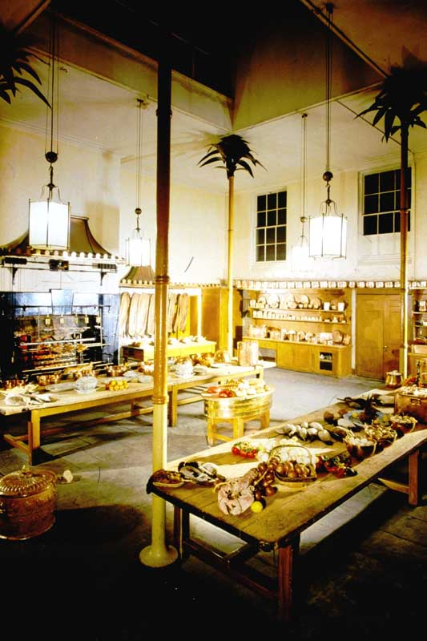
14. The Royal Pavilion Brighton – Kitchen.

Slide 16
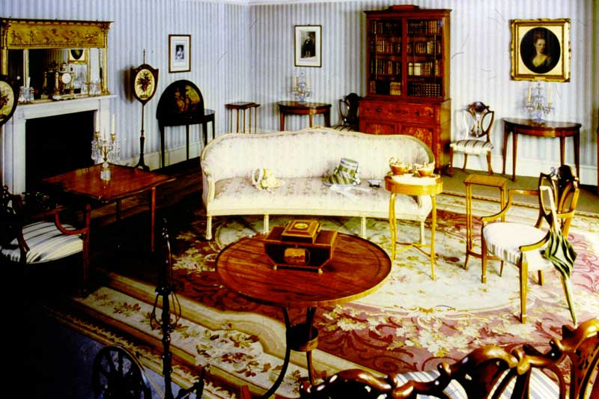
15. The Royal Pavilion Brighton – Mrs. Fitzherbert’s Room

Slide 17
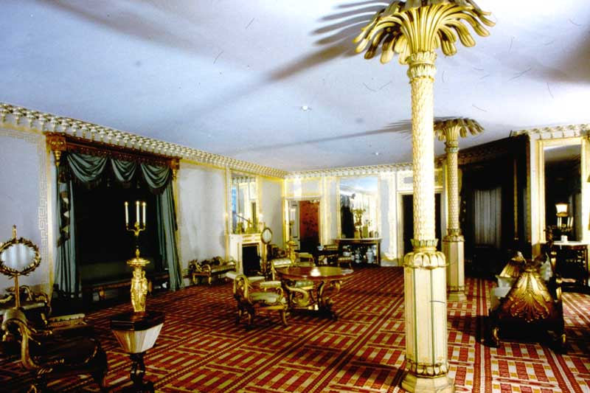
16. The Royal Pavilion Brighton – South Drawing Room.

Slide 18
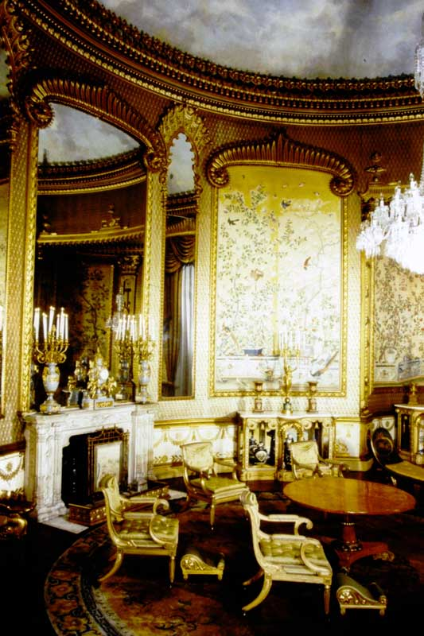
17. The Royal Pavilion Brighton – Saloon.

Slide 19
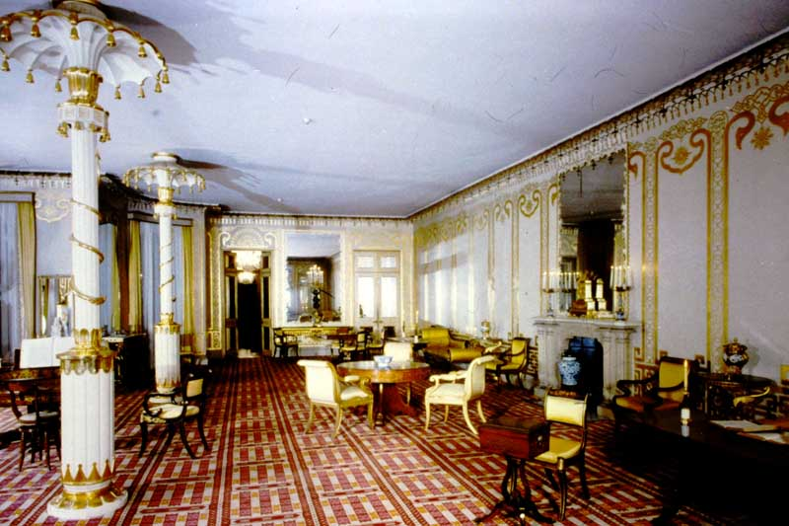
18. The Royal Pavilion Brighton – North Drawing Room.

Slide 20
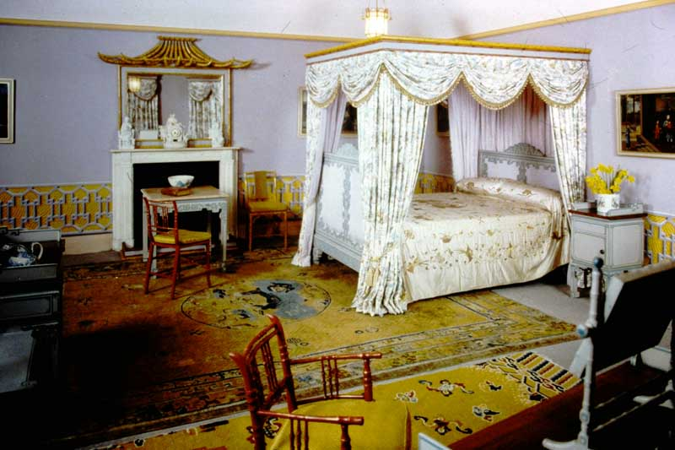
19. The Royal Pavilion Brighton – Princess Charlotte’s Bedroom.

Slide 21
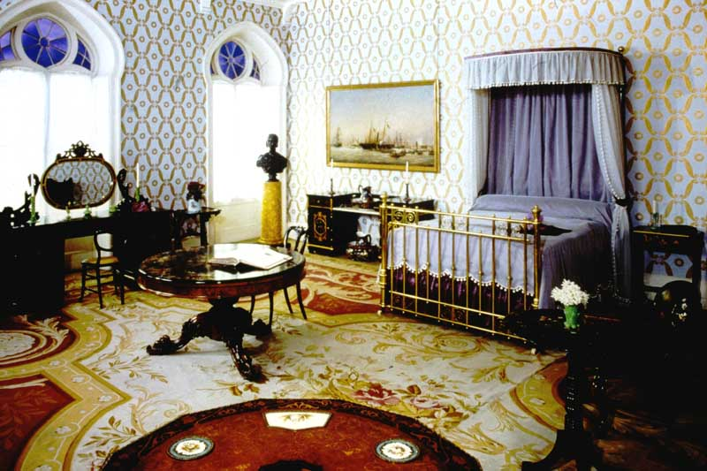
20. The Royal Pavilion Brighton – Queen Victoria’s Bedroom.

Slide 22
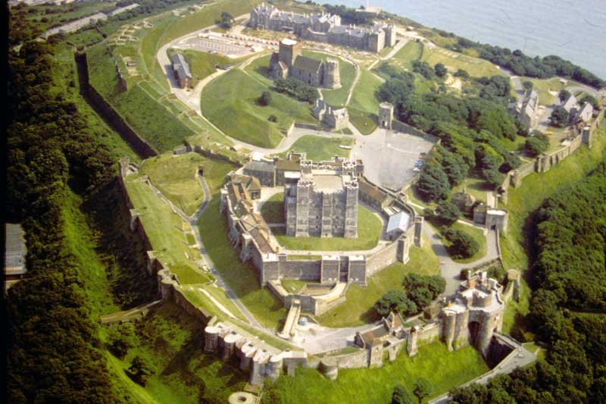
S84-17 Dover Castle, Kent. Air View from Northwest.

Slide 23
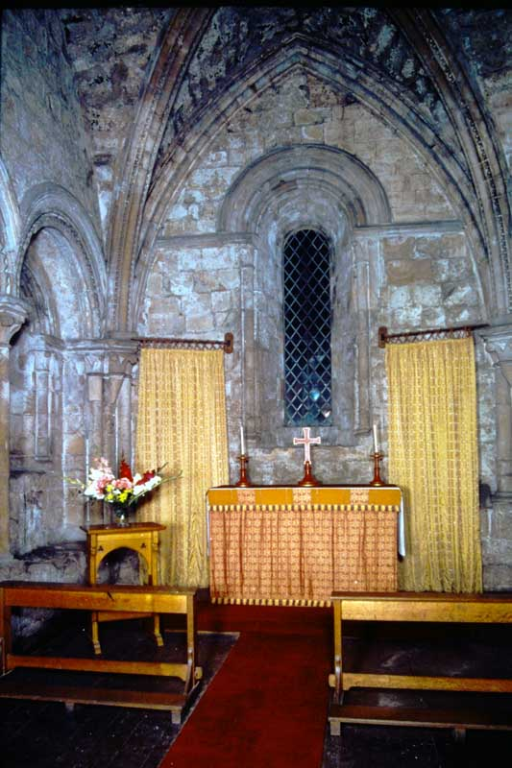
57. Dover Castle, Kent Upper Chapel in Keep.

Slide 24
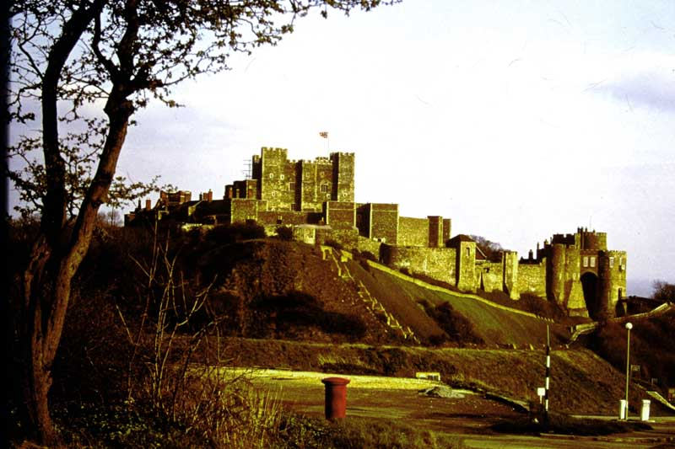
254. Dover Castle, Kent. View from Northwest, with Keep and Constable’s Gate

Slide 25
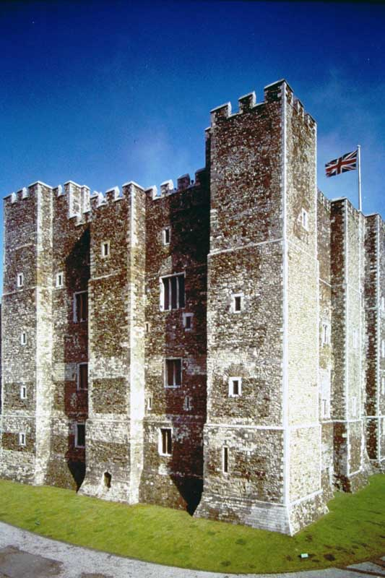
514. Dover Castle, Kent. Keep from West.

Slide 26
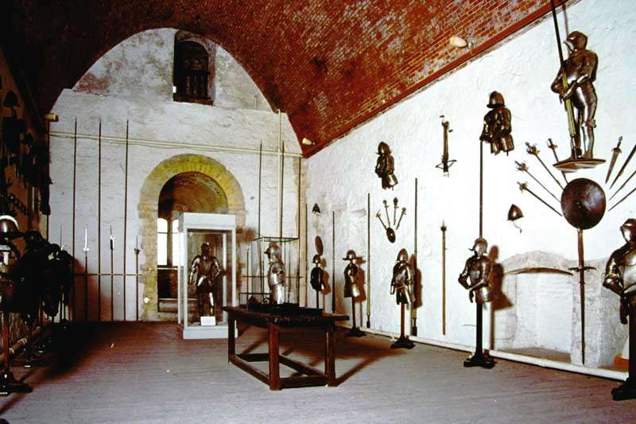
580. Dover Castle, Kent. Keep, East Hall on 2nd floor.

Slide 27
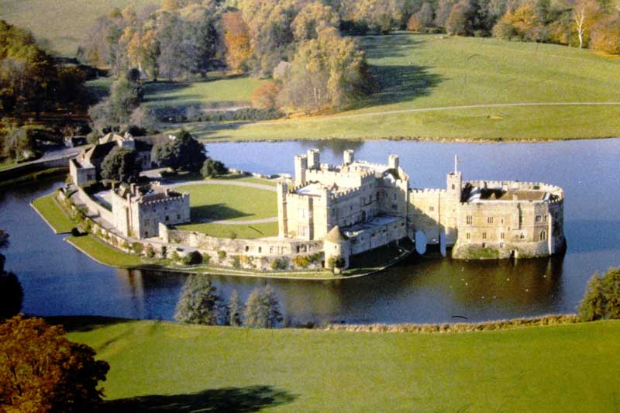
1. Leeds Castle, Kent, and its lake from the park.

Slide 28
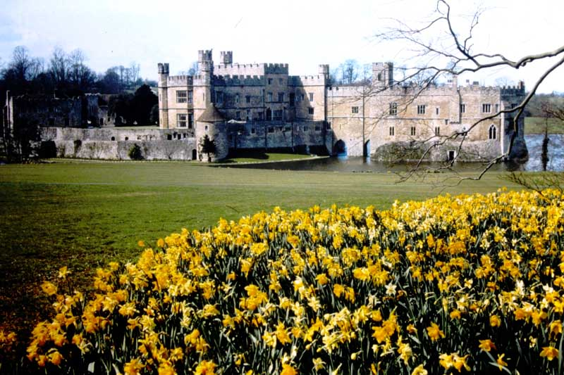
2. Leeds Castle, Kent. Daffodil time at Leeds castle.

Slide 29
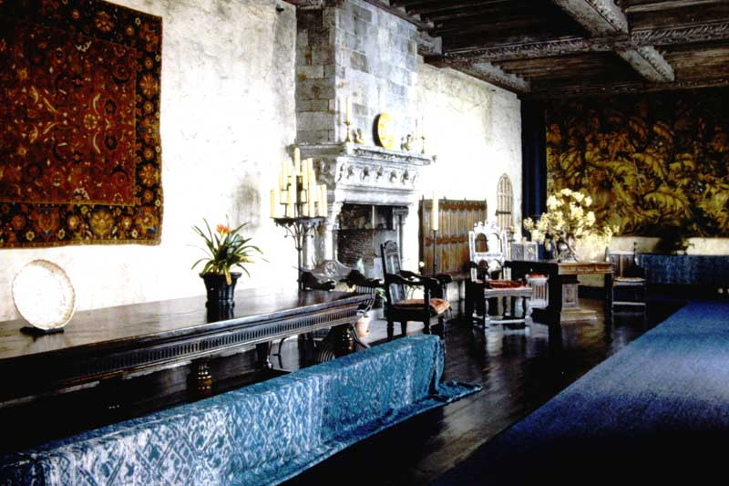
3. Leeds Castle, Kent. Henry VIII’s Banqueting Hall.

Slide 30
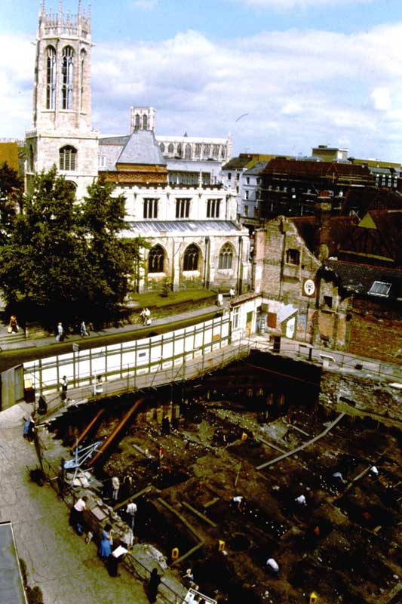
AY1. COPPERGATE EXCAVATIONS – Excavation of Viking-age layers in progress.

Slide 31
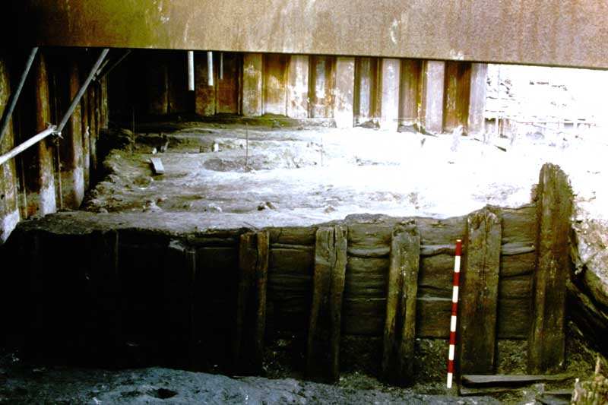
AY2. COPPERGATE EXCAVATIONS – Wall of late 10th century house (scale: 1m)

Slide 32
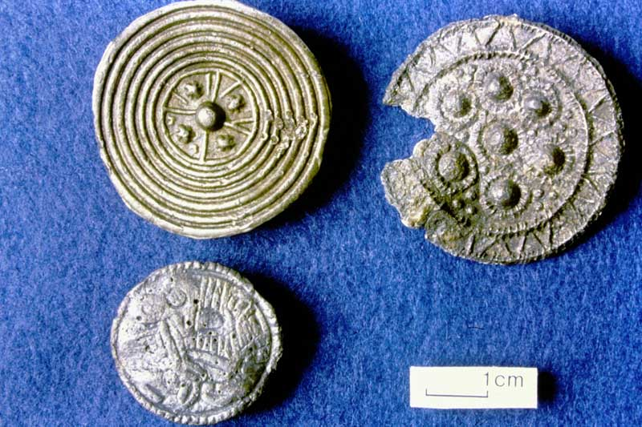
AY3. COPPERGATE EXCAVATIONS – 10th century silver (top left) and lead alloy disc brooches.

Slide 33
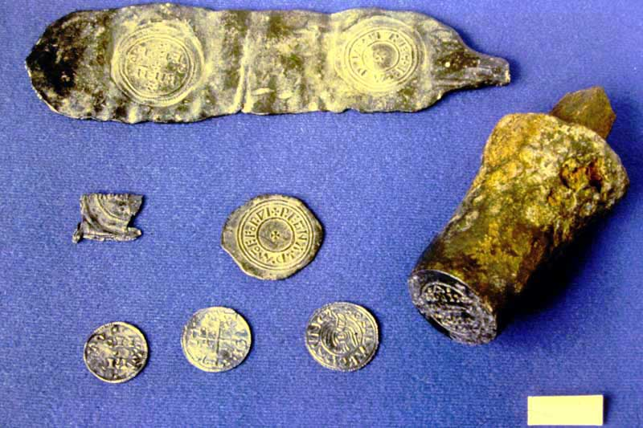
AY4. COPPERGATE EXCAVATIONS – 10th century coin die, lead trial pieces and silver pennies.

Slide 34
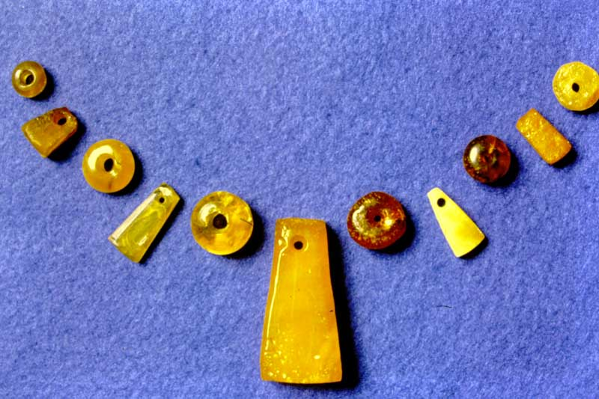
AY5. COPPERGATE EXCAVATIONS – 10th Century amber jewelry.

Slide 35
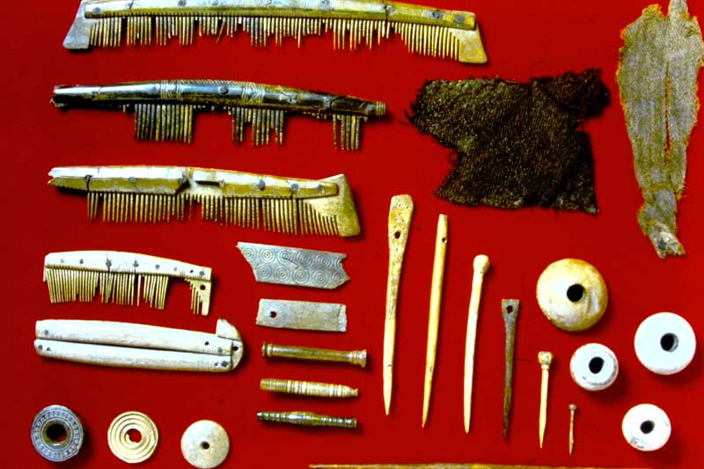
AY6. COPPERGATE EXCAVATIONS – 10th Century bone and antler combs, pins, spindle whorls and textiles.

Slide 36
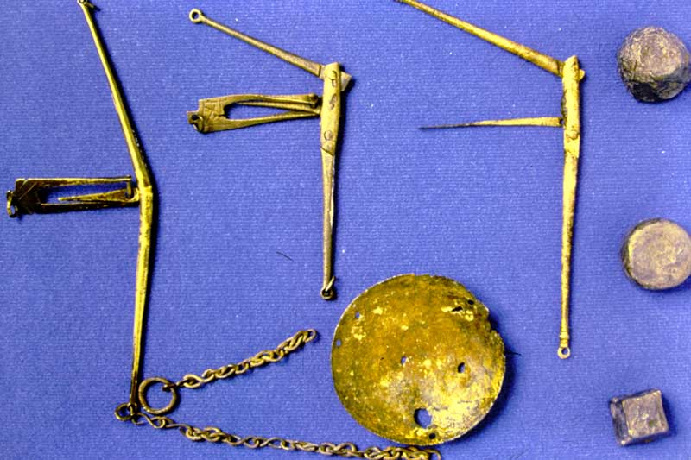
AY7. COPPERGATE EXCAVATIONS – 10th Century folding scales, pan and lead weights.

Slide 37
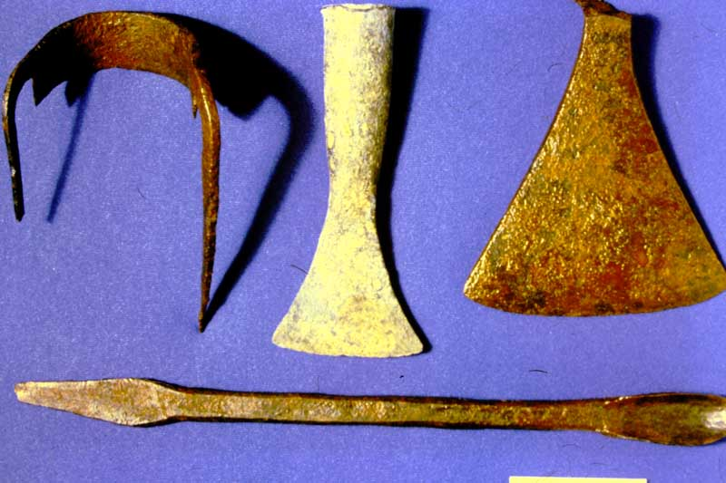
AY8. COPPERGATE EXCAVATIONS – 10th Century woodworking tools: draw knife, chisel, axe and bit.

Slide 38
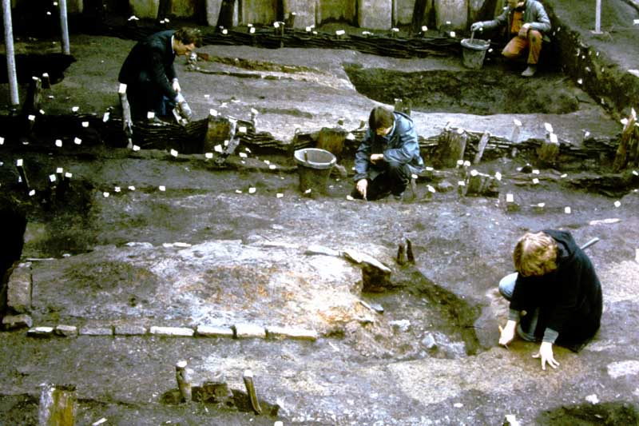
AY9. COPPERGATE EXCAVATIONS – Wattle buildings c. 900-950 under excavation.

Slide 39
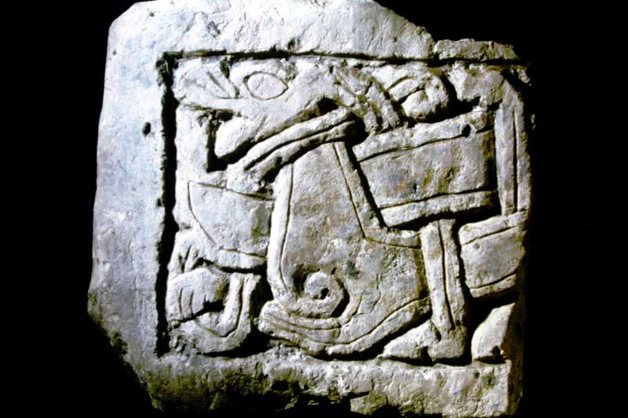
AY10. COPPERGATE EXCAVATIONS – Grave cover fragment with animal interlace c. 950.

Slide 40
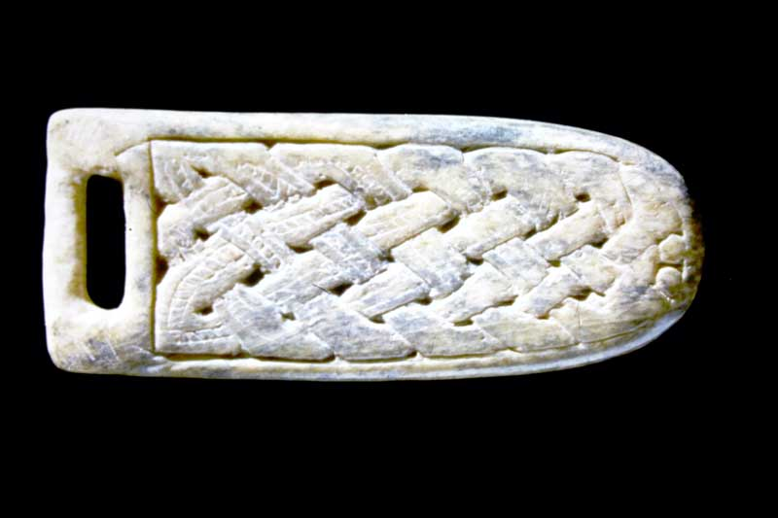
AY11. COPPERGATE EXCAVATIONS – 10th Century decorated bone strap-end. Length 6cm.

Slide 41
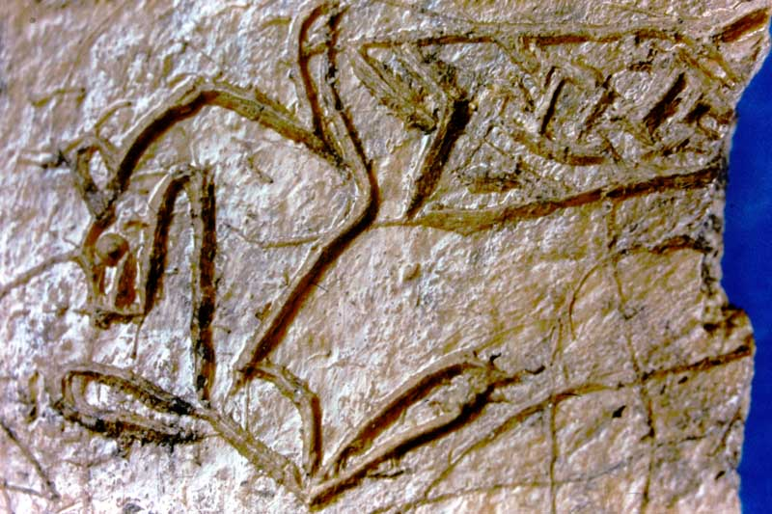
AY12. COPPERGATE EXCAVATIONS – 10th Century artist’s bone trial-piece. (detail).

Slide 42
END OF BOX 7.

