Slide 1
THE ROYAL BOTANICAL GARDENS, KEW PALACE, STONEHENGE
These slides are from the estate of Paul Berthelot who found the English culture and architecture intriguing. He acquired these images while stationed in England serving in the US Air Force.

Slide 2
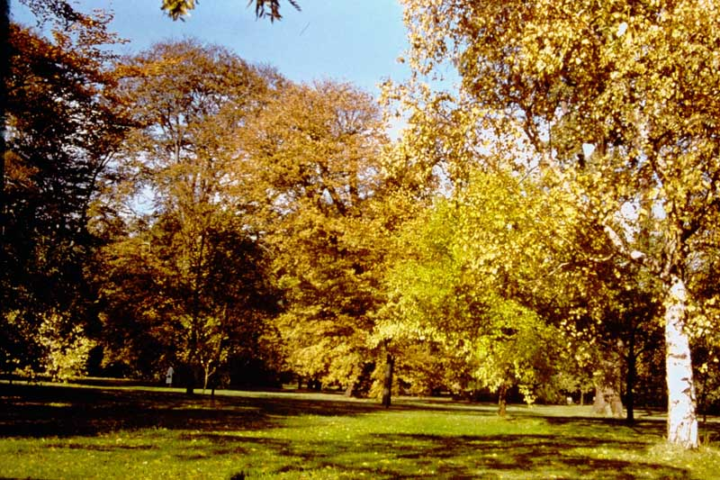
1. Arboretum: Autumn scene showing leaf coloring of Silver Birch, Beech, Elm, popular and other trees

Slide 3
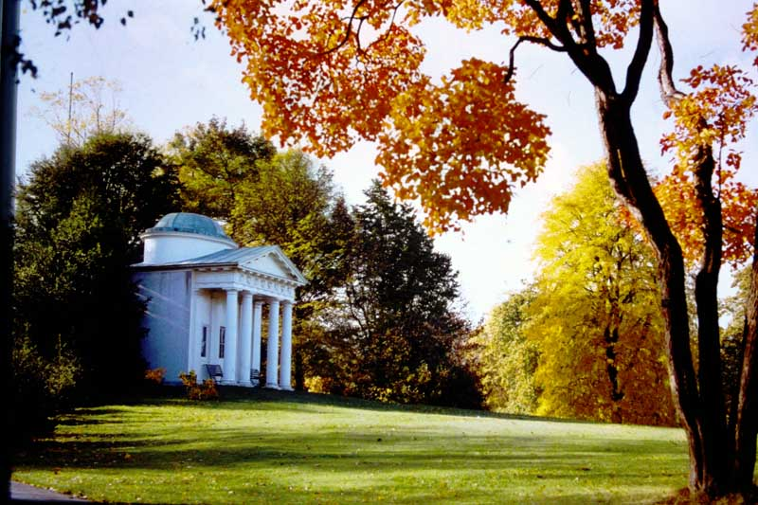
2. Temple of Bellion's and Sumac tree in Autumn

Slide 4
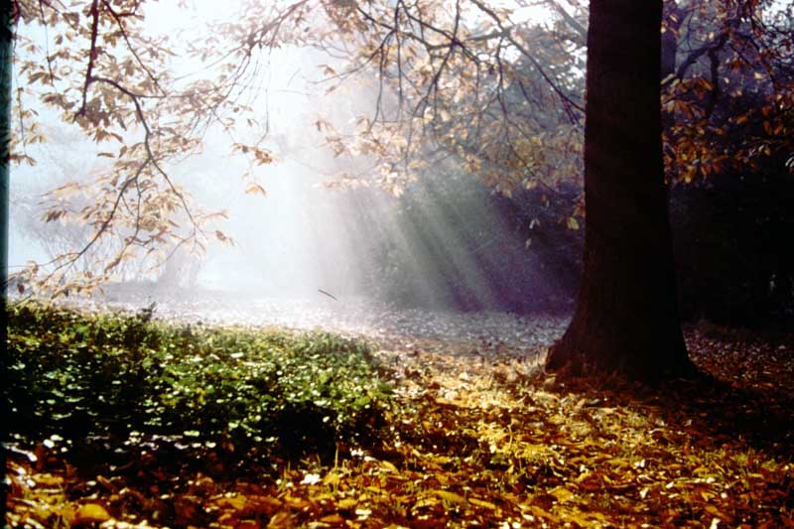
3. Autumn scene in the Arboretum; leaf fall of the Sweet Chestnut.

Slide 5
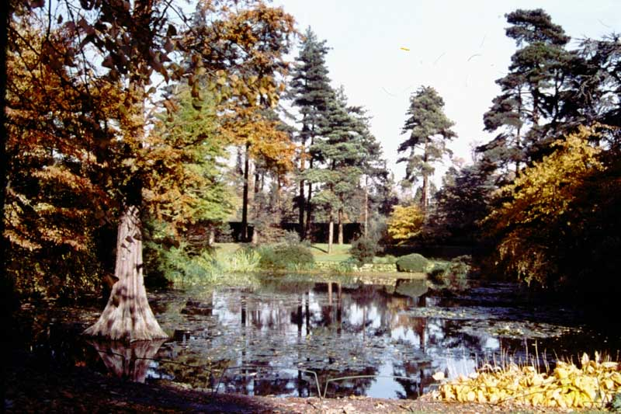
4. Lily Pond in the Arboretum; autumn scene with water lilies, Swamp Cypress in water and Pine trees in background.

Slide 6
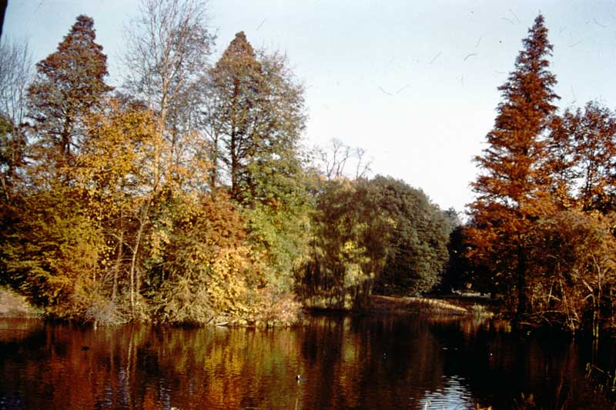
5. Lake in Autumn: trees of Alder, Swamp Cypress and Popular fringing lake, and evergreen Oak in background.

Slide 7
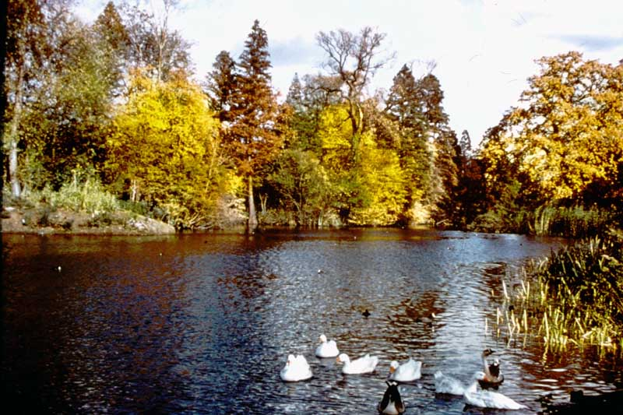
6. Lake in Autumn: fringed with trees of Alder, Popular, Swamp Cypress and Oak; Ornamental water fowl in foreground.

Slide 8
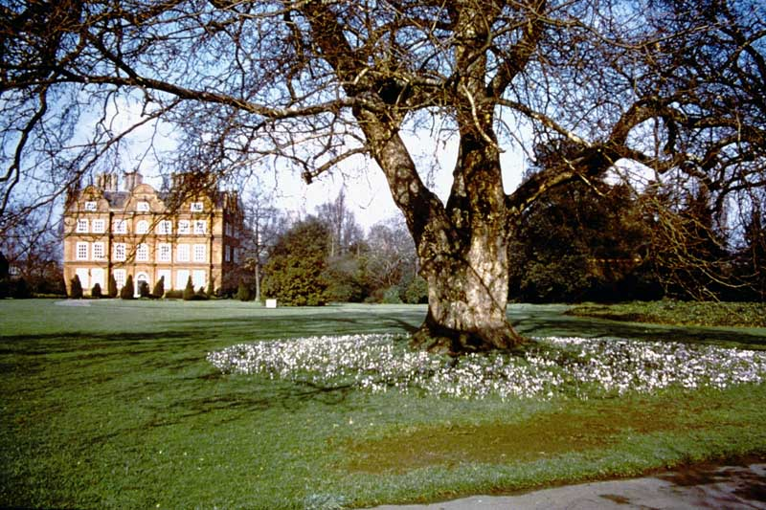
7. Kew Palace (Erected 1631) in early spring with Crocus in flower beneath the Oriental Plane, the later planted in 1762.

Slide 9
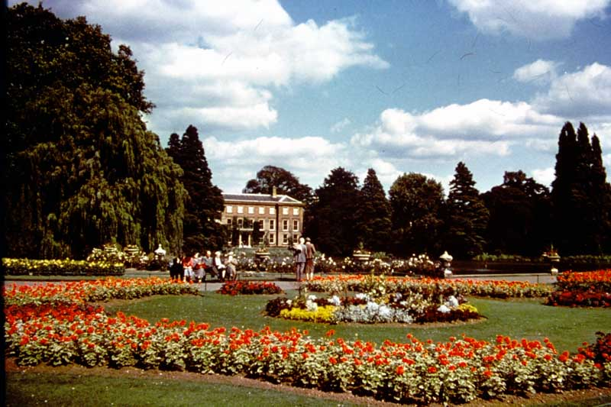
9. Summer bedding in front of Palm House; beds of Pelargoniums, Begonias, Dahlias and subtropical foliage plants. General Museum in background.

Slide 10
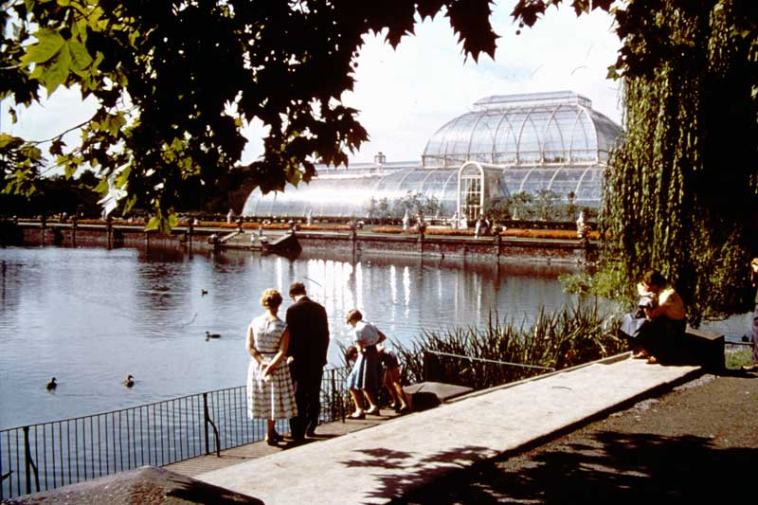
10. Palm House (erected 1844-48); view from steps on north side of Pond, with Weeping Willow to right.

Slide 11
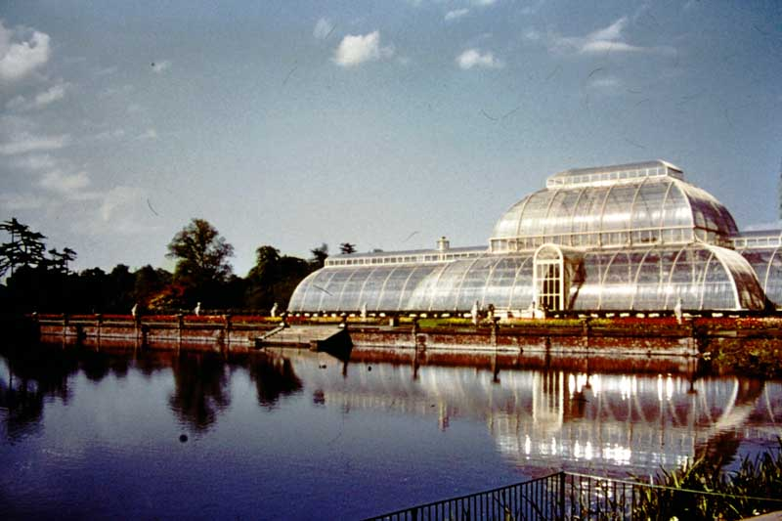
11. Palm House (erected 1844-48); view from steps on north side of Pond showing spring bedding (Tulips, etc.) and Queen’s Beasts at foot of the Terrace.

Slide 12
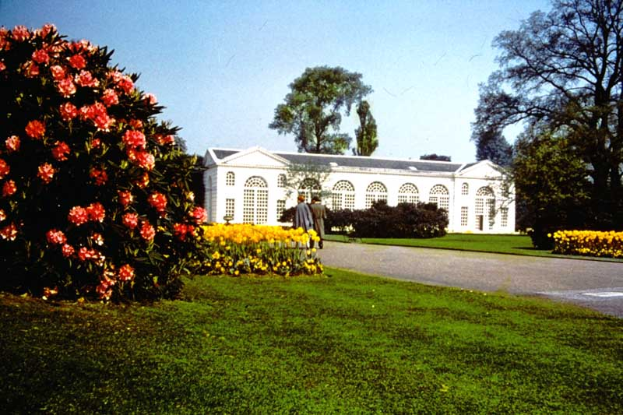
13. Orangery (erected 1761); view from Broad Walk, with beds of Tulips and Pansies, Rhododendron “Countess Fitzwilliam”, and large Elms.

Slide 13
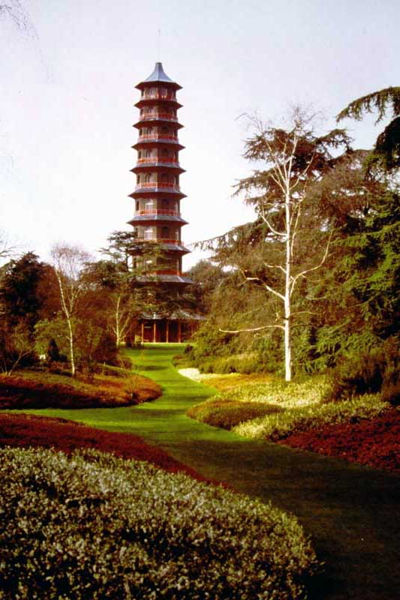
16. Pagoda viewed from Heath Garden. The Pagoda was built in 1761 for Princess Augusta to Chambers’ design.

Slide 14
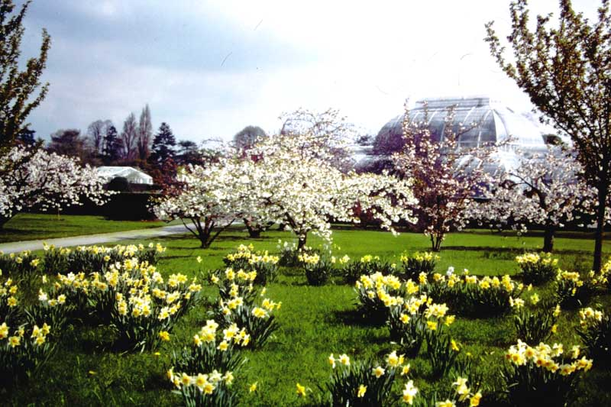
17. Spring scene: Daffodils and Japanese Cherries with the Palm House in the background. The Palm House was built between 1844-48.

Slide 15
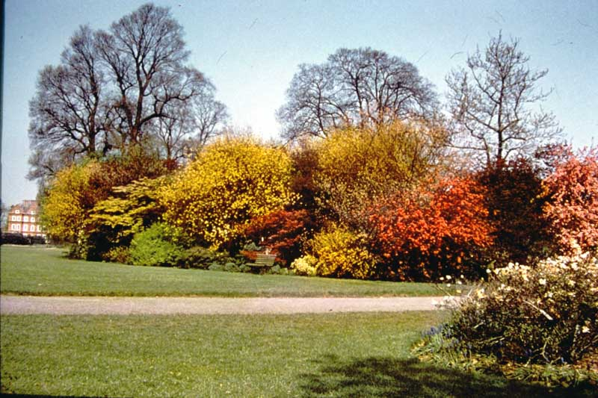
18. Shrubs and trees with colored foliage; with Magnolia stellata in flower; Kew Palace in distance.

Slide 16
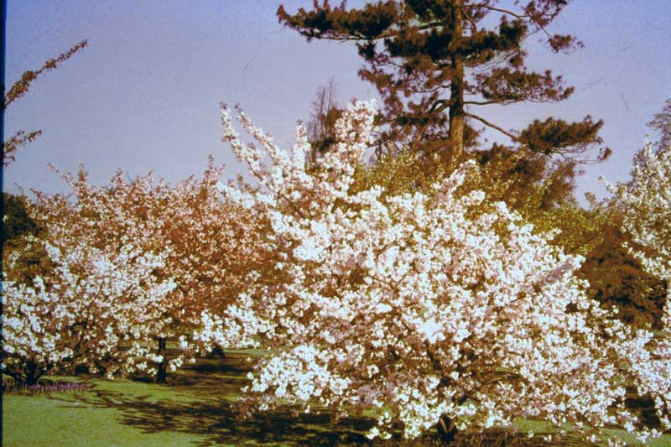
19. Varieties of Japanese Cherries (Prunus serrulata) flowering in Spring, under-planted with Grape Hyacinth (Muscari armeniacum).

Slide 17
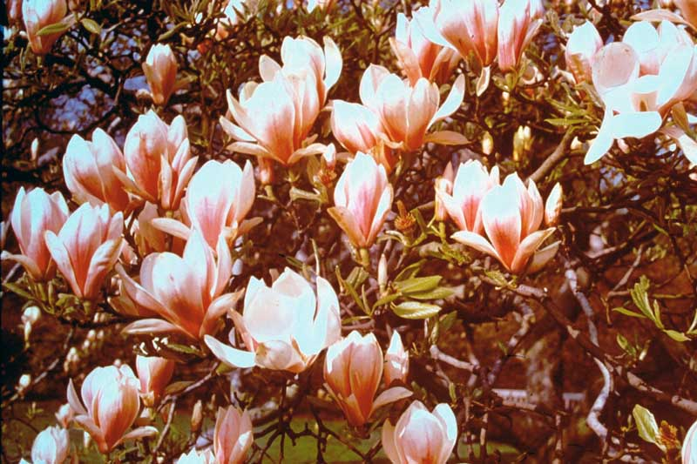
21. Magnolia soulangiana, a hybrid between M. denudata and M. liliflora, a small tree lowering April to May.

Slide 18
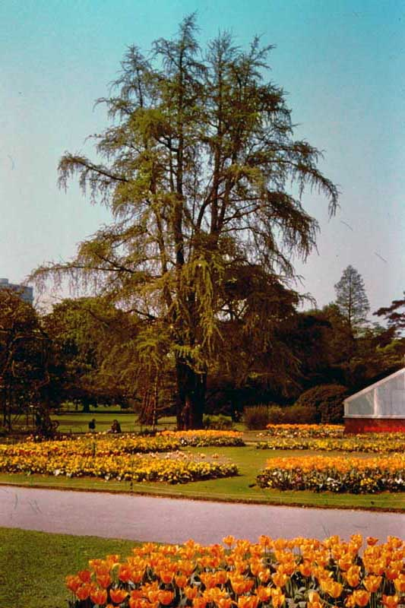
23. Spring bedding of Tulips and Pansies, with Maidenhair Tree (Ginkgo bilboa), Planted 1762.

Slide 19
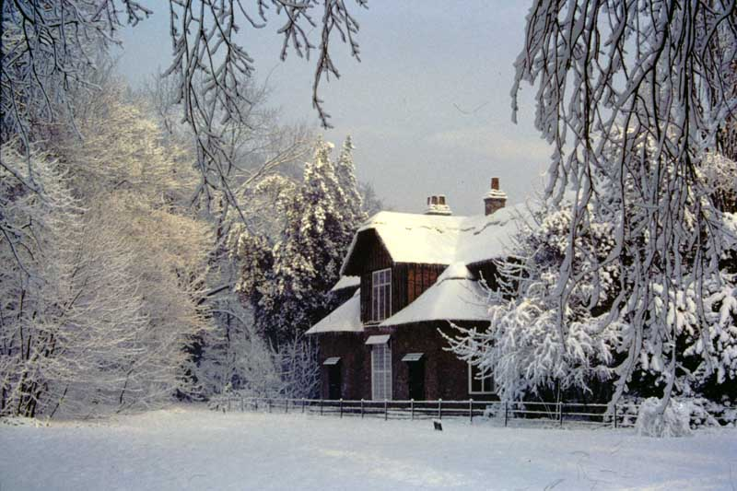
24. Winter scene in Woodland, with Queen’s Cottage (built c. 1770).

Slide 20
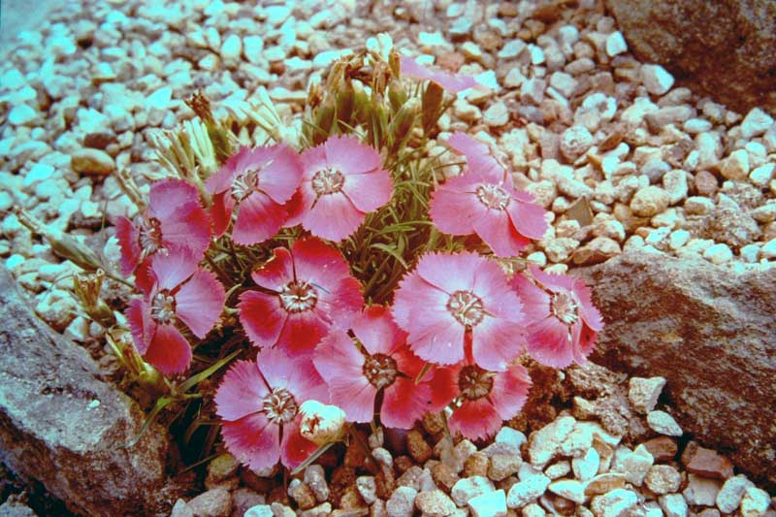
25. Dianthus neglectus, a wild alpine pink of Europe, flowering in June.

Slide 21
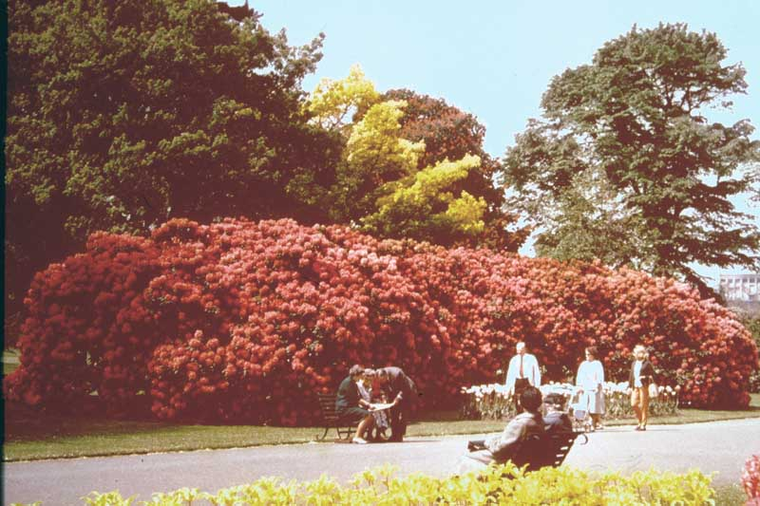
26. Spring scene in the Broad Walk, with Tulips, Rhododendron “Lord Palmerston” and Elm, Oak and Chestnut in background.

Slide 22
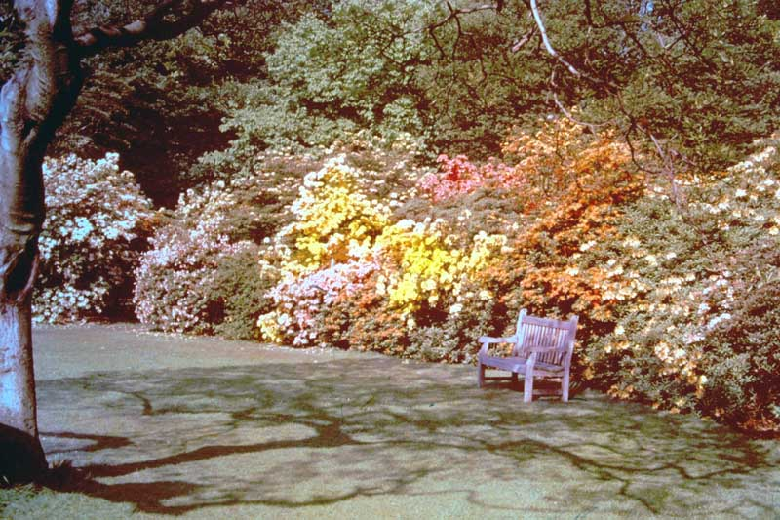
27. Azalea Garden, in May with fragrant deciduous hybrids and species of Rhododendron (azalea group).

Slide 23
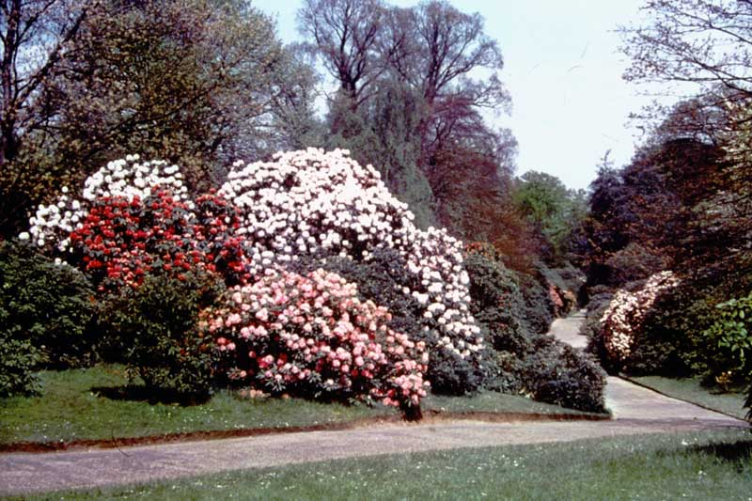
26. Rhododendron Dell with numerous Rhododendron hybrids flowering in May.

Slide 24
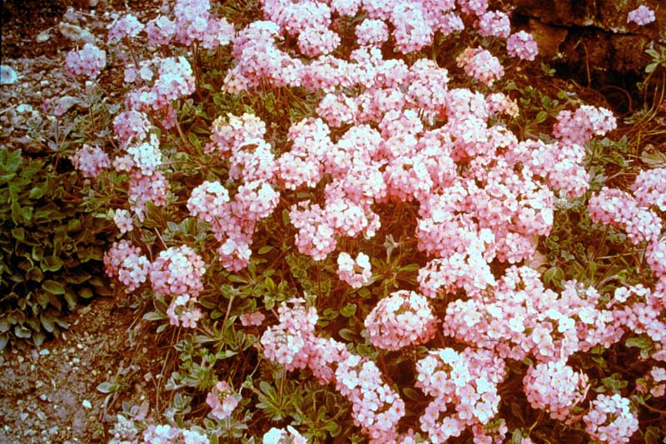
29. Androsace sarmentosa var. yunnanensis, a creeping alpine, native of Western China, flowering in May.

Slide 25
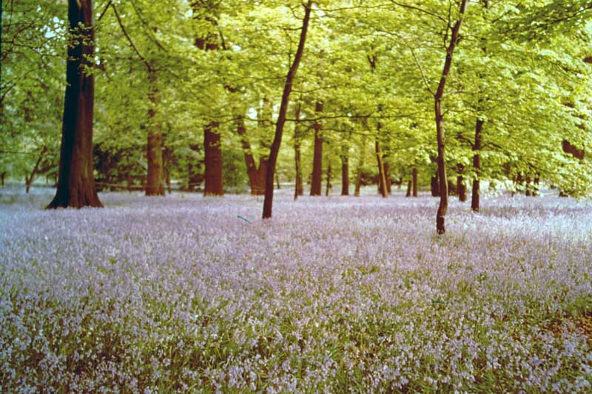
30. Bluebells (Hyacinthoides non-scripta) in Beech Woodland, Queens Cottage grounds, flowering in May.

Slide 26
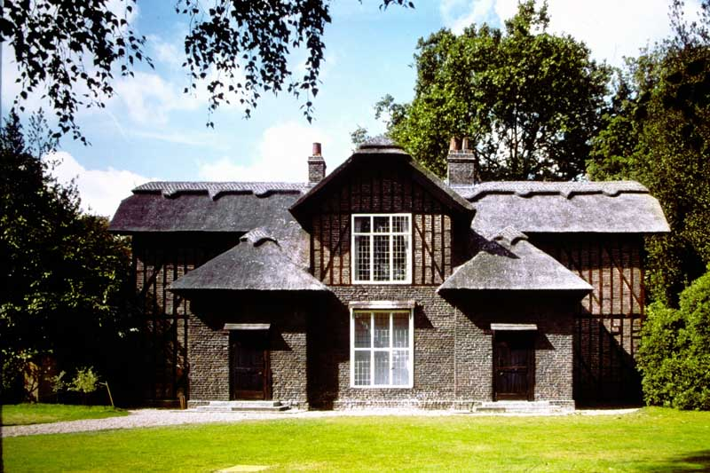
63X. Kew Gardens. Queen Charlotte’s Cottage.

Slide 27
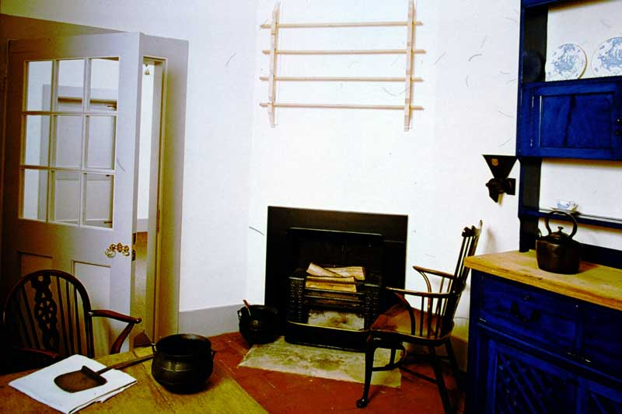
785. Kew Gardens. Queen Charlotte’s Cottage. The Kitchen.

Slide 28
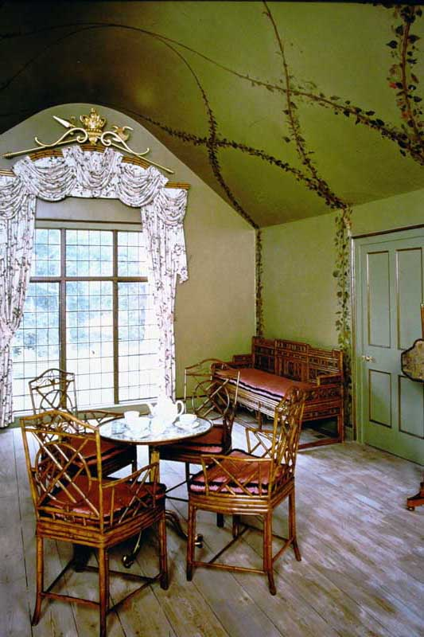
786. Kew Gardens. Queen Charlotte’s Cottage. Picnic Room.

Slide 29
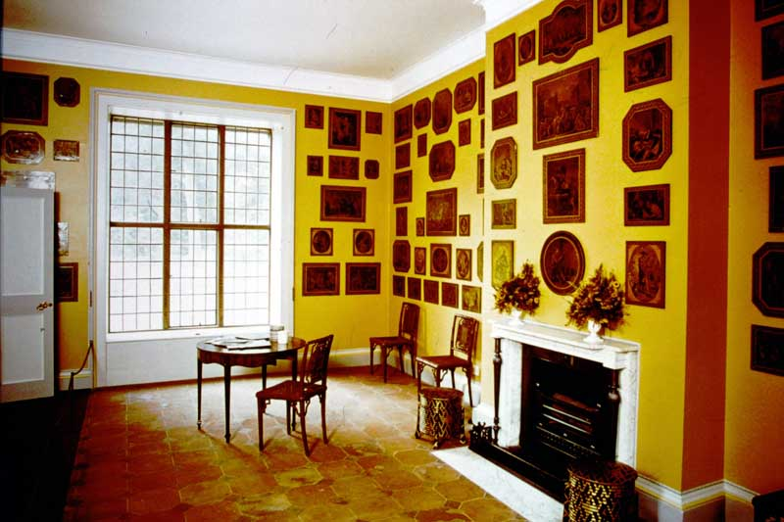
S84-12 Kew Palace. Queen Charlotte’s Cottage, The Print Room.

Slide 30
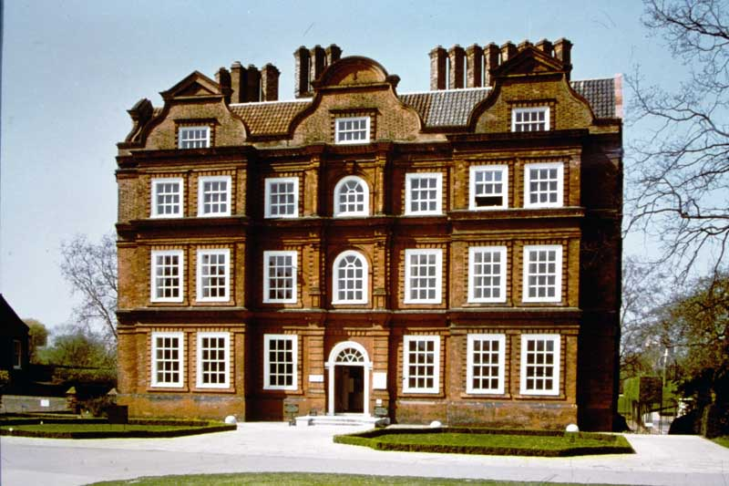
58. KEW PALACE, LONDON.

Slide 31
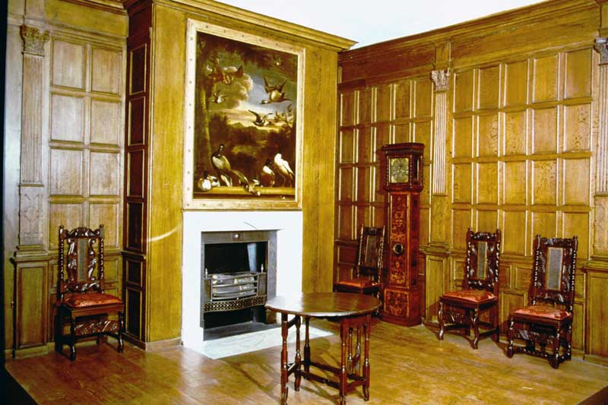
496. Kew Palace. London. The King’s Breakfast Room.

Slide 32
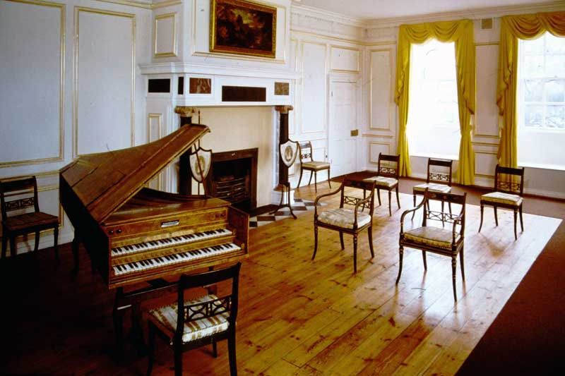
719. Kew Palace, London. The Queens Drawing Room.

Slide 33
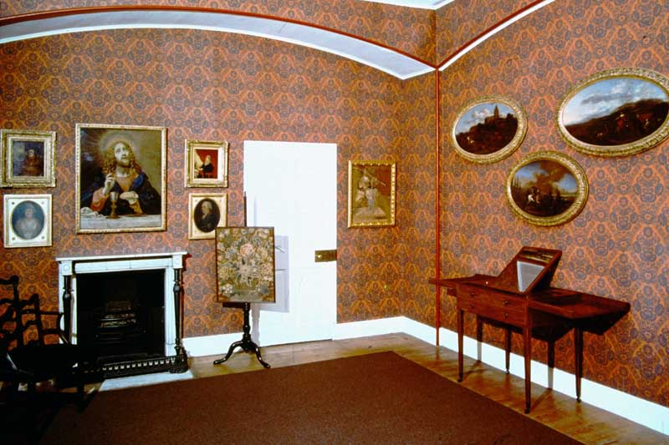
720. Kew Palace, London. The King’s Bedchamber.

Slide 34
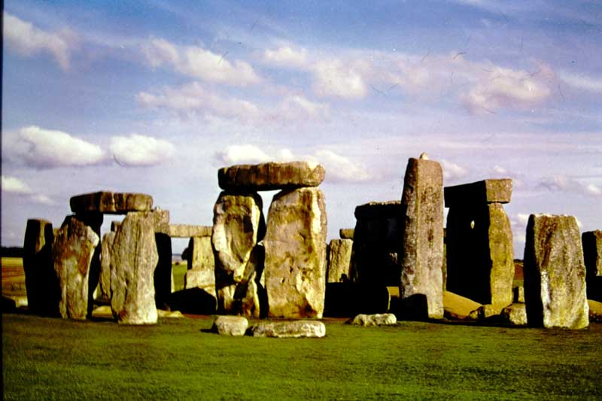
241. Stonehenge, Wiltshire. View from South West.

Slide 35
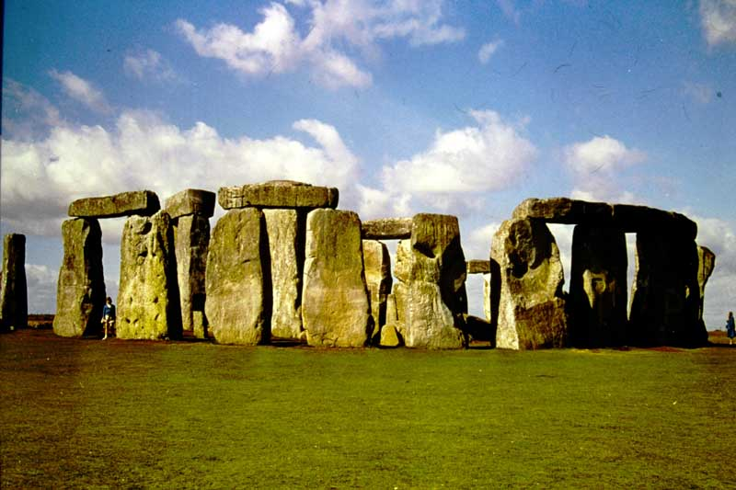
242. Stonehenge, Wiltshire. View from east.

Slide 36
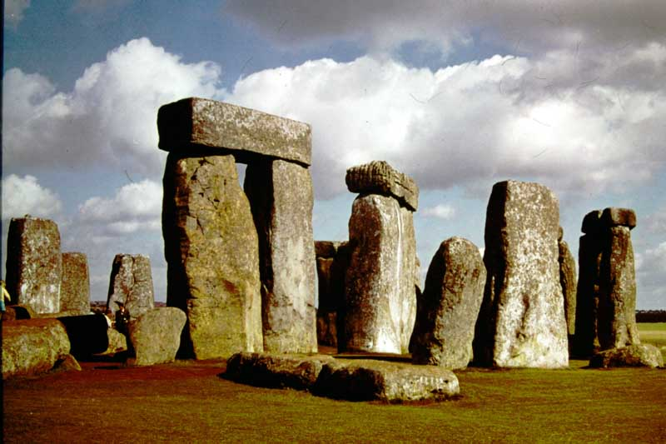
243. Stonehenge, Wiltshire. View looking northeast showing Trilithons 53-4 and 51-2

Slide 37
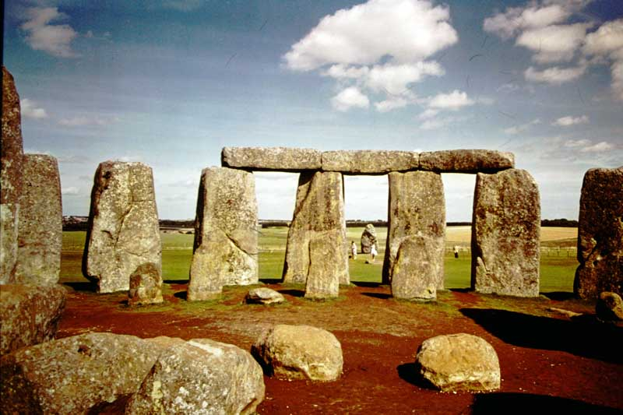
253. Stonehenge, Wiltshire. View looking east.

Slide 38
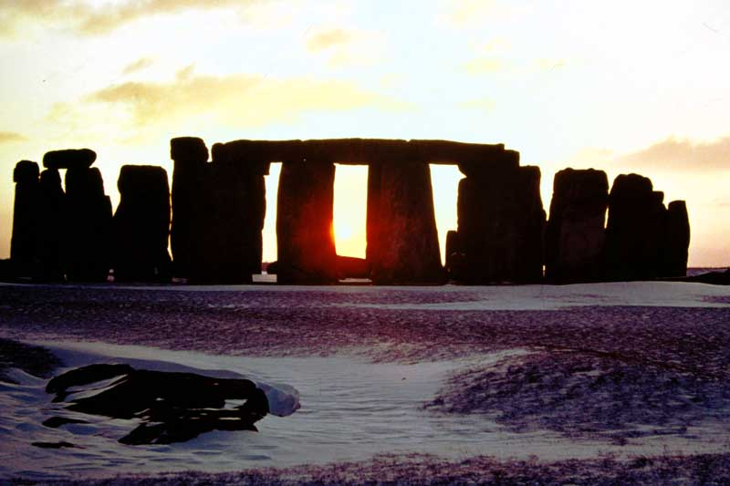
626. Stonehenge, Wiltshire. Winter Sunset.

Slide 39
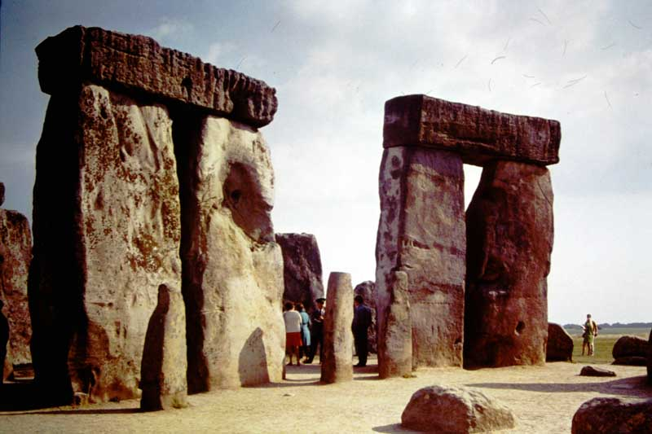
642. Stonehenge, Wiltshire. Two Sarsen Trilithons and uprights of the Bluestone Horseshoe.

Slide 40
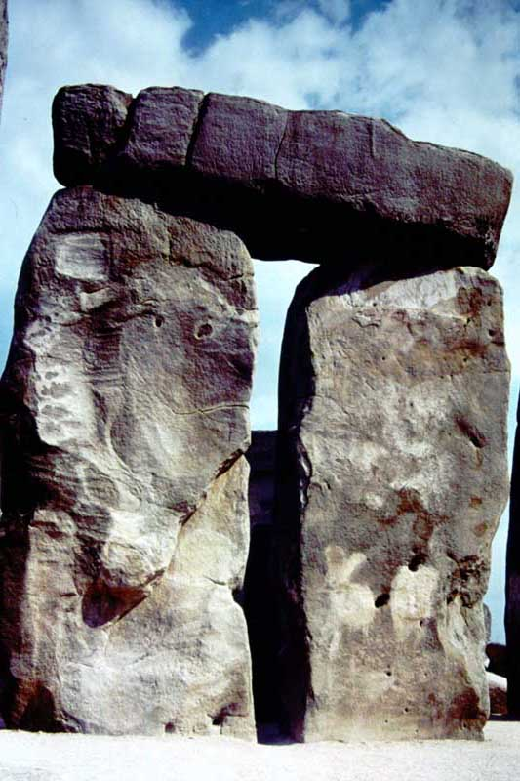
651. Stonehenge, Wiltshire. Trilithon 57, 58, 158.

Slide 41
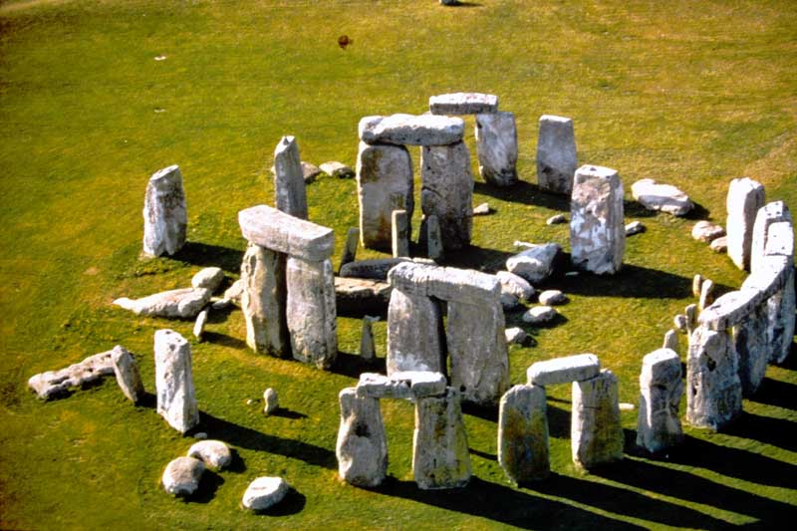
757. Stonehenge, Wiltshire. Aerial View of the center from the southeast.

Slide 42
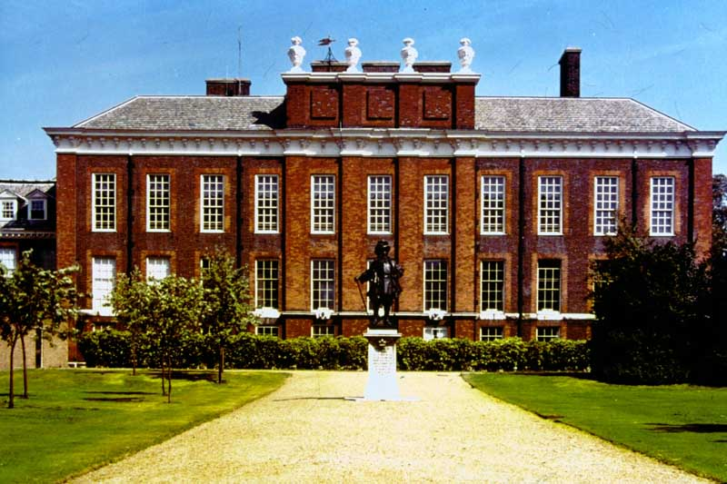
KNP-1 Kensington Palace. London. The South Front.

Slide 43
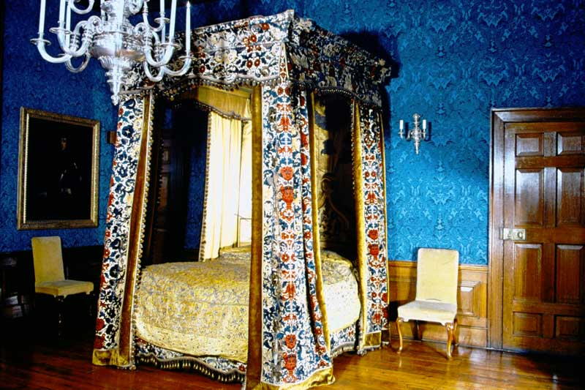
KNP-2 Kensington Palace, London. Queen Mary’s Bedchamber.

Slide 44
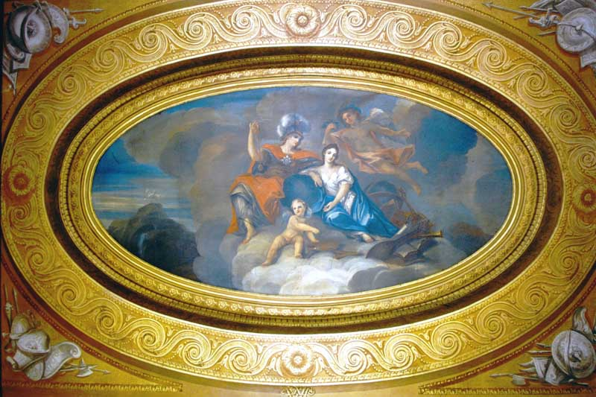
KNP-3. Kensington Palace, London. Ceiling of the privy Chamber.

Slide 45
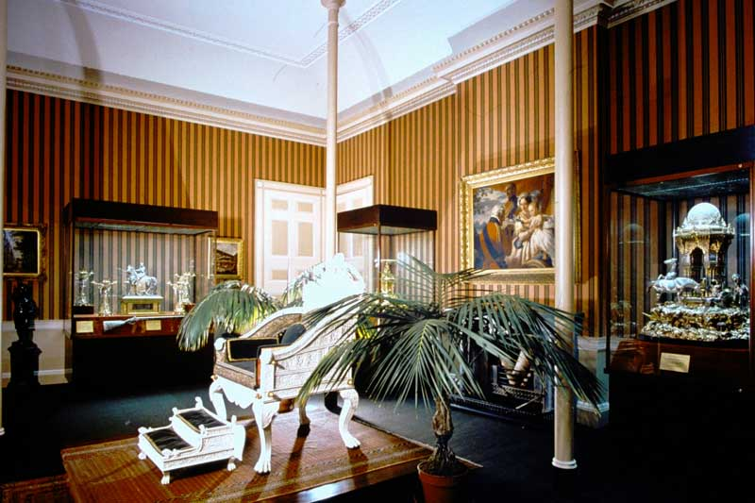
KNP-4 Kensington Palace, London. The Council Chamber.

Slide 46
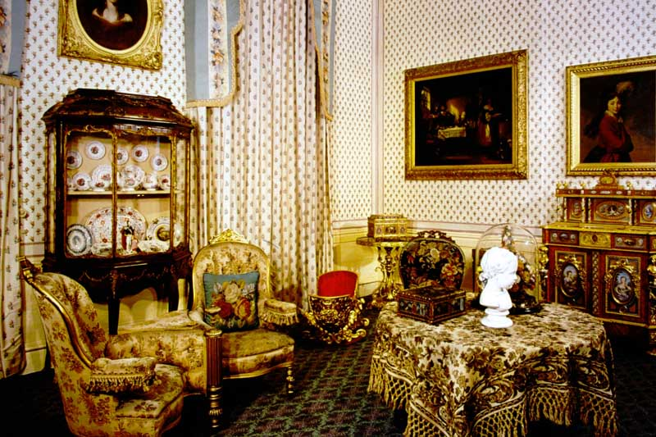
KNP-5 Kensington Palace, London. Duchess of Kent’s Dressing Room

Slide 47
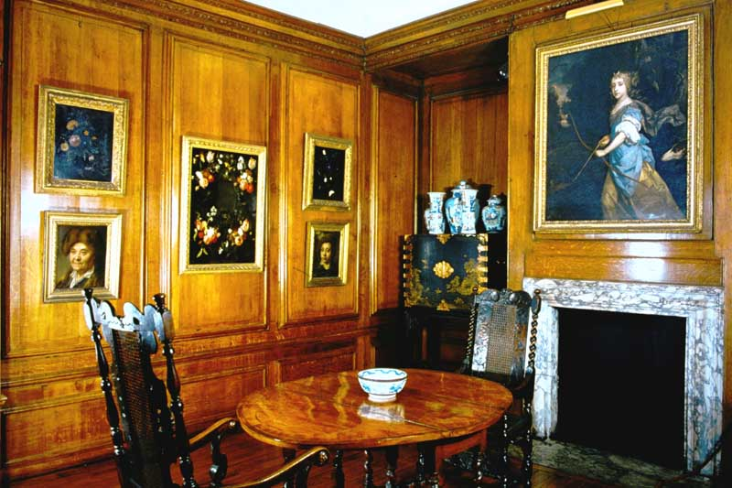
KNP-6 Kensington Palace, London. Queen Mary’s Dining Room.

Slide 48
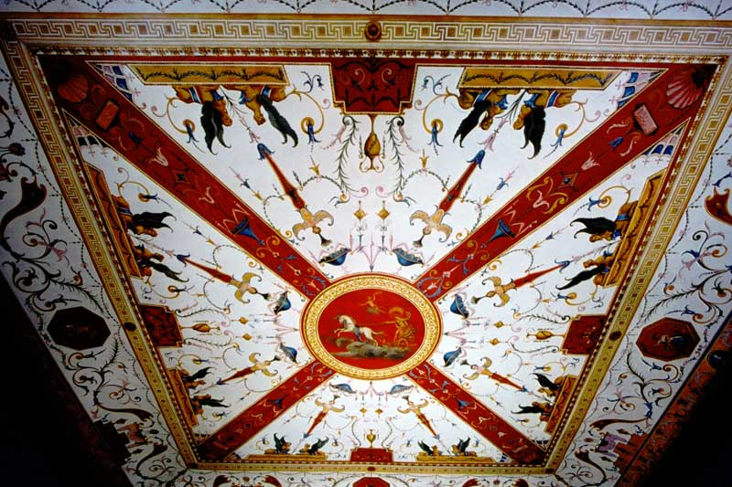
KNP-7 Kensington Palace, London. Ceiling of the Presence Chamber.

Slide 49
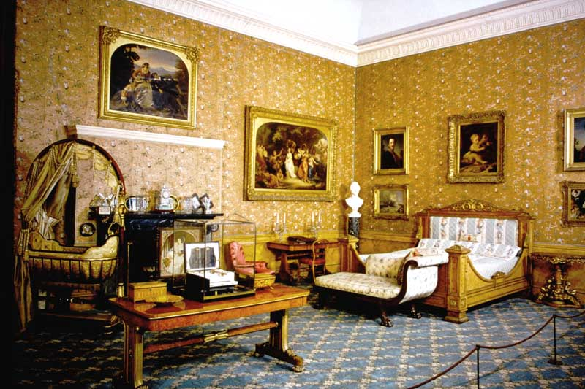
KNP-8 Kensington Palace, London. Queen Victoria’s Bedroom.

Slide 50
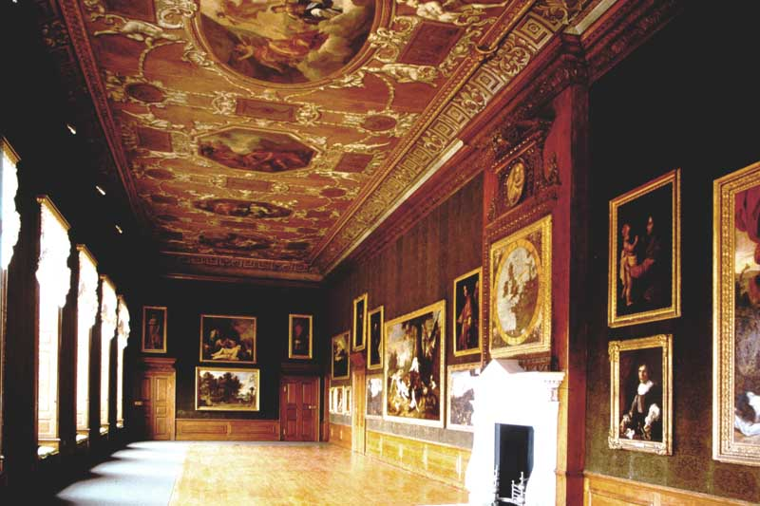
KNP-9 Kensington Palace, London. The King’s Gallery.

Slide 51
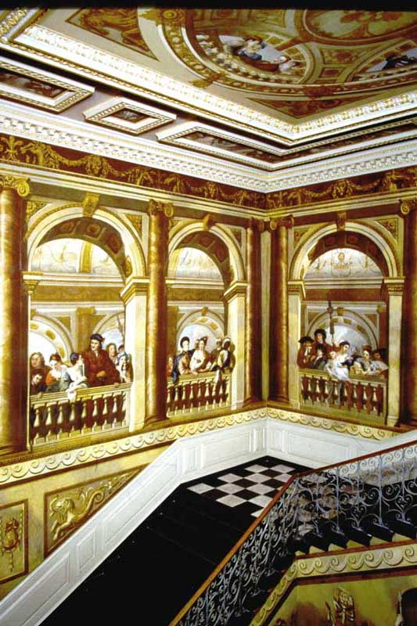
KNP-10 Kensington Palace, London. The King’s Staircase.

Slide 52
END OF SLIDE BOX 5

