Slide 1
47th Annual Rainbow of Gems 2014
Photos provided by
Bill Hood
Margaret Henson
Lee Reyburn
Vernon Deck
Prepared by Wes Lingerfelt

Slide 2
Another great success due to hard work and dedication.
Only a couple of incidents this year (That I know of)!
The show was well attended and the weather was fantastic.
The Snack Bar was more successful this year.
The Treasure Chest did better than last year.
The BBQ was less successful this year (only 78 tickets were sold; 1 was used but not paid for).
The Hospitality Booth and the Kids Booth did very well.
There were fewer Inside dealers and more outside dealers
over last year. The number of outside dealers grew to 50 while the inside dealers fell to 10 from 12 last year.
Diamond Pacific demonstrated a new grinder/polisher with 8 eight inch wheels. Once again the displays were phenomenal.

Slide 3
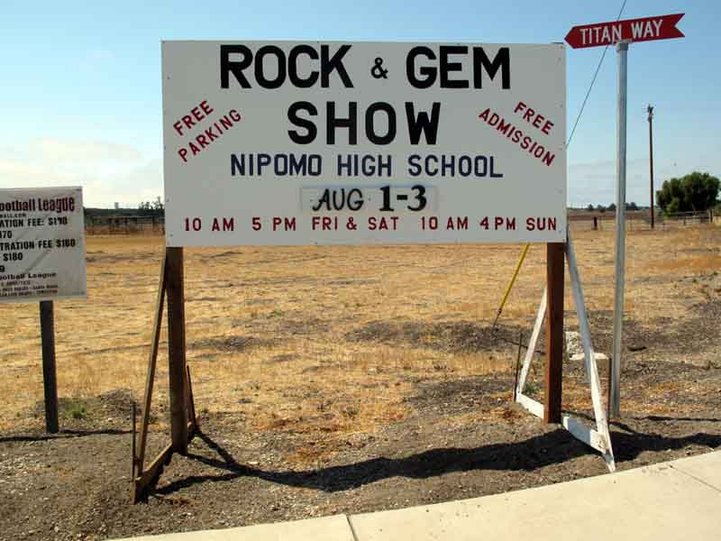

Slide 4
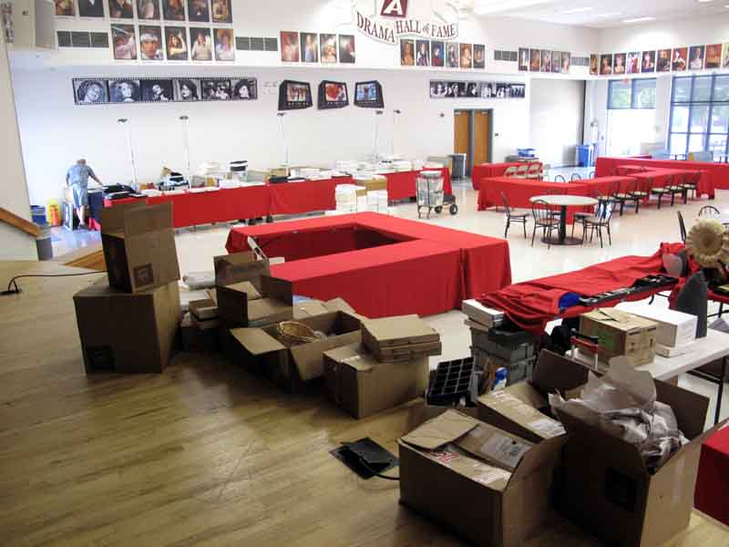

Slide 5
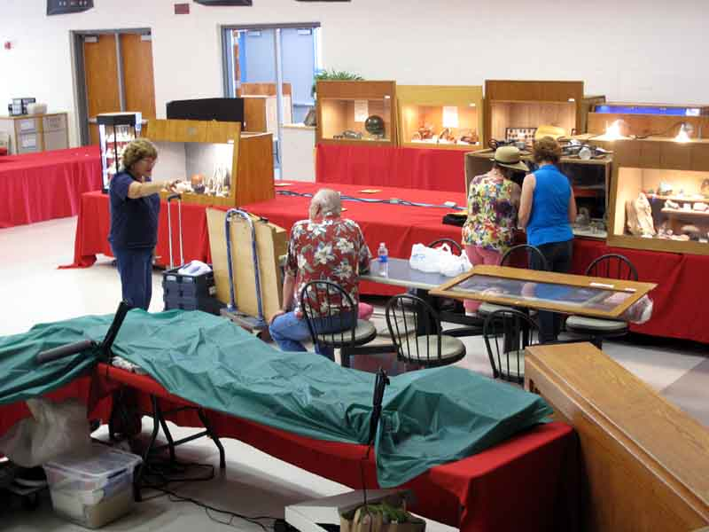

Slide 6
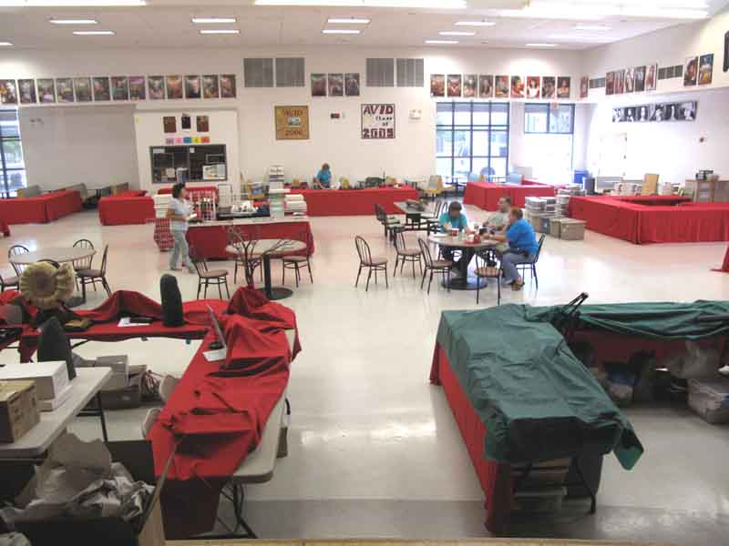

Slide 7
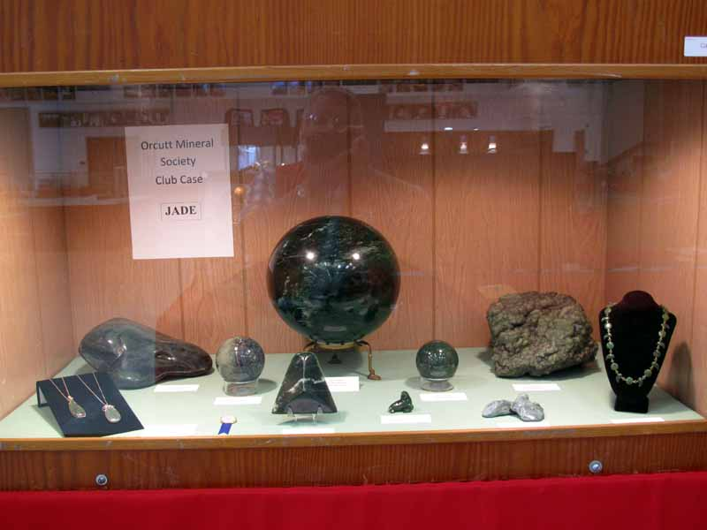

Slide 8
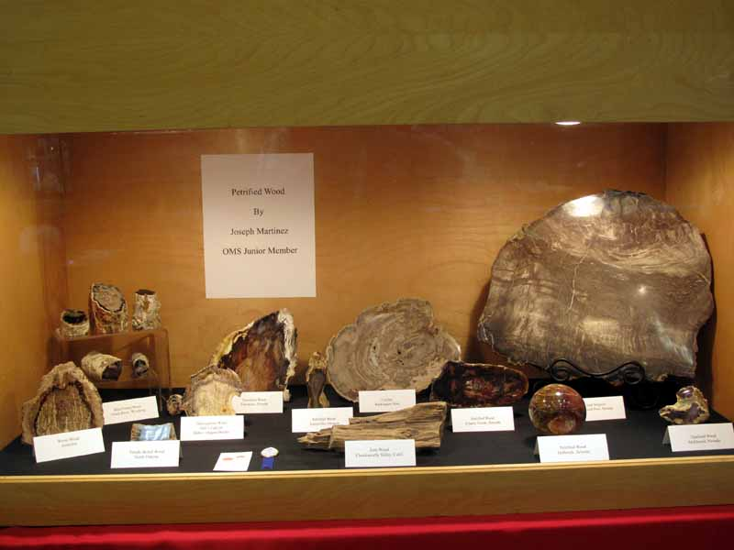

Slide 9
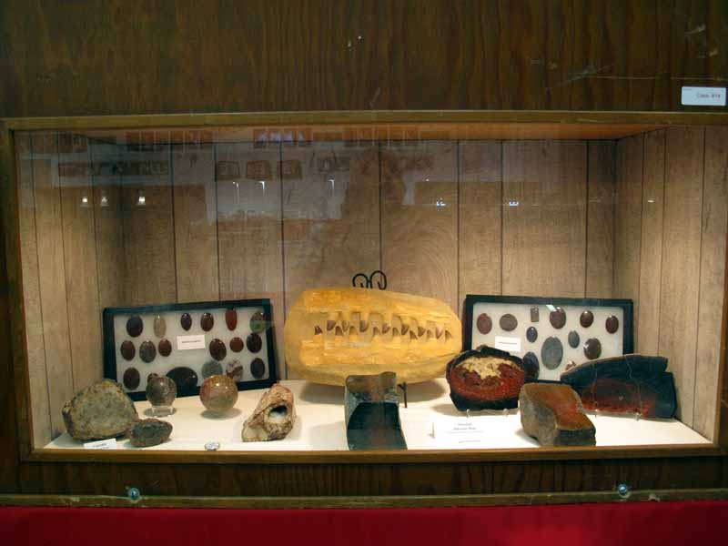

Slide 10
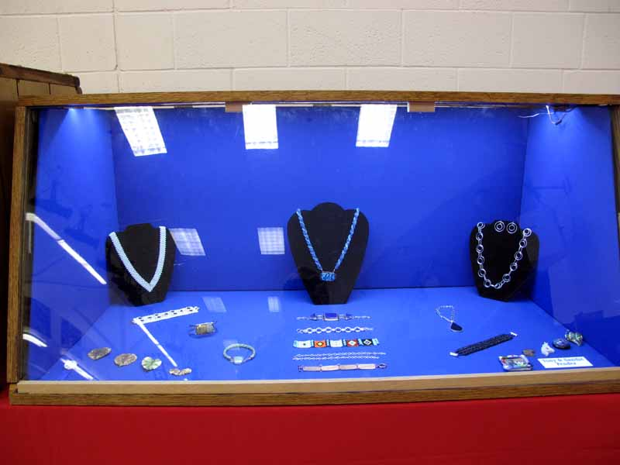

Slide 11
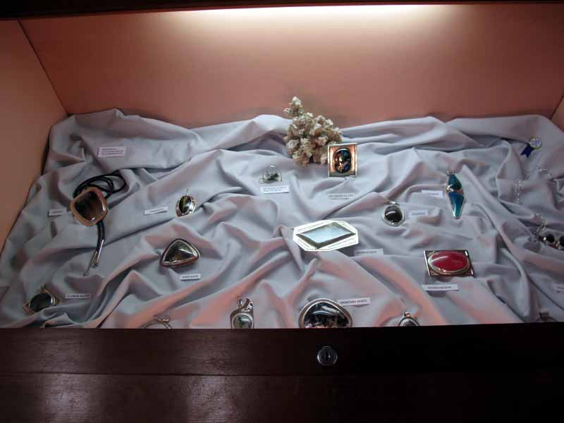

Slide 12
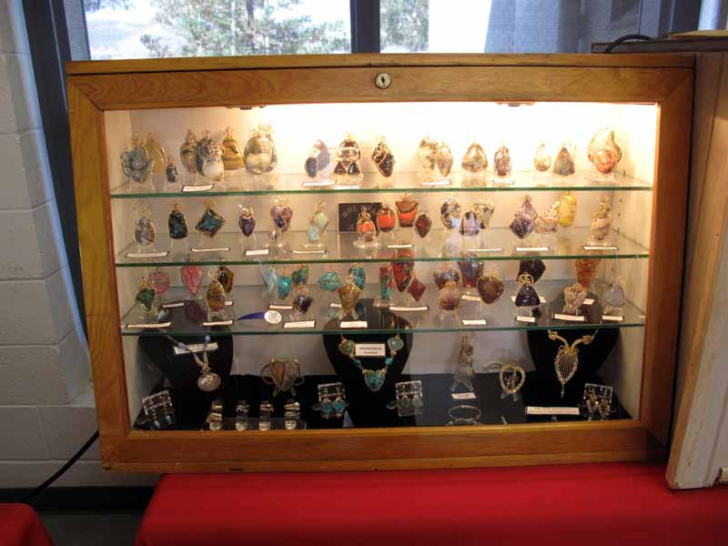

Slide 13
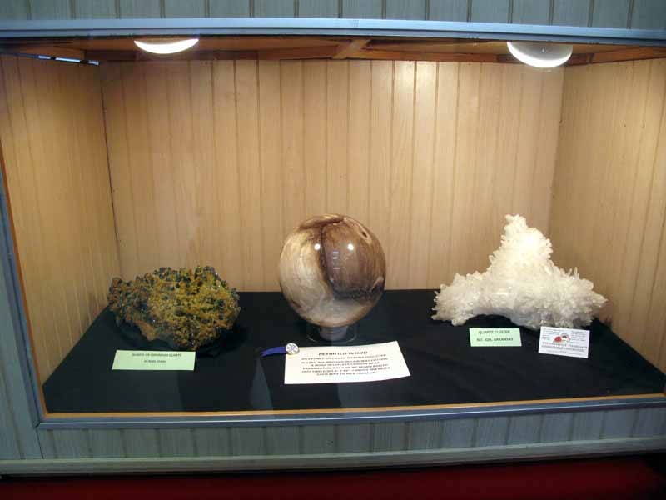

Slide 14
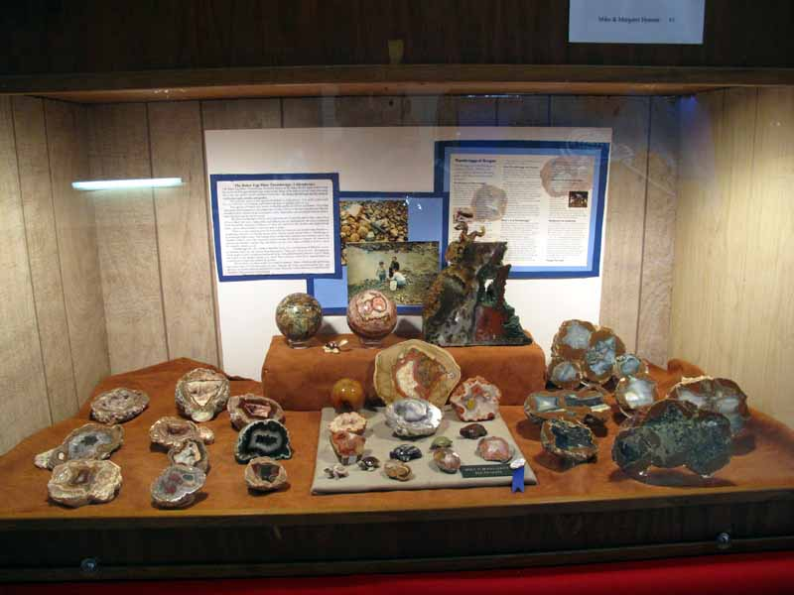

Slide 15
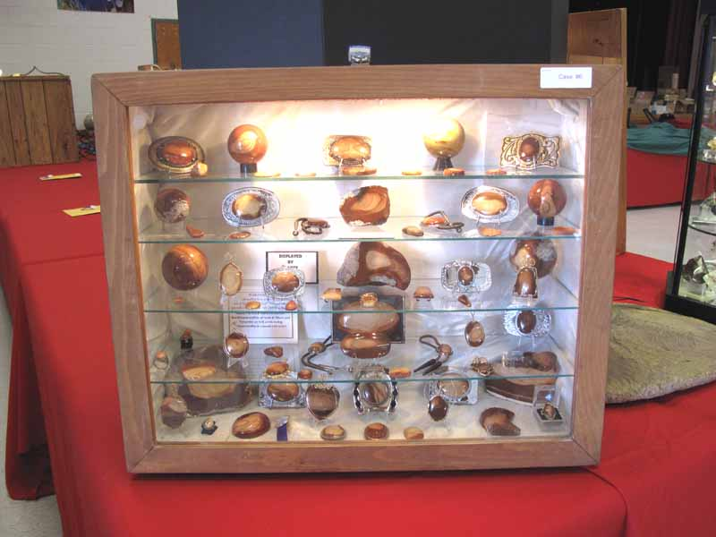

Slide 16
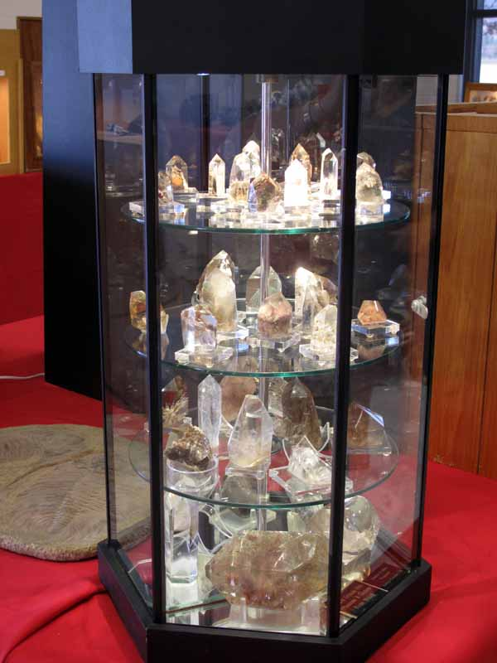

Slide 17
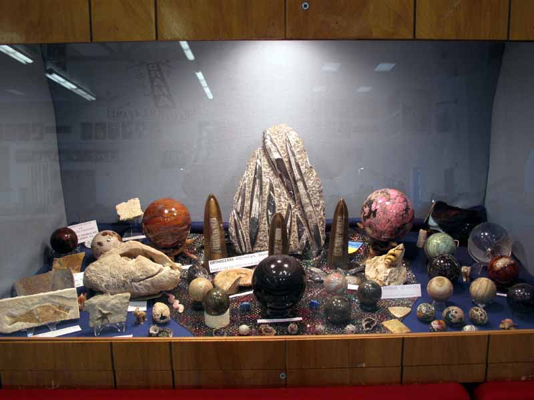

Slide 18
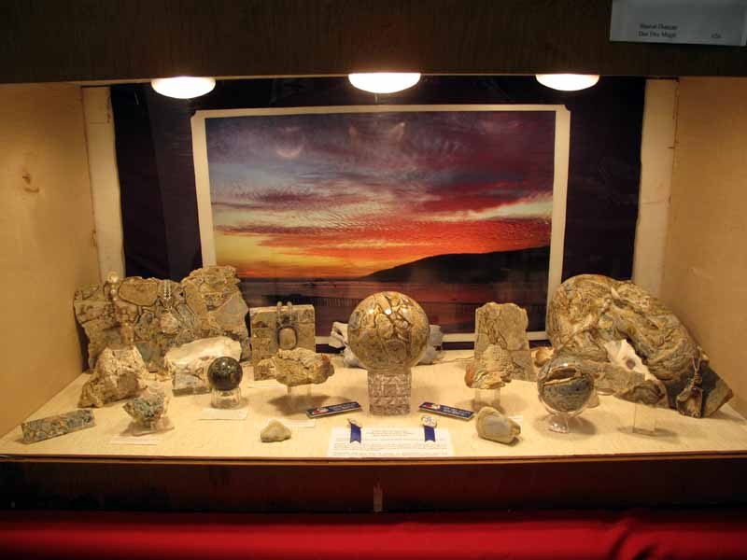

Slide 19
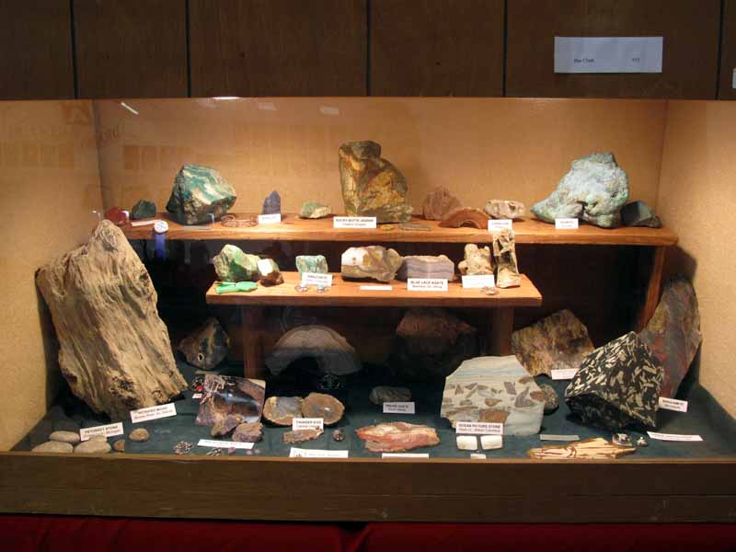

Slide 20
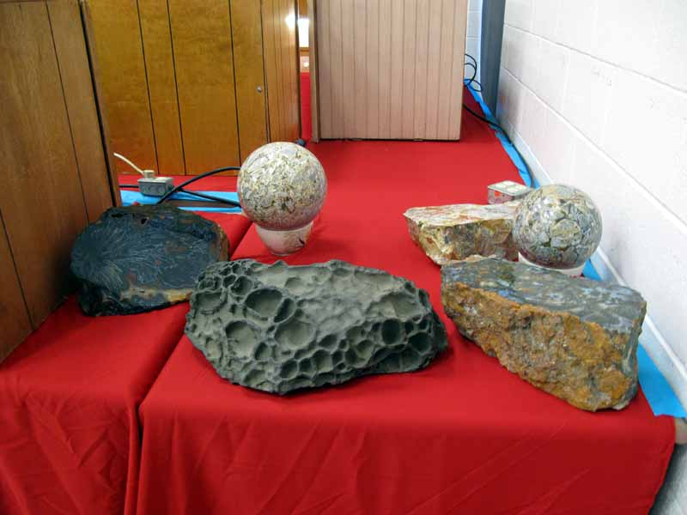

Slide 21
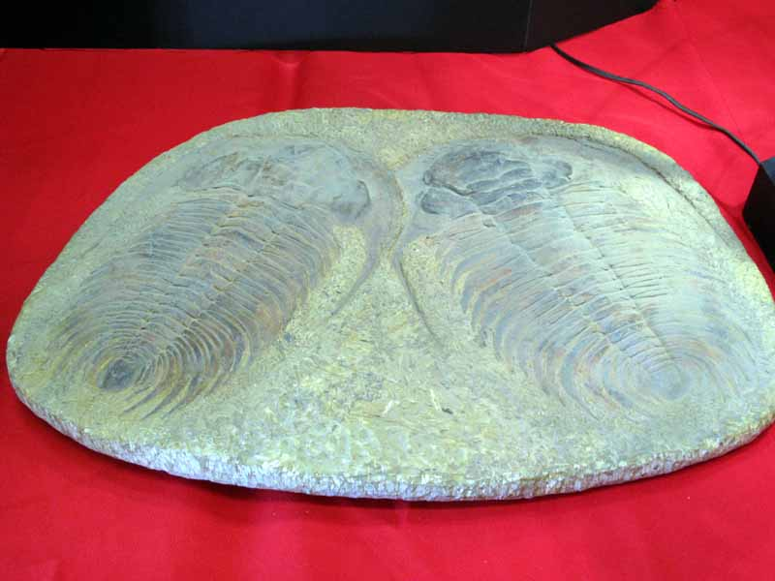

Slide 22
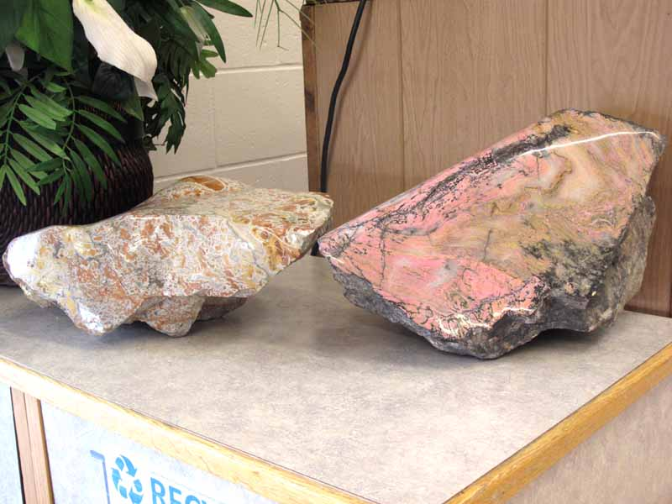

Slide 23
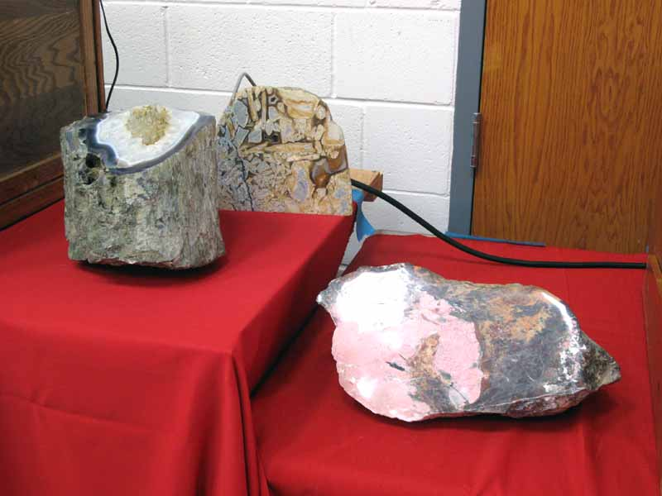

Slide 24
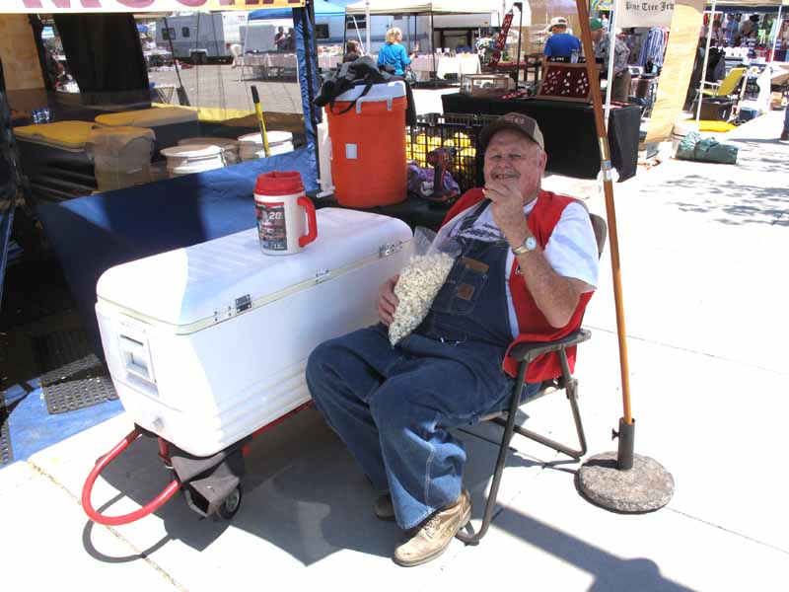

Slide 25
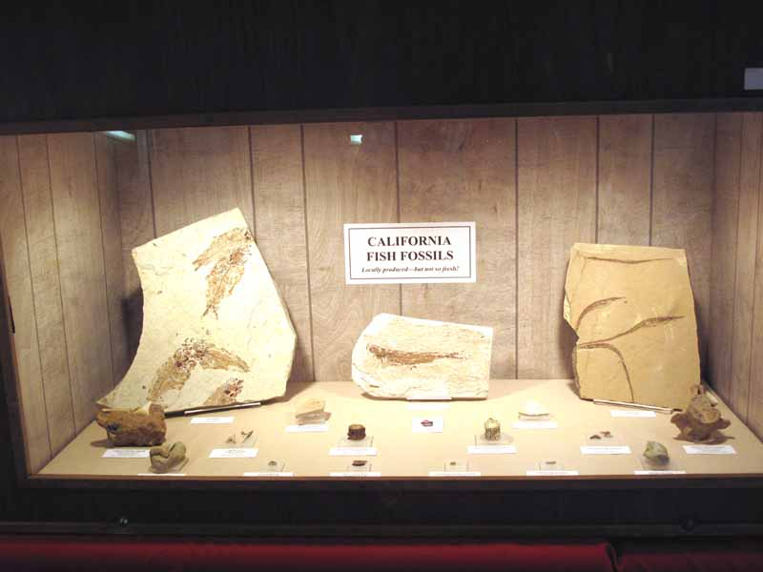

Slide 26
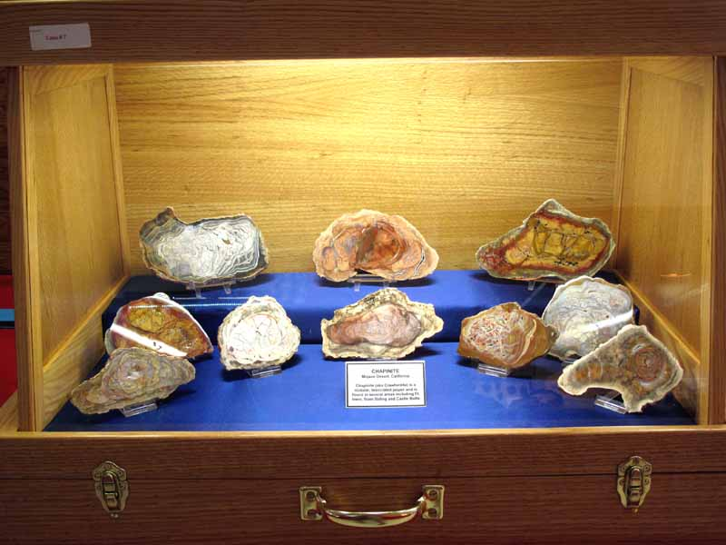

Slide 27
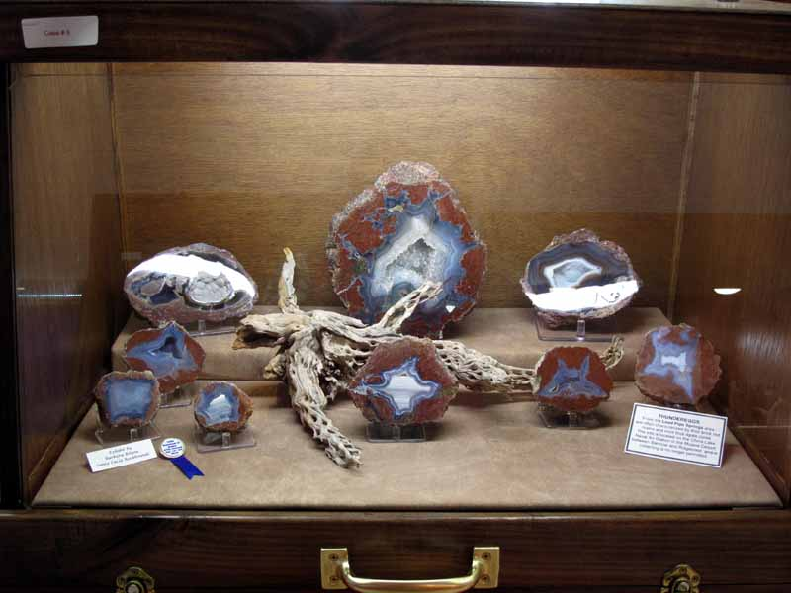

Slide 28
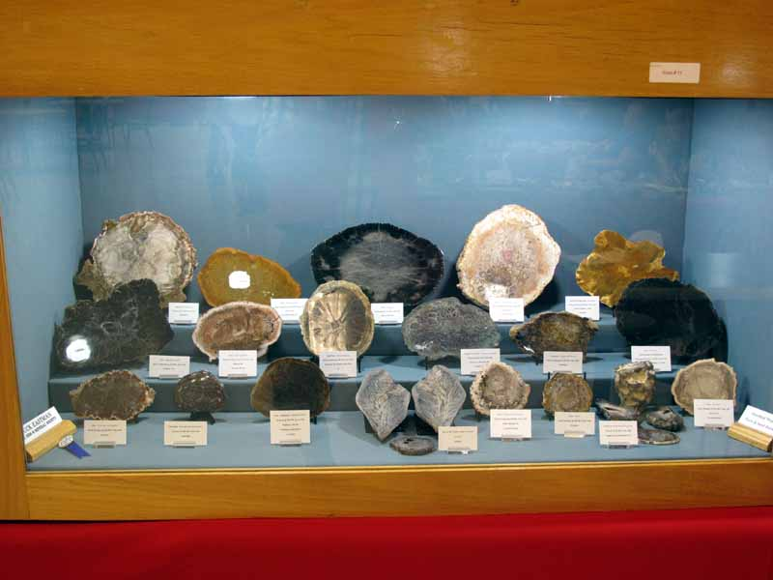

Slide 29
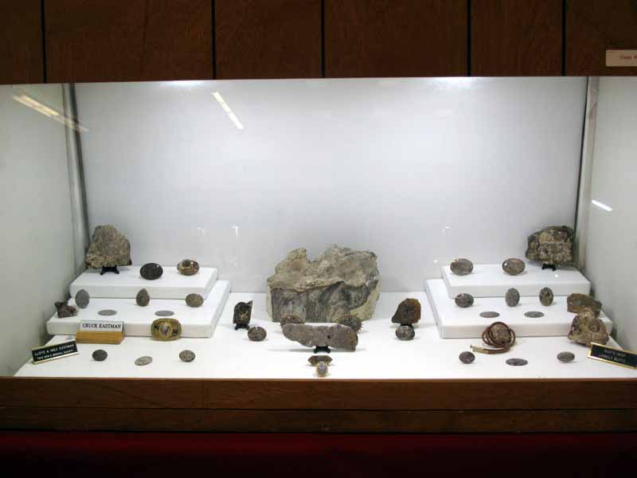

Slide 30
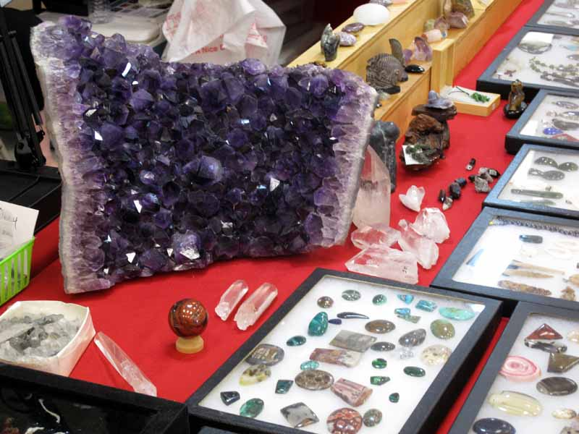

Slide 31
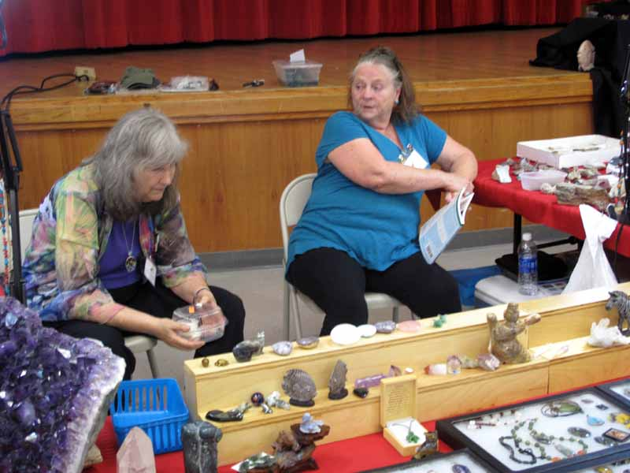

Slide 32
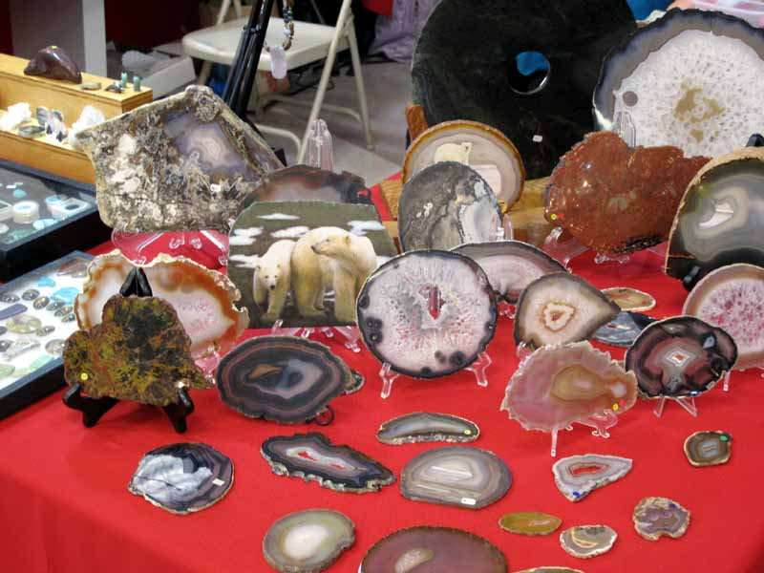

Slide 33
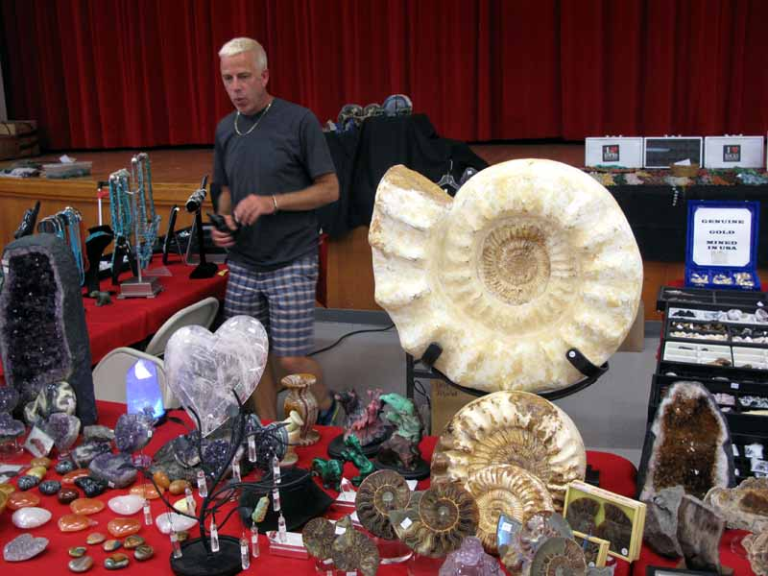

Slide 34
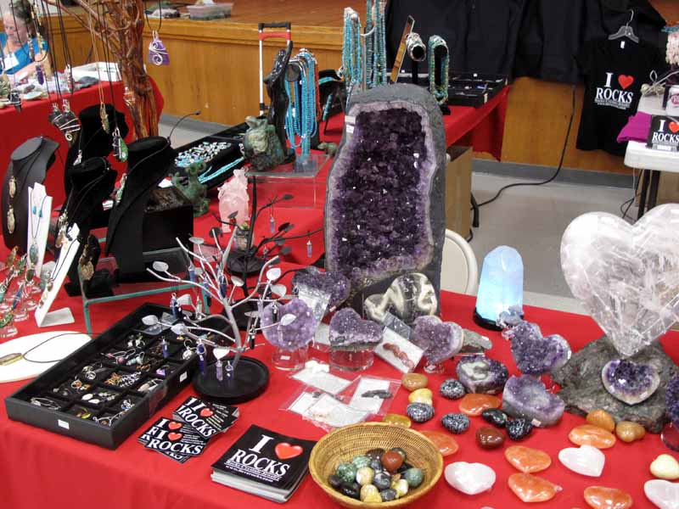

Slide 35
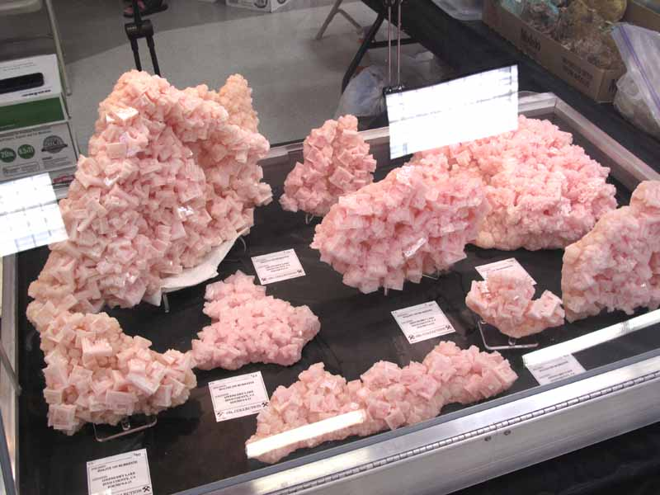

Slide 36
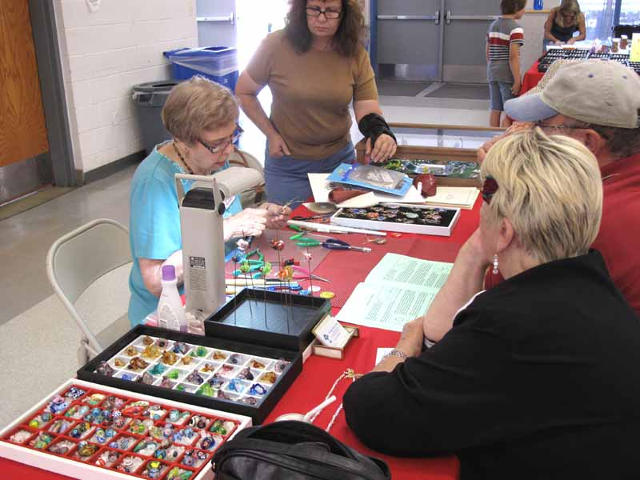

Slide 37
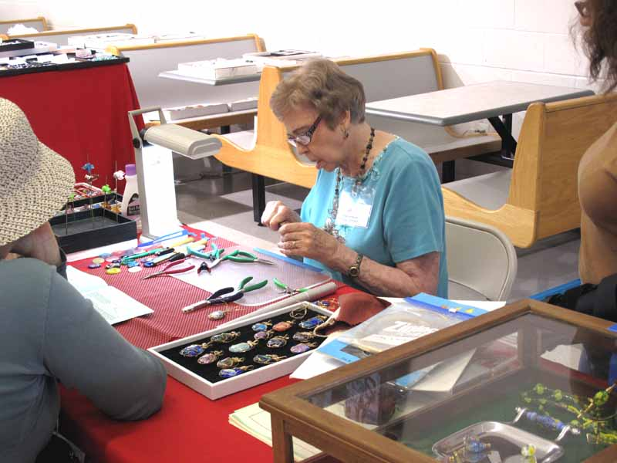

Slide 38
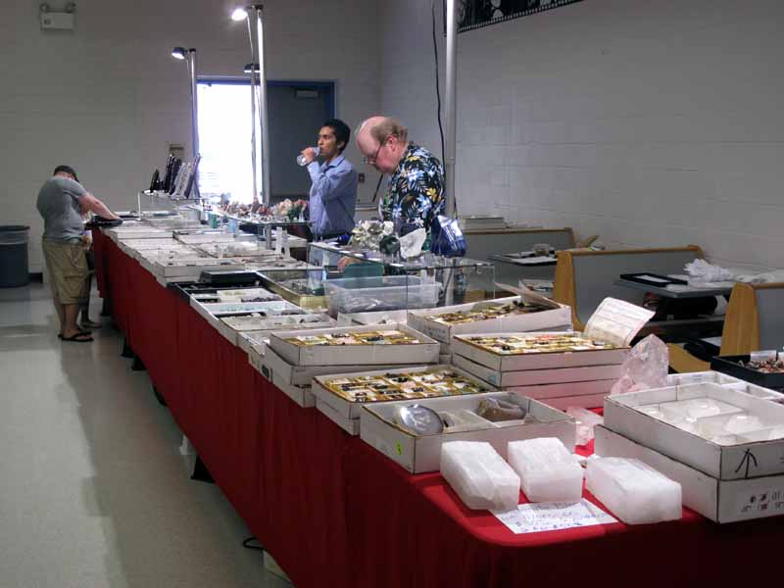

Slide 39
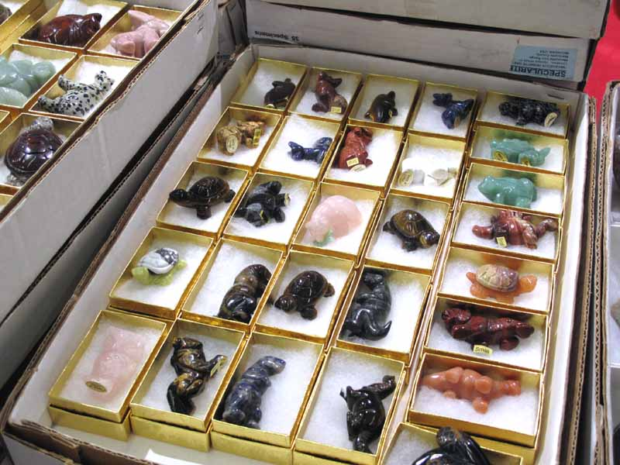

Slide 40
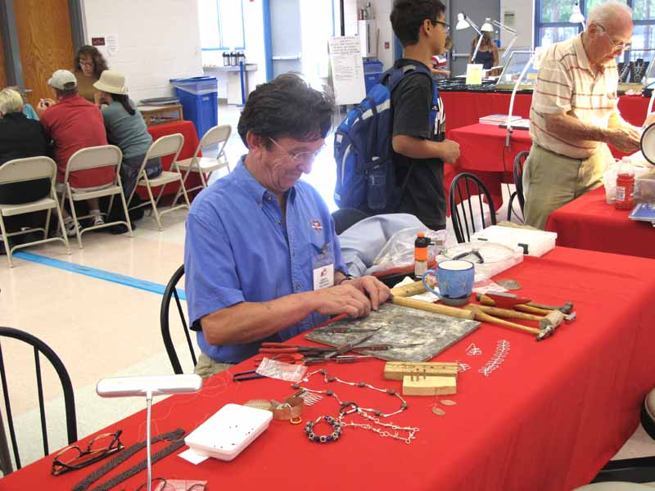

Slide 41
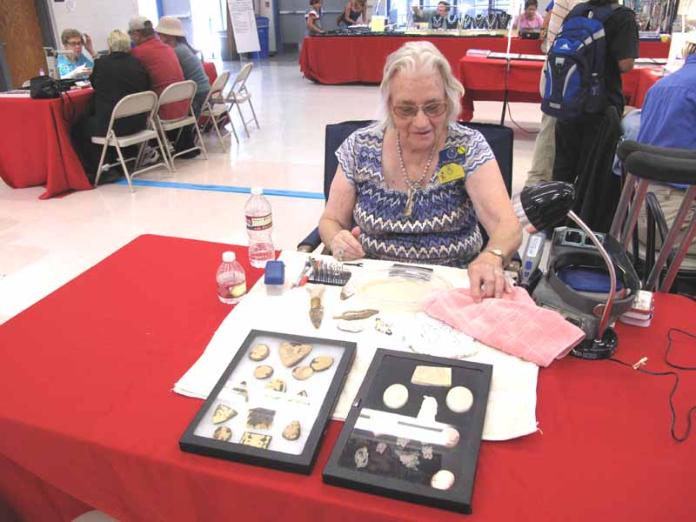

Slide 42
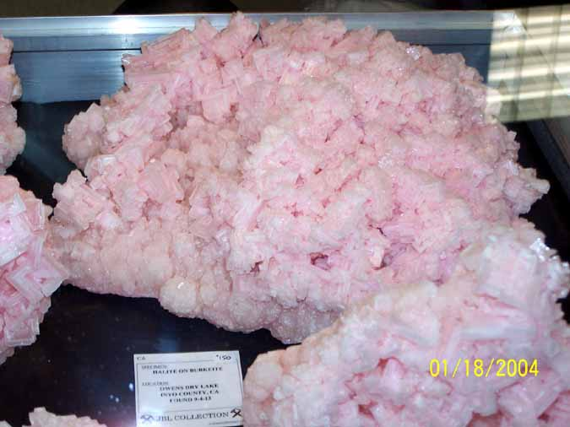
#########

Slide 43
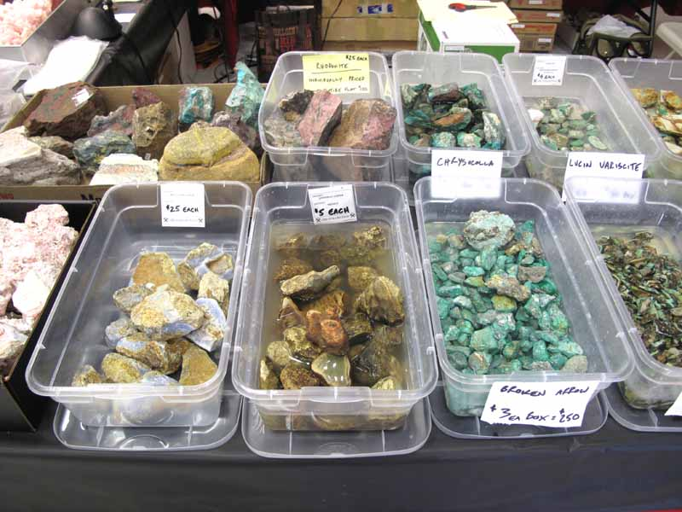

Slide 44
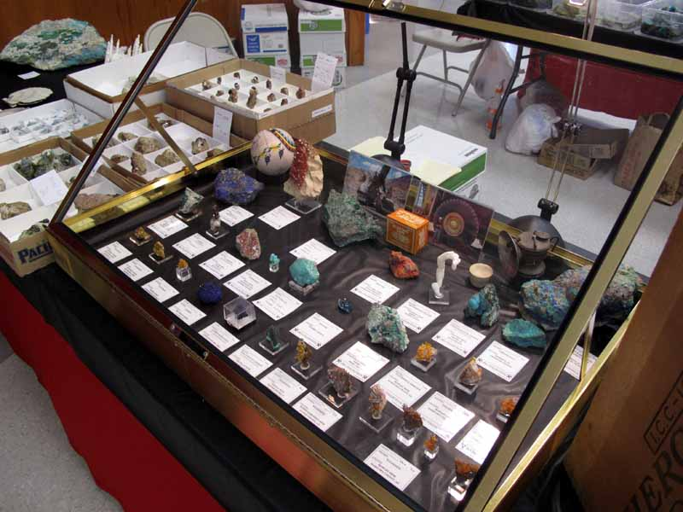

Slide 45
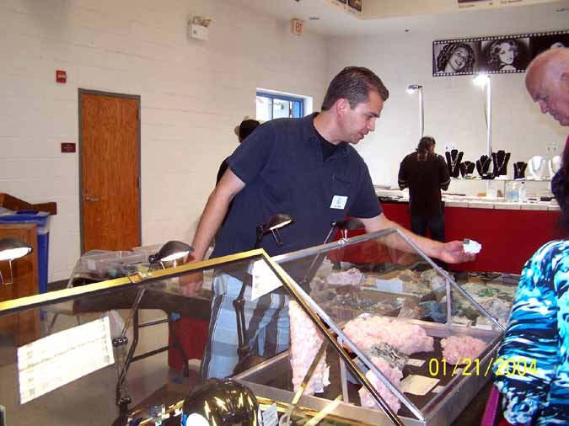
###########

Slide 46
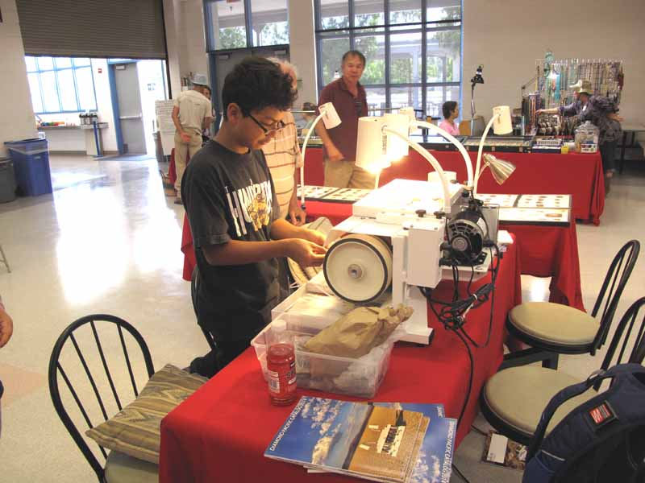

Slide 47
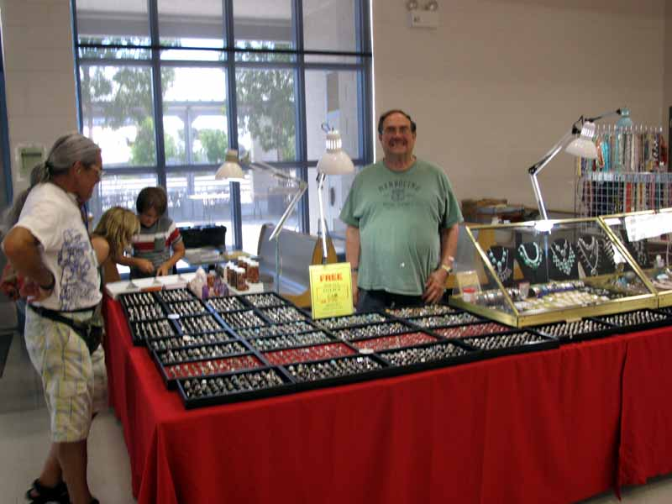

Slide 48
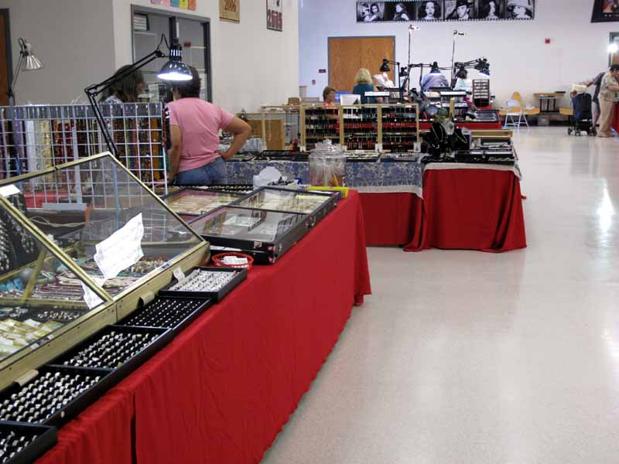

Slide 49
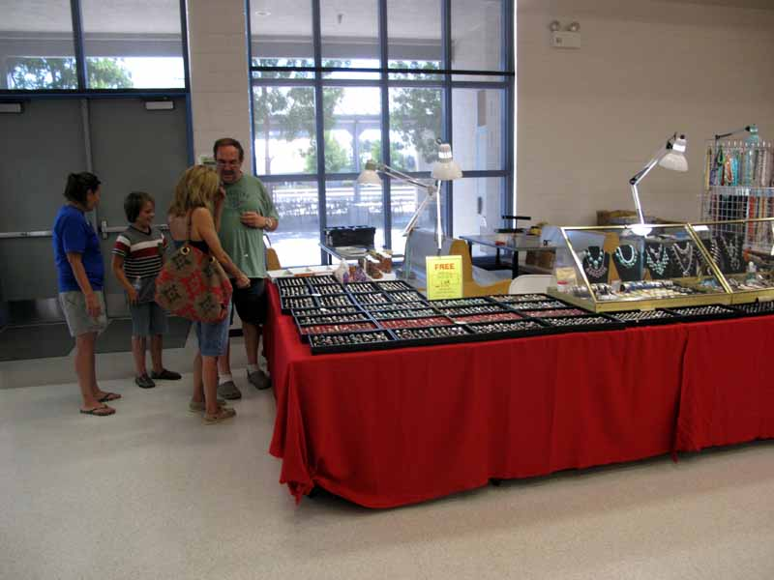

Slide 50
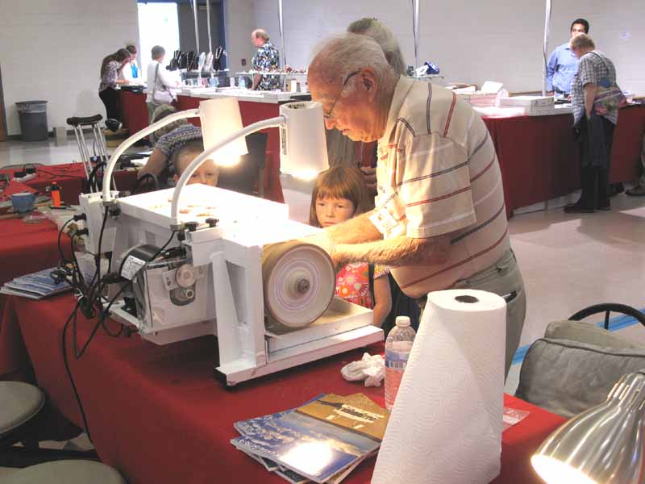

Slide 51
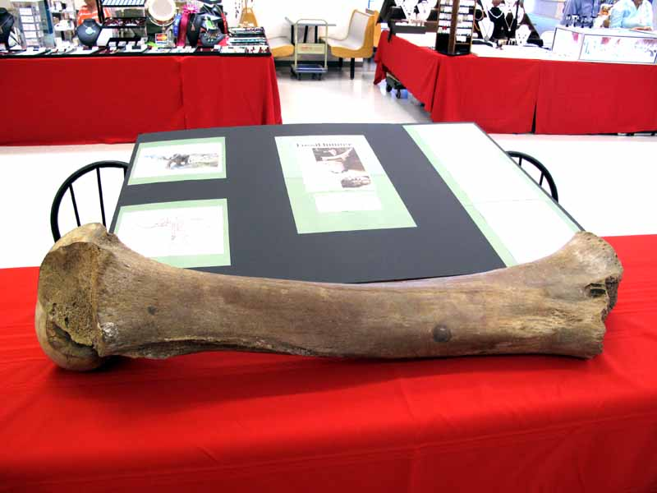

Slide 52
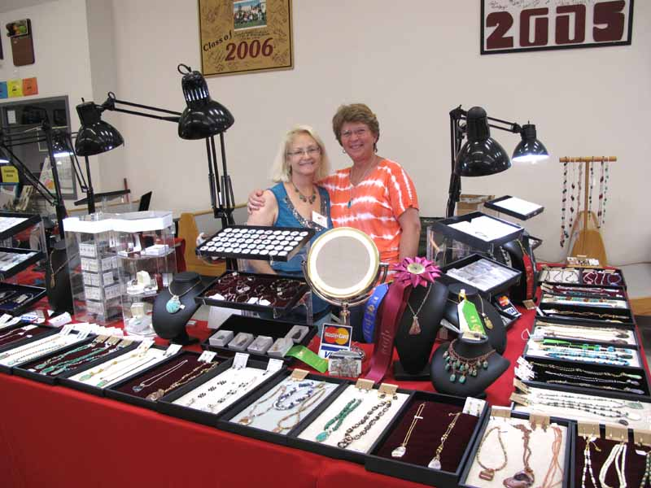

Slide 78
#############

Slide 79
11111111111

Slide 80
111111111111

Slide 81
############

Slide 83
#############

Slide 84
############

Slide 87
IT ONLY COMES ONCE EACH YEAR – PLANNING FOR NEXT YEAR STARTS NOW! WE NEED MORE PARTICIPATION TO KEEP THE SHOW ON A SOUND FOOTING! WON’T YOU HELP?

